Slide 1
Club and organization officer training
Presented by Student Activities Office

Slide 2
Overview
Club requirements
Forms & Paperwork
Constitutions & Charters
Advisor Roles
Planning an Event
Running Effective Meetings
Recruiting/Retaining Members
Minutes/Agendas

Slide 3
Club Requirements
Minimum of 6 meetings per year (3 per semester)
Minutes on file at Student Activities Office within one week of meeting
1 community service project per year
List of club officers and members must be provided to Student Activities Office (within one month of start of each semester)
Submit and receive approval on Activity & Fundraising Planning Forms prior to proceeding with any event planning or fundraising
Activity Planning forms at least one week prior to planning event
Fundraising forms at least one month prior to soliciating
Follow all College and Club policies and procedures

Slide 4
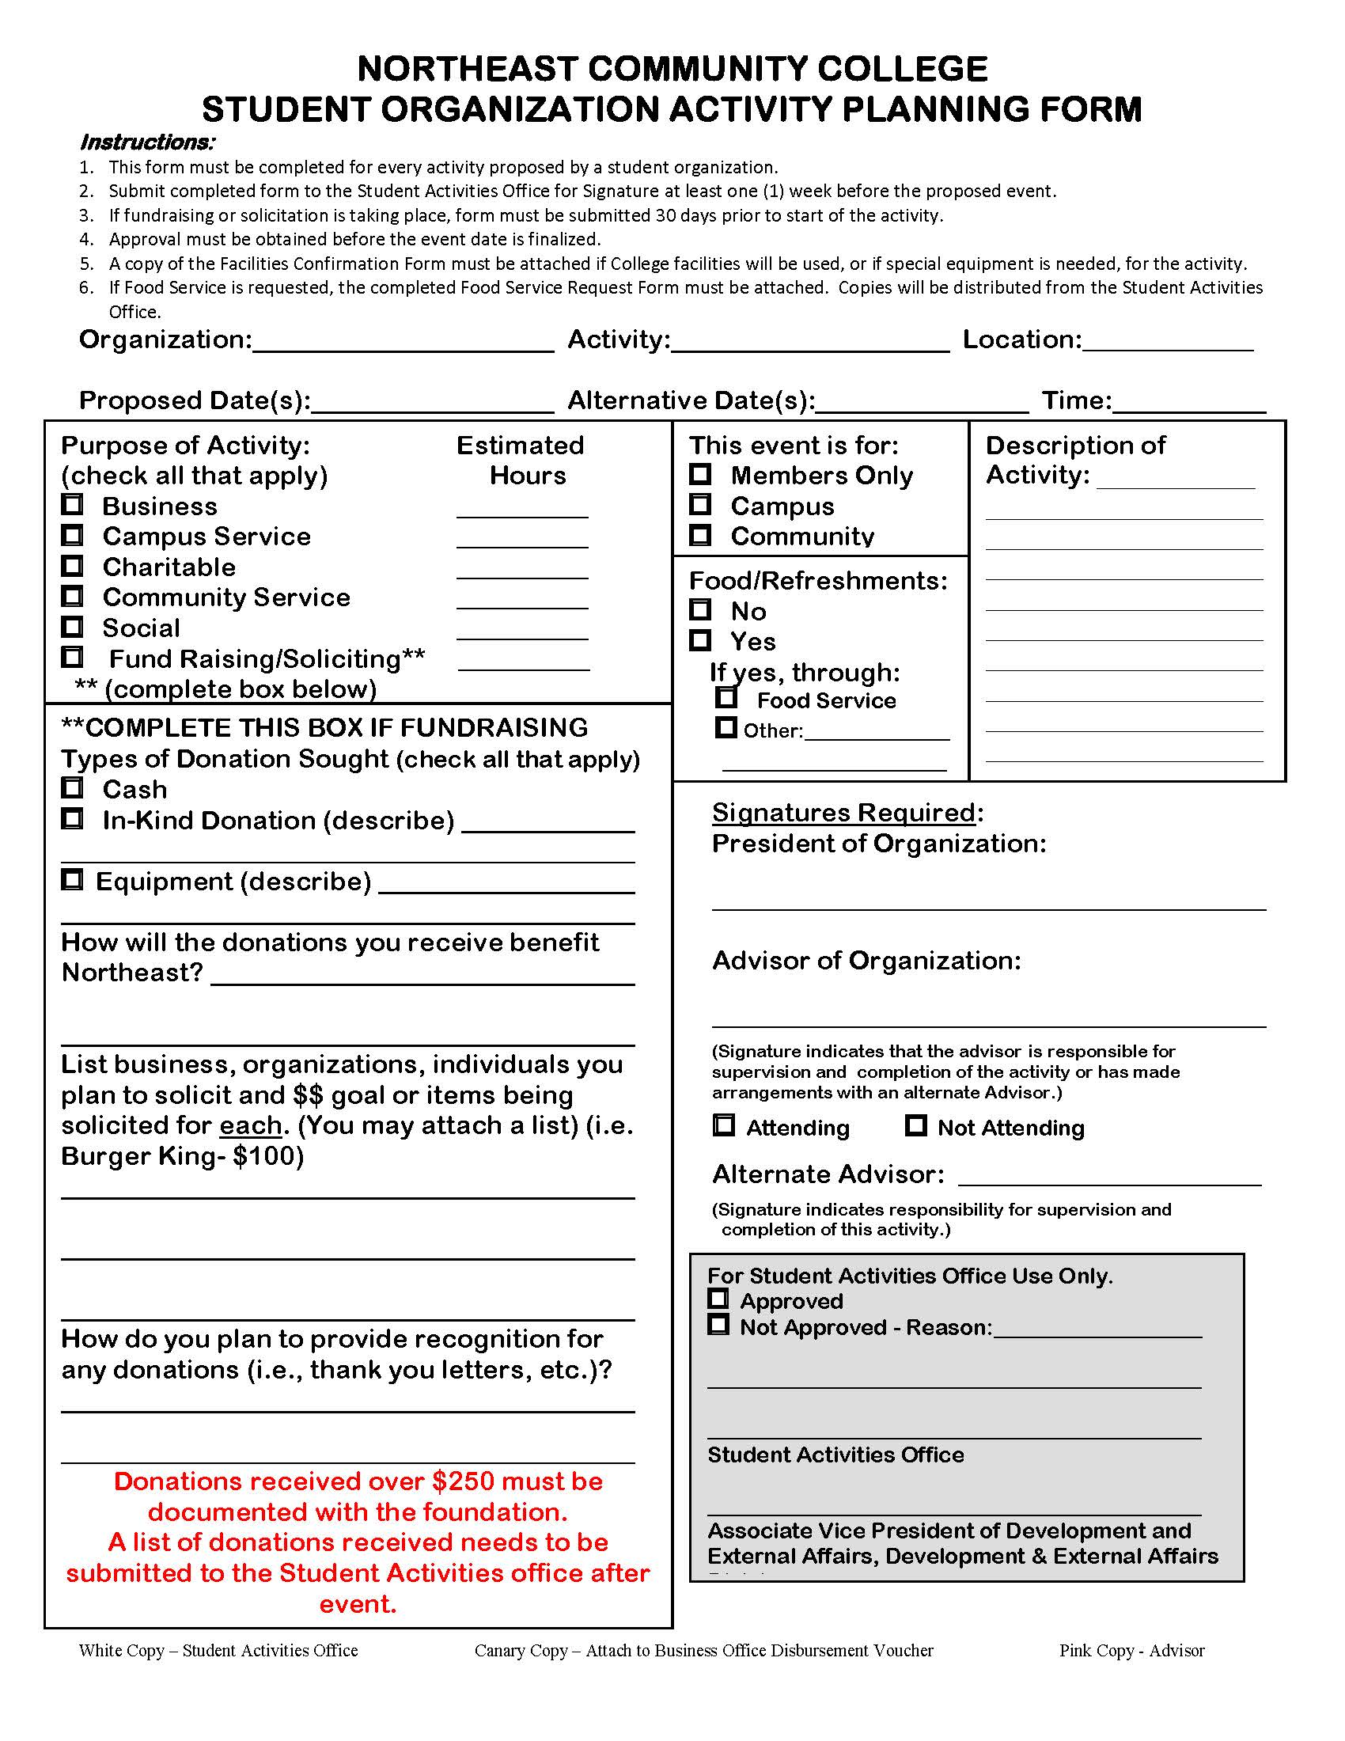
Forms & Paperwork Activity Planning FORM
Before planning an event you must complete a Student Organization Activity planning form:
Available in the mailroom or student activities office
This form needs to be completed for all activities other then regularly scheduled meetings
This includes both on and off campus events (all club sponsored events (on or off campus) must adhere to the Student Code of Conduct)
For Activities (required one week in advance)
For Fundraising (required one month in advance)
Any donation over $250 must be documented with the foundation
You are not allowed to solicit or fundraise until you have received approval
You are not allowed to host and event/activity until you have received approval
Definitions for Activities:
Business- Travel, guest speaker, etc, that would be either educational or beneficial to organization members toward the purpose of the organization.
Campus Service- Time, work, or money donated toward the NECC campus only (i.e. - Arbor Day tree planting).
Charitable- Time, work, or money donated toward an individual or family (i.e. – gift for a birth, loss or illness in the family of an organization member, advisor, etc.).
Community Service- Time, work, or money donated toward a local community (i.e. – clothing or food drives for the Norfolk Rescue Mission).
Fundraising- Attempting to raise money for the organization (i.e. – bake sales, raffles, etc.)
Social- Event with the main purpose of gaining new members, dinner for organization, etc.

Slide 5
Forms & Paperwork Activity Planning FORM
Contracts- any contract for your club needs to be signed by the Vice President of Administrative Services
The Vice President of Administrative Services signs all campus contracts
Includes: club retreats, performers/speakers, facility rentals, agreements, etc.
There is a turnover time when turning in contracts for signature, allow at least 2 weeks.
Email a copy to Stephanie Hecht and once the contract has been reviewed and ok’d you will need to send down 2 hard copies for signature, after the signed contract is returned, you will need to get the contract signed by the performer/business, and then send a completed copy of the contract back to Stephanie for their files.

Slide 6
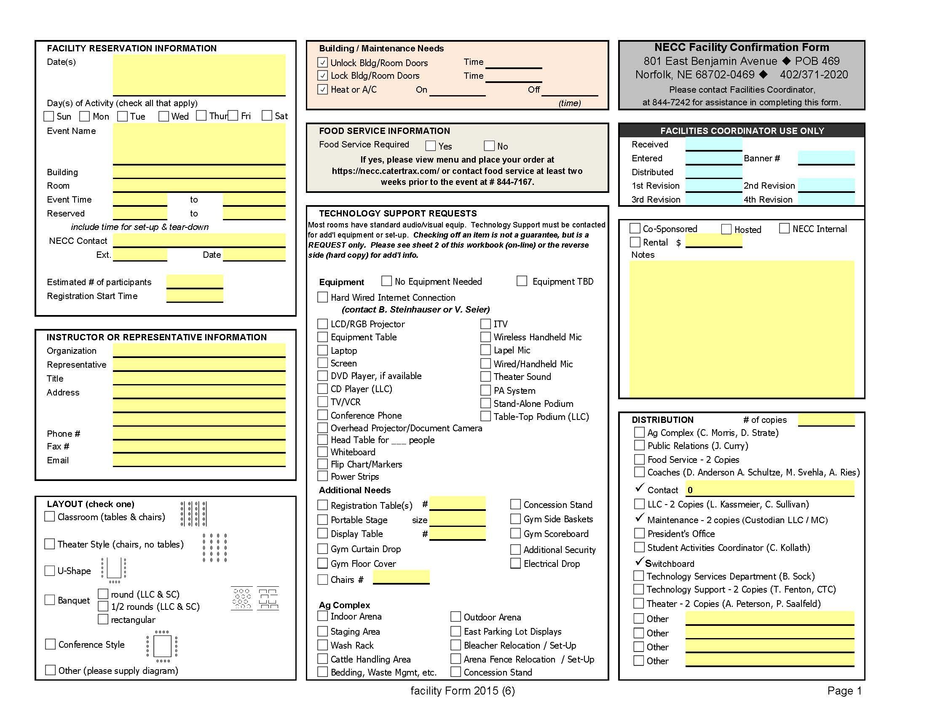
Forms & Paperwork Facility Request & Food Service
A facility request needs to be completed to reserve a space on campus (available in the mailroom and online)
They are submitted to Linda Luikens
You can contact her in advance to see if the space is available prior to completing the form
You are required to use food service on campus for any event requiring food unless it’s received through a donation
To contact catering: 402-844-7167 or https://necc.catertrax.com

Slide 7
FORMS & Paperwork ON Campus signs & solicitations
All posters/flyers must be stamped for approval by the College Welcome Center Receptionist prior to posting
All solicitation on campus by clubs must be conducted in a manner that is not disruptive to College operations
The Procedural regulations:
1. Signs may only be posted on bulletin boards or other places provided for that purpose. Some bulletin boards are reserved for specific use and may require special permission.
2. The student services division may provide centrally located bulletin boards subject only to student services regulation.
3. The posting of signs is prohibited on utility poles, trees, painted surfaces and under windshield wipers.
4. Commercial postings may be permitted only if approved by the Vice President of Student Services or his/her authorized representative. Such approved posting must comply with all campus regulations and are permitted when of service to the campus community.
5. Student and student organization signs are required to have the approval of the student services division prior to posting.
6. Signs must contain the following information: (a) the name of the individual or organization responsible for the posting of the sign; (b) the name of an individual who is their authorized representative; (c) the imprint of the student services division authorization; and (d) a pull date.
7. The person or organization shall remove each of its signs not later than fourteen days after posting or not later than one business day after the event to which the sign relates, whichever is earlier. Exceptions are at the discretion of the Vice President of Student Services.

Slide 8
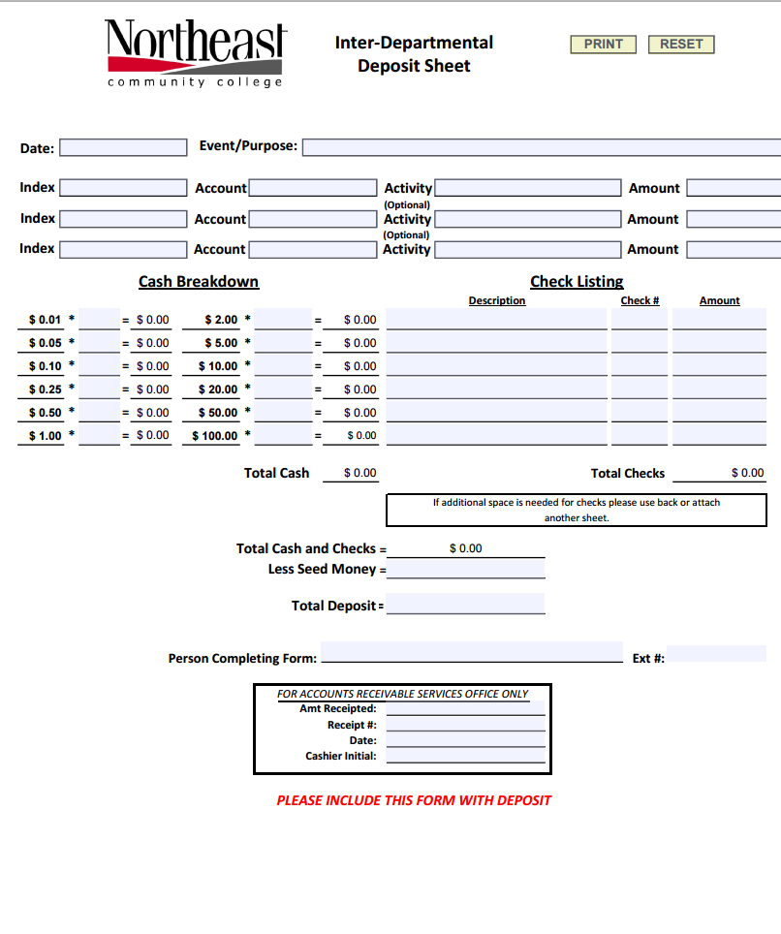
FORMS & Paperwork Business office information
All club monies must be deposited within 24 hours to the Business Office and club account
If there is a large event (corn maze, home show, spook-tacular, etc), your club advisor should work with the business office to deposit the money that evening.
A club advisor or student should NEVER take the funds home with them.
A deposit sheet is required when making deposit (available at business office)
Clubs are responsible for tracking their club balance (for up-to-date balances you can contact the Director of Student Activities or the Business Office)
Clubs can only accept cash or check (written out to Northeast Community College)
If someone would like to pay via credit card or debit they need to call the Cashier -844-7001 or stop down to the CWC business office to make the charge.
Student clubs can NOT collect credit/debit card information- this is a violation of PCIDSS (Payment Card Industry Data Security Standard).

Slide 9
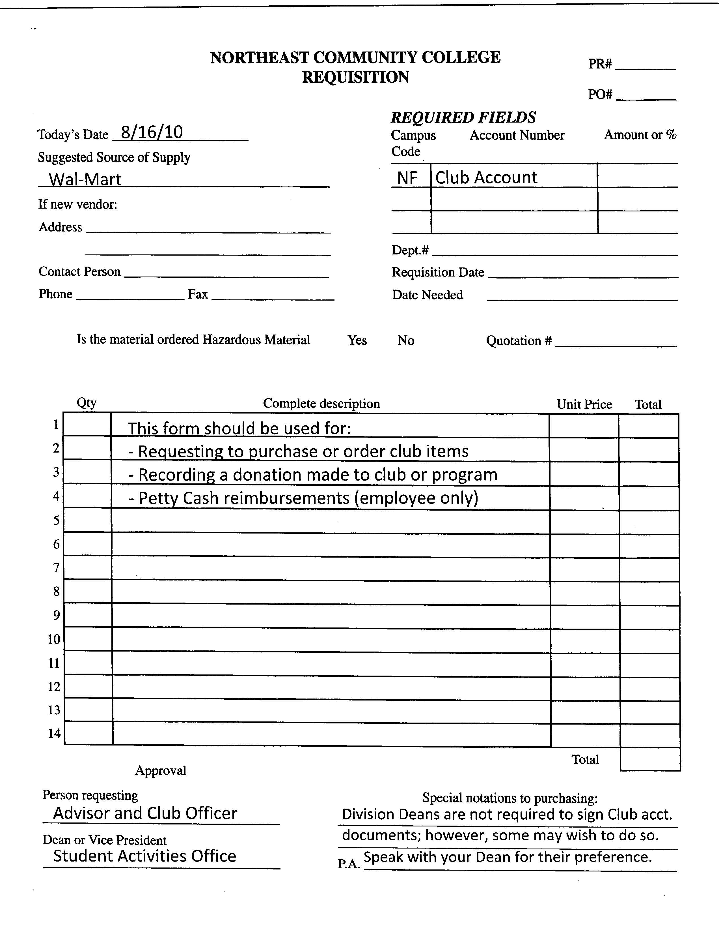
Forms & Paperwork requisitions
A requisition form is used for expenditures for goods and services, such as purchase orders
It requires:
your club account number
Club officer signature
Advisor signature
Director of Student Activities signature
Copy of invoice, price quote, artwork, etc.
The Purchasing Department will then process your requisition in a timely manner (please be considerate in planning that this may take time)
You are NOT allowed to place any orders for items (i.e. t-shirts)- you can contact the company and get price quotes but only Purchasing can place the order.
Must be turned in by noon Monday to Student Activities Office to be processed in same week

Slide 10
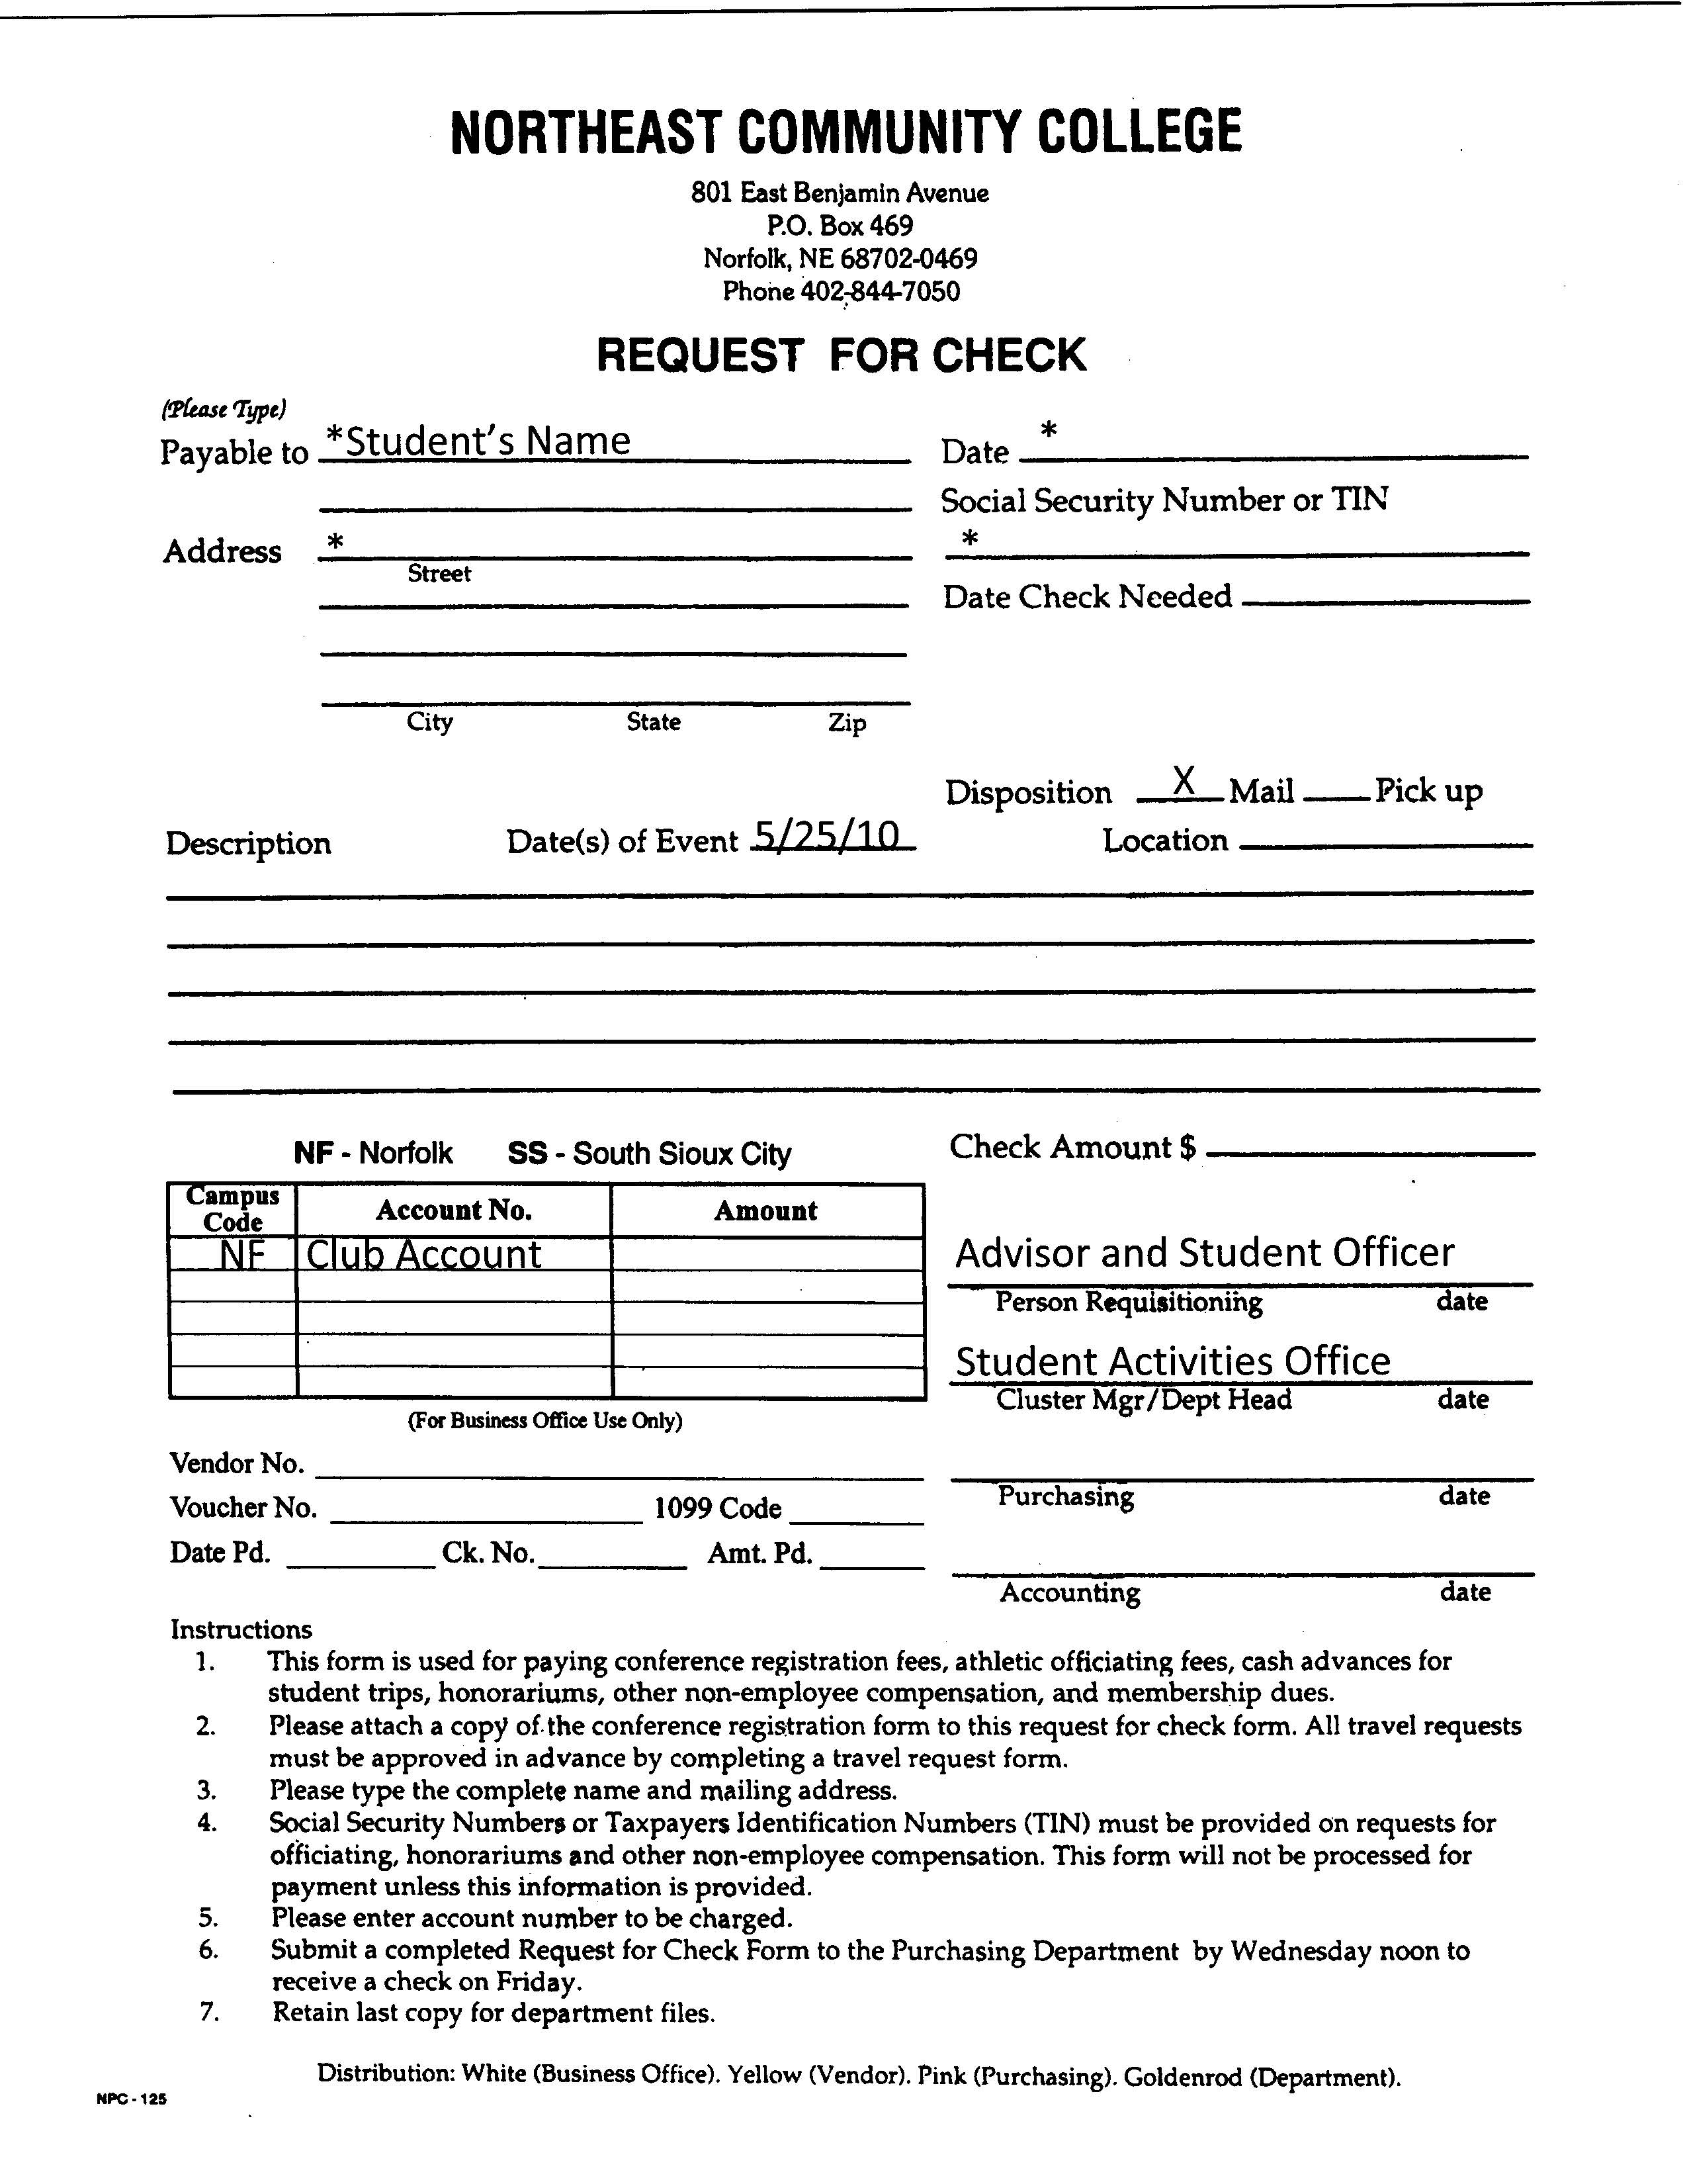
Forms & Paperwork Request for Check
You would use this form if you are paying for a speaker/performer- attach W-9 & contract/invoice
If a student incurs expenses for the organization- submit a request for check form to be reimbursed
UNLESS they are on the college payroll system (work study, student employee, etc)
Must include itemized receipts
This form requires:
The club account number
Club Officer Signature
Club Advisor Signature
Director of Student Activities Signature
Receipt/bill/invoice
If applicable, a copy of your activity planning form should be attached as well
Must be turned in by noon Monday to Student Activities Office to be processed in same week

Slide 11
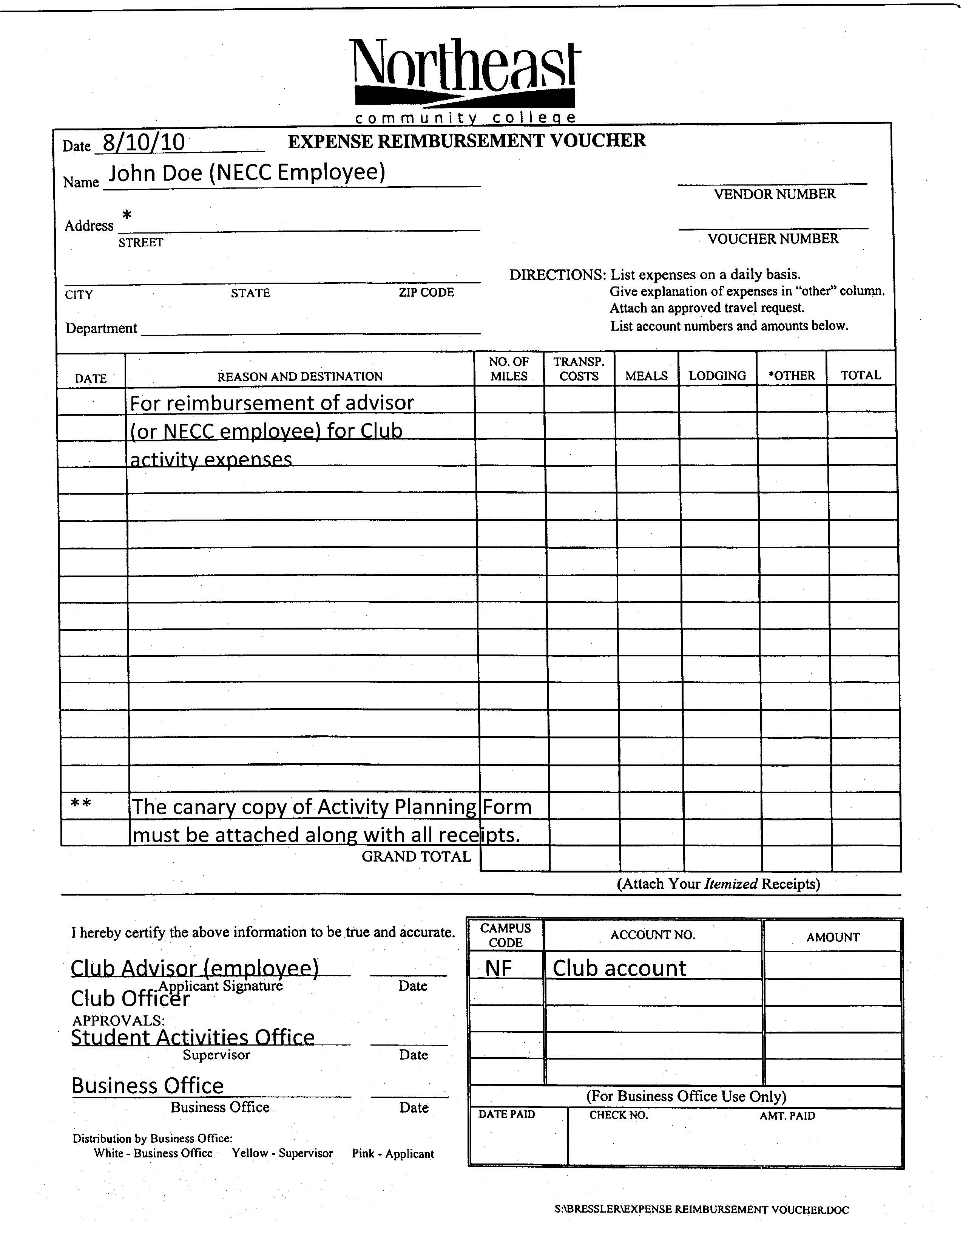
Forms & Paperwork expense reimbursements
If a Faculty/Staff member or student employee incurs expenses for the organization- submit an expense reimbursement voucher
UNLESS they are on the college payroll system (work study, student employee, etc.)
Must include itemized receipts
This form requires:
The club account number
Club Officer Signature
Club Advisor Signature
Director of Student Activities Signature
Receipts
If applicable, a copy of your activity planning form should be attached as well
Must be turned in by noon Monday to Student Activities Office to be processed in same week

Slide 12
Sales tax
Sales Tax is payable on any fundraiser/activity where students sell products/services to individuals.
While you may purchase the items to sell tax free (because the college is tax exempt), the college and your club account are billed for the sales tax when you sell the item. Please factor these taxes in to your overall sale price of items.
Some common taxable club activities:
Candle sales, plant sales, butter braid sales, lanyard sales, etc. are all taxable revenues.
Coats/t-shirts ordered by the clubs and bought by the students are taxable.
Car washes that have a set price is taxable revenue. However, if the carwash is advertised as “freewill donation”, the revenue is not taxable.
All admission monies are taxable—i.e. spooktacular ticket sales, corn maze admission, home show admission, etc
Some not taxable activities are:
Bake sale revenues are not taxable.
Club dues are not taxable.

Slide 13
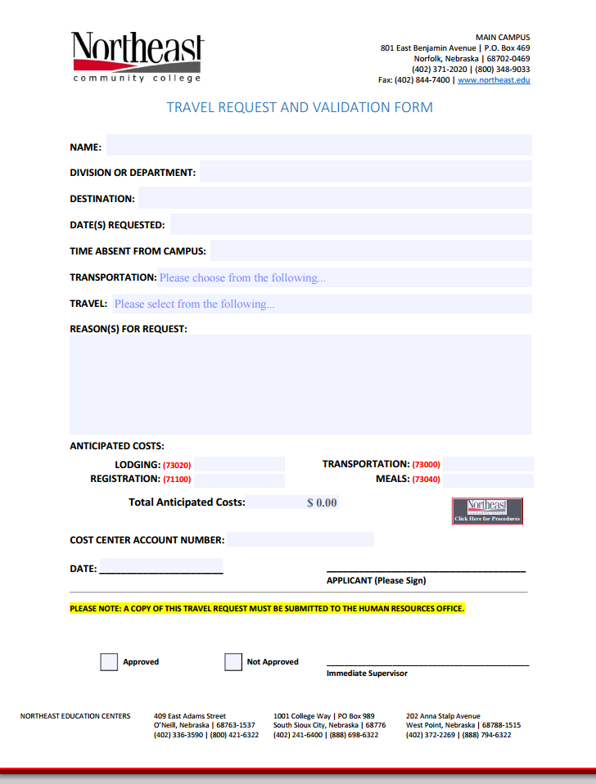
Forms & paperwork travel request
Student Travel- when traveling with a student group you must complete the following:
Complete Activity Planning Form prior to the trip
Include a list of all students attending the trip and their emergency contact information with the Activity Planning Form
Your advisor will need to complete a travel request if they are traveling with the club
These are available online and in the mailroom
If you are taking a college vehicle, you will need to reserve that as soon as possible with the maintenance department, and factor in the gas money to your total cost (you club account will be billed for the gas)

Slide 14
Constitution & Charter
Constitutions & Charters are on file in the Student Activities Office
Any amendments made to the club constitution needs to be submitted for approval by the Student Activities Office and Vice President of Student Services
If you are creating a new club, you can get the constitution and charter templates from the Student Activities Office.

Slide 15
Advisor’s Role
Club Advisors are there to assist your club in an advisory role as opposed to a directive capacity. Student Clubs should be student lead (however, some advisors are more involved then others).
Below is a list of the club advisor responsibilities; however, it is the club officers job to complete the paperwork and items listed, the Advisor is to ensure it is all turned in properly and on time.
Club Advisor Responsibilities
A faculty/staff member or community leader approved by the Director of Student Activities.
Attend any advisor training and procedure review sessions.
Serve as a positive role model to the students and take an active role in helping students plan and administer meaningful programming that is consistent with the club’s purpose.
Attend all club activities, meetings, events, and trips in their entirety (unless excused by the Director of Student Activities).
Be well informed about all club activities and keep Student Activities Office informed. (Documentation of a minimum of three (3) meetings per semester and one community service project per year is required).
Ensure that all necessary club documentation is current and on file in the Student Activities Office.
Provide a list of student officers and club members to the Student Activities Office within one month from the start of each semester.
Submit an Activity & Fundraising Planning Form for approval prior to proceeding with any event planning or fundraising activity.
Provide training to club officers on the process of balancing and monitoring the club account, fundraising and spending, and how to create meeting agendas and minutes and ensure minutes are submitted to the Student Activities Office within one week of each meeting.
Ensure College & Club policies and procedures are followed in conducting all club activities as outlined in the Club Advisor Manual.
Inform the Director of Student Activities as soon as possible, if a club disbands or becomes inactive.
Before May 1 of each year, submit a written summary report of the activities accomplished by student club members.

Slide 16
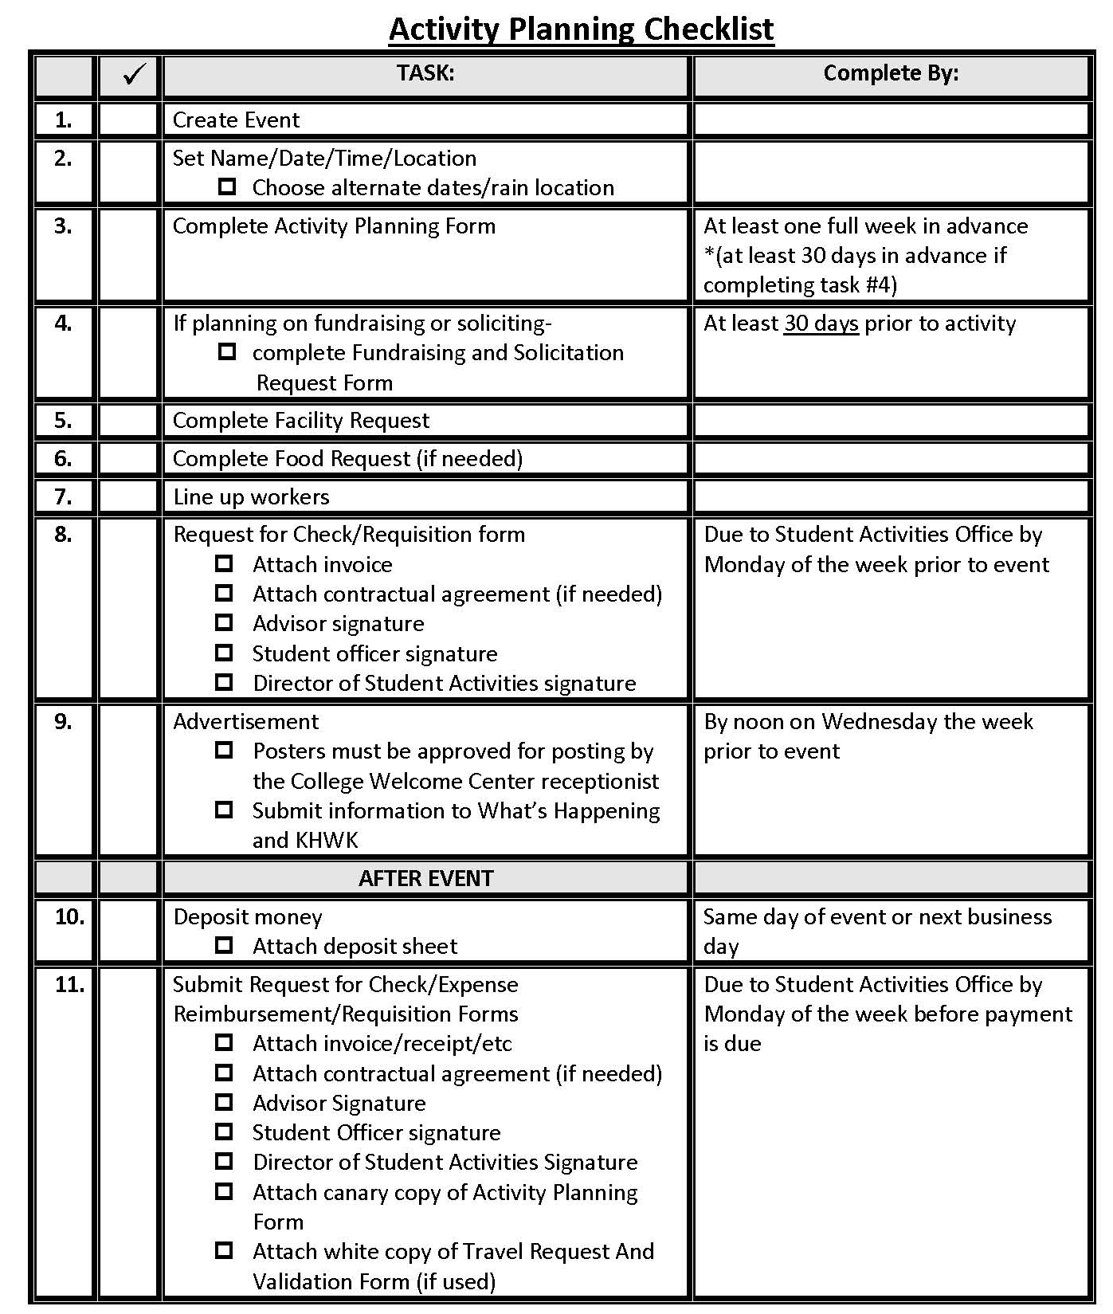
Planning an Event
Utilize this checklist when planning an event

Slide 17
Running Effective Meetings
Have concrete goals at each meeting (follow the agenda)
Make sure all members are aware in advance of meeting day, time, and location
Always start a meeting on time
Prepare the agenda (use the official template from Student Activities Office)
Have a process for group decision making that is consistently used (refer to your club constitution)
Keep the meeting on track- don’t be afraid to take control and refocus the group to the task at hand (politely)
The secretary should be taking detailed minutes about what is discussed and decided on in meetings.
Don’t be afraid to spice up your meeting. Have a guest speaker or refreshments once in awhile, have a fun icebreaker at the beginning of the meeting to get to know each other even better.

Slide 18
Recruiting and retaining members
Recruit:
Recruit at the club fairs (root beer kegger during Welcome Week)
Set up informational tables in the Hawks Landing or Hawk Point
Advertise on KHWK, What’s Happening, on bulletin boards
Use your current members to blast social media
Bring a friend incentive program
Retain:
Stay positive
Be consistent
When you make mistakes, admit it
Have confidence in your members
Explain why an idea won’t work- don’t just reject it- talk about it
Give members responsibility- bonus if you can assign tasks to people’s strengths (i.e.- someone artistic could make the flyers)
Let members know they are appreciated-both public recognition and private
Hold members accountable for assigned tasks – it takes everyone to make a group run effectively

Slide 19
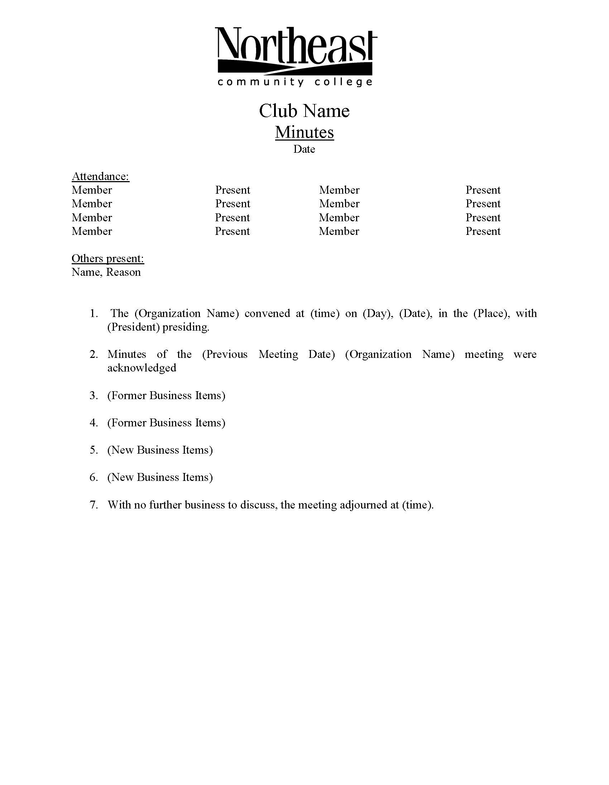
Minutes and Agendas
Use the official Minutes and Agenda templates available through the Student Activities Office (email studentactivities@northeast.edu to receive the templates)
Minutes must be on file in the Student Activities Office within one week of the meeting.
Why take minutes?
To provide a record of what was decided at meetings and why.
For clarification and shared understanding among members.
To provide an action plan to ensure the decisions are acted upon.
Minutes should include:
Date, time place
Who attended and their role (i.e. President, Advisor)
Agenda items, with summary of what was covered, who presented it, who was assigned tasks
Motions and what the outcome of the motion was, including who made the motion and who seconded it.
Any amendments to the motions should be included.
What decisions were made in the course of the meeting. Include what the problem was, what alternatives were presented and what solution was agreed to.
Action items, include who was assigned to what and what the timeframe for completion is.

Slide 20
QUESTIONS??
Please contact the Student Activities Office to answer any additional questions you may have.
402-844-7159
studentactivities@northeast.edu

