Slide 1

Solving the Soil
A Case Study

Slide 2
Baseline
Who has seen a soil test report?
What items do you see on a soil test report?
Why are these values important for us to gather?

Slide 3


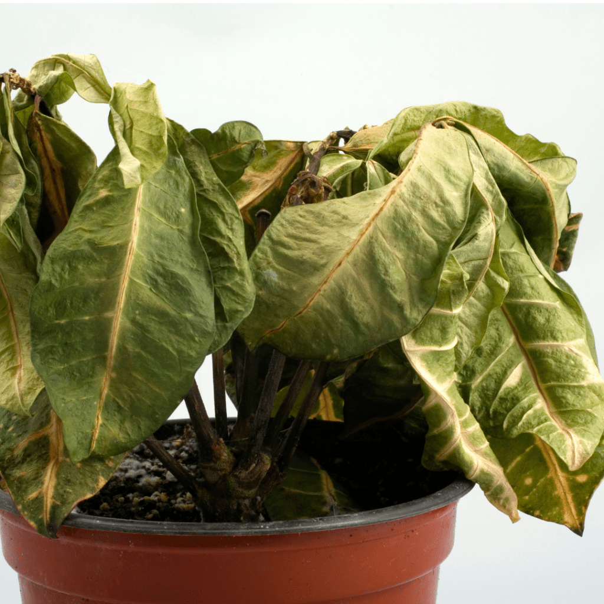
Why do we care about this?
Connect the Dots: Human Nutrition
Plants also need proper nutrition!
Notes:
How to Revive a Dying Houseplant - The Home Depot
How To Water Houseplants: Your Essential Guide To Plant Hydration - Easy To Grow Plants

Slide 4
Soil Nutrition
Availability of nutrients in the soil that are available to the plants for growth
17 essential elements
These nutrients affect plant growth, pH, soil temperature, and soil moisture

Slide 5
Essential Elements: Life Elements
Make up nearly all life on earth
Plants use these elements in respiration, photosynthesis, and transpiration
Carbon (C), Hydrogen (H), Oxygen (O)

Slide 6
Essential Elements: Macronutrients
Elements needed in “large” quantities by plants
Fertilizer elements/Primary Macronutrients = nutrients required in the greatest quantity. Used by the plant for growth and stress resistance
  Nitrogen (N), Phosphorus (P), Potassium (K)
Secondary Macronutrients = used by plants to increase colors, flavors, and the strength of stems and other tissues
  Magnesium (Mg), Sulfur (S), Calcium (Ca)

Slide 7
Essential Elements: Micronutrients
Elements that plants use in very small quantities
They might only be used for a small portion of the plant’s life cycle
Chlorine (Cl), Iron (Fe), Manganese (Mn), Molybdenum (Mo), Zinc (Zn), Nickel (Ni), Boron (B), Copper (Cu)

Slide 8
Primary macronutrients/Fertilizer Elements
Nitrogen-basic building block for all proteins in the plant
  We apply this to corn fields, as the corn uses large quantities of nitrogen to grow and produce yield.
Phosphorus-plays a key role in photosynthesis. Contributes to root growth and flowering and seed development
Potassium-activates enzymes, helps with water retention, and helps strengthen plant stems and roots
Notes:
Nutrient Deficiency Guide For Crops – Cropnuts https://cropnuts.com/plant-nutrient-deficiency-symptom-guide-for-crops/ This website has some photos of nutrient deficiency symptoms for nitrogen, phosphorus, and potassium. If you have time or want to go down this route, they provide a nice visual for your students. It goes on to show some of the deficiencies of other nutrients as well.

Slide 9
Soil pH
Reveals how acidic or alkaline the soil is
0.0-6.9 = acidic
7.0 = neutral
7.1-14.0 = alkaline
Affect the availability of the essential elements
Notes:
Show pictures of plants in low, adequate, and high pH.

Slide 10
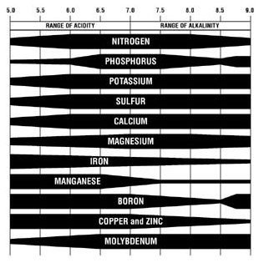
Nutrient Availability

Slide 11
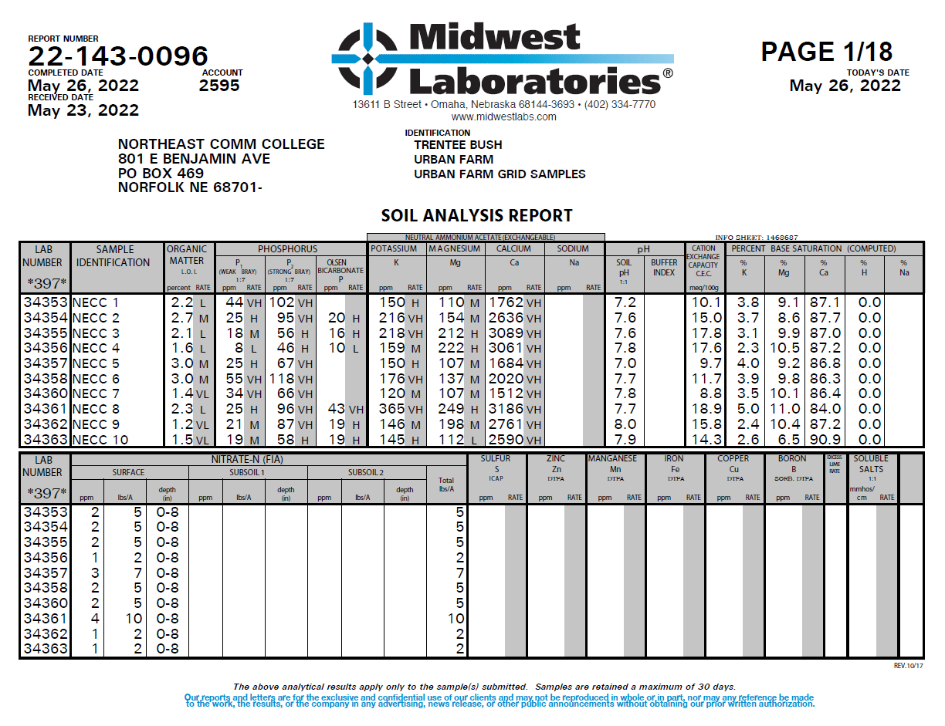
Activity
Let’s take a look at a soil test report!

Slide 12
Discussion
Why is it important to do regular soil testing?
What nutrient challenges do you note on the Urban Farm?
Which plots were best for growing with minimal inputs?
Which plots were undesirable for growing pumpkins?
What does this information tell us about soil health and Urban Ag?
If the soil is not adequate for growing pumpkins, what other ideas might you have for producing an ag product on this site?
Notes:
1. Anything that comes off soil has to be replaced. (Nutrient wise)

Slide 13
Wrap up
Note: soil health is a complex topic. We just scratched the surface today.
Who uses this knowledge?
  Farmers, agronomists, ranchers with pasture, homeowners with gardens, landscapers, etc.
Chemistry is an important class to pay attention in to learn how these different concepts are used in science. You can then apply it to soil science!

Slide 14
Grant Acknowledgements
This material is based upon work supported by the National Science Foundation under Grant No. 2202151. Any opinions, findings, and conclusions or recommendations expressed in this material are those of the author(s) and do not necessarily reflect the views of the National Science Foundation.

