Slide 1

Growing Media

Slide 2
What we’re going to do:
Define Soilless Media to understand other options besides soil to grow plants
Explore individual components of potting soil to learn how they each interact with the plant and what value they provide
Make a soil recipe for a specific plant to practice understanding unique plant needs

Slide 3
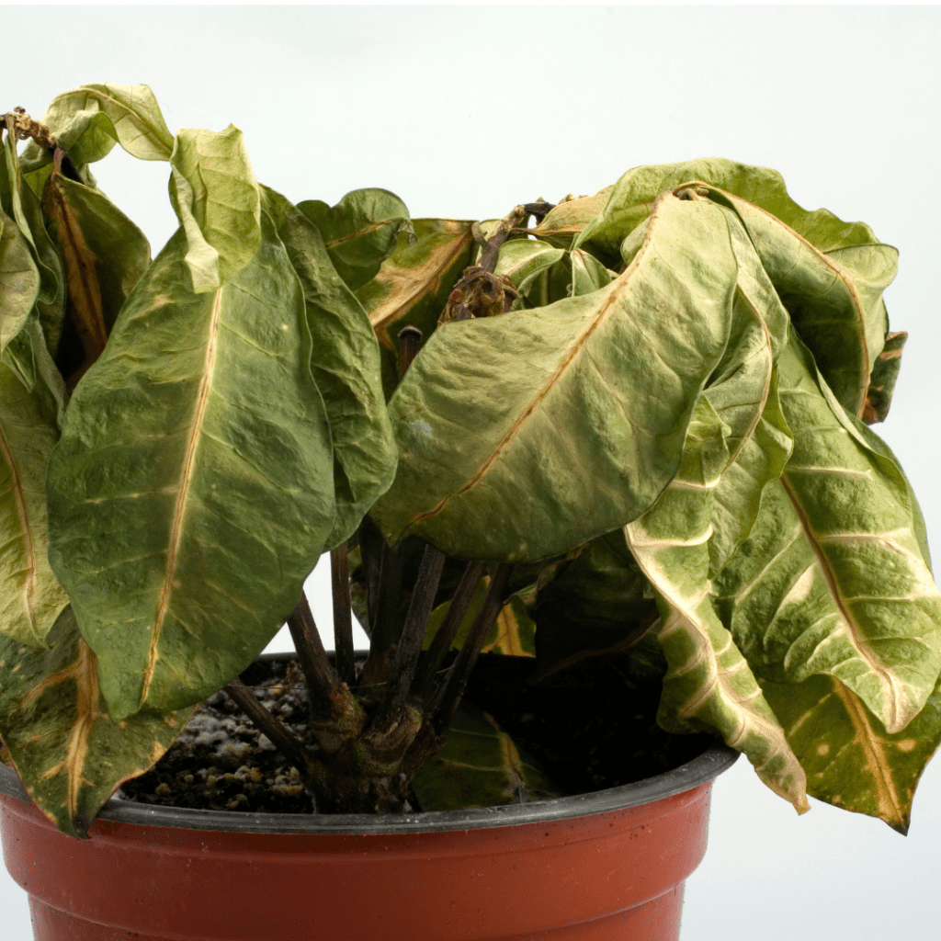

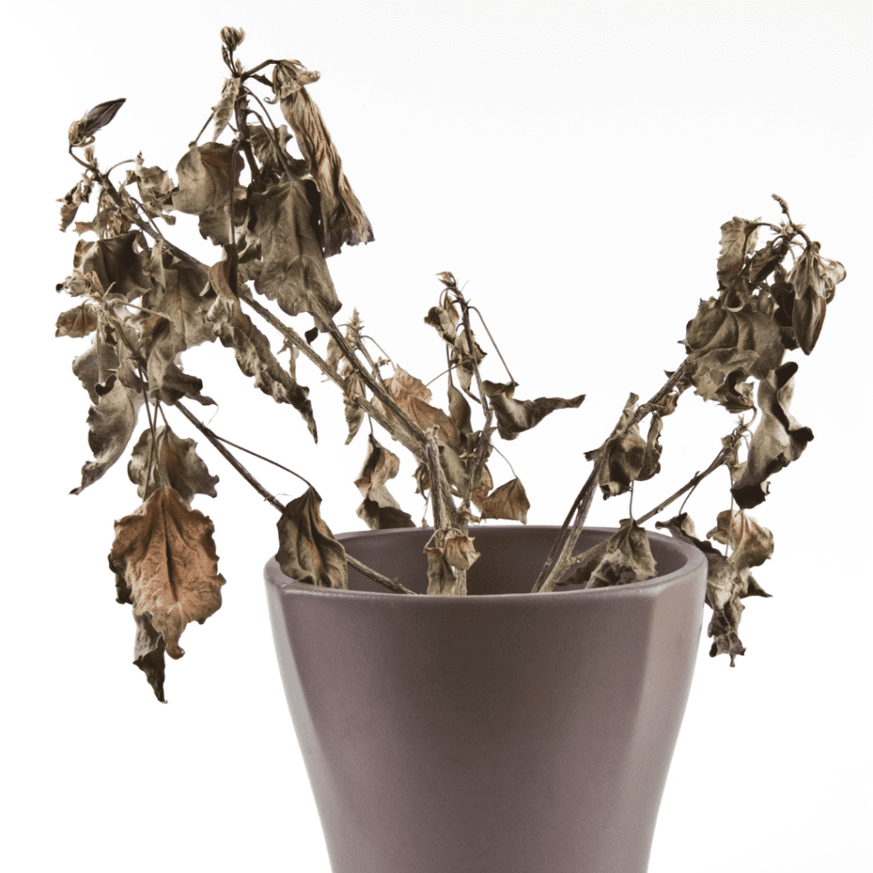
Why do we care about this?
Notes:
How to Revive a Dying Houseplant - The Home Depot
How To Water Houseplants: Your Essential Guide To Plant Hydration - Easy To Grow Plants

Slide 4
Growing Media Definition
Any structure that plant roots reside in
  Field Soil
  Soilless Media

Slide 5
Field Soil
Comprised of sand, silt, and clay
Various amounts of organic matter
  Organic Matter = carbon-based material that comes from living organisms, or what was once alive. Decomposed residue. It has great nutrient value for the soil.
Heavy with a high bulk density
  Bulk Density = how much mass a material has for a given volume
  Why Bulk Density Matters = it tells us how compact or loose our soil is
  Lower bulk density = looser soil and has more air and water space
  Higher Bulk Density = more compacted

Slide 6
Soilless Media
Field soil becomes easily compacted in containers and is not recommended
Soilless media = an artificial growing environment that balances the nutritional and structural needs of the plant
Commonly used in container production

Slide 7
Soilless Media Cont.
A combination of several components is often mixed to achieve the ideal amount of nutrients, water holding capacity, and aeration
  Water Holding Capacity = the max amount of water a soil can hold against gravity
  Aeration = process by which air, especially oxygen, enters and moves through the pore spaces in soil. Helps with plant root growth
Notes:
Source: Iowa State University Digital Press. Soil Aeration – Introduction to Soil Science, Second Edition

Slide 8
Characteristics
Drainage
Aeration
Water Retention
Bulk Density
pH
Buffering Capacity
Cation Exchange Capacity
Notes:
pH = how acidic or alkaline your soil is. This plays a big role in how well the plants can access their nutrients. Scale; 0-14.
7.0 is neutral
Below 7 = acidic (more H+ ions)
Above 7 = alkaline (basic) (more OH- ions)
Cation Exchange Capacity = soil’s ability to retain and exchange positively charged ions (cations), directly influencing soil fertility and nutrient availability

Slide 9
Sphagnum/Peat Moss
Formed in wet conditions where the organic matter maintains a high level of acidity and nutrient availability for plants
High in organic matter
Holds 10-20 times its dry weight in water
Decomposes very slowly
Good aeration until decomposition breaks down the fibers
pH between 3.5 – 4.5
Lightweight
Notes:
Sphagnum Moss Vs. Peat Moss: What's the Difference? (& How to Use Each)
In short, the difference between sphagnum and peat moss is the sphagnum moss is the living top layer of moss harvested from bogs, while peat moss is the decomposed, compressed layer beneath it.
According to Tee, sphagnum moss is preferred because strands are long with a large surface area

Slide 10
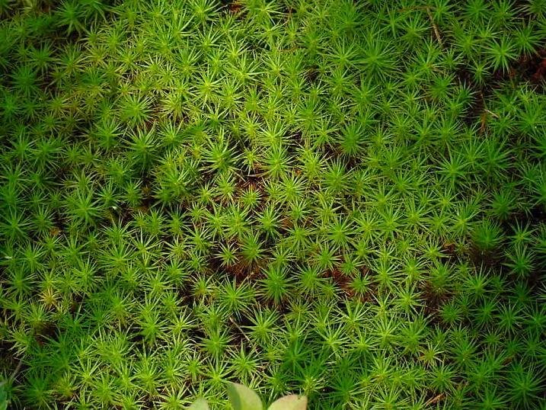
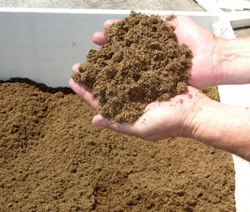
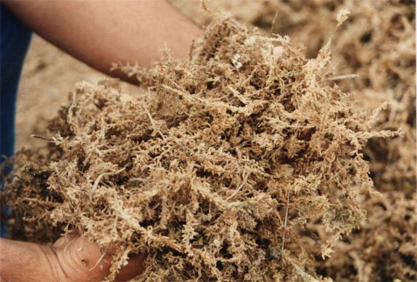
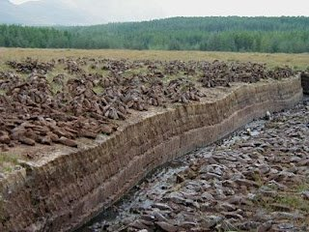
Sphagnum and Peat Moss
Notes:
Left: peat moss you would normally see in a potting soil http://www.kissner.com/wp-content/uploads/2012/08/peat-moss.jpg
Bottom Center: Sphagnum peat moss. A more fibrous form of peat moss http://brightbrowncreative.files.wordpress.com/2011/05/sphagnum-moss.jpg
Top Right: A living sample of what will become peat moss http://gardeningoncloud9.com/wp-content/uploads/2009/03/sphagnum-moss-01.jpg
Bottom Right: Peat bog http://2.bp.blogspot.com/-qxmNDXeLvaI/TWhAfekeA3I/AAAAAAAAAHI/0K93ke0M7cg/s320/peat.jpg

Slide 11
Sand
Eroded and broken-down rock particles
Inorganic
No nutrient availability/contains no nutrients
Low cation exchange capacity
Excellent aeration and drainage
pH is variable
Heavy weight
Notes:
Inorganic = non-living, mineral-based components of soil, primarily composed of sand, silt, and clay. No organic matter

Slide 12
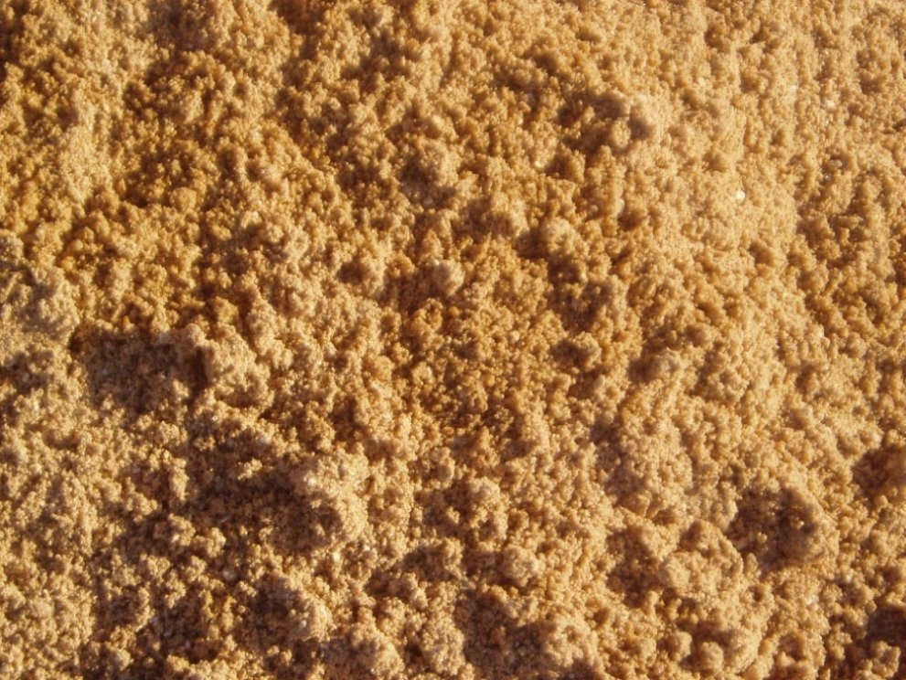
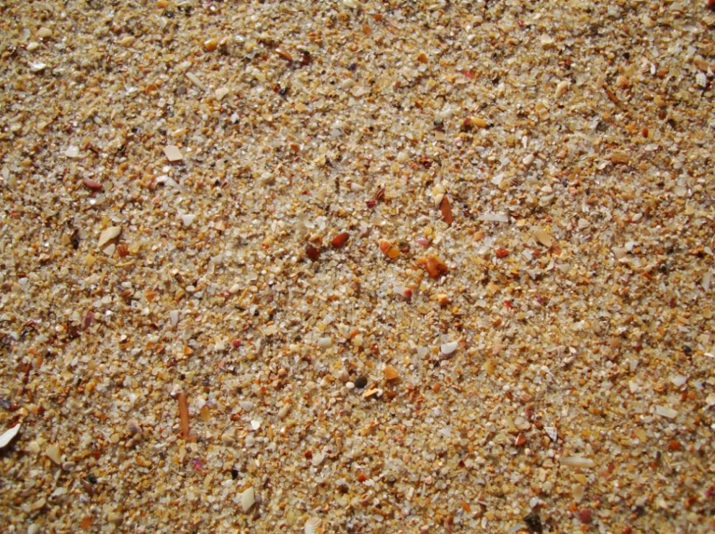
Sand Pictures
Notes:
Left Photo: http://selectsg.com/yahoo_site_admin/assets/images/ConcreteSand2.323191609.JPG
Right Photo: http://www.asisbiz.com/Photos/Sand/images/Textures-Beach-Sand-Closeups-02.JPG

Slide 13
Vermiculite
Expanded mica that has been heated to about 2000°F
Inorganic
Contains trace amounts of Magnesium (Mg) and Potassium (K)
High water-holding capacity
Excellent aeration and drainage
pH of 7.0 of higher
Good buffering capacity
Light weight
Notes:
Magnesium is a key component of chlorophyll. Adequate Mg helps plants produce healthy green foliage and supports strong roots (Vermiculite: The Secret Ingredient For Thriving Plants - THE LIFESTYLE COLLECTIVE)
Potassium helps plants withstand drought, disease, and temperature extremes. It also helps support fruit and flower development.

Slide 14
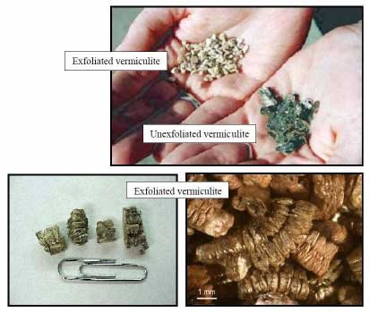
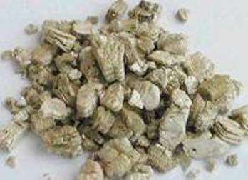
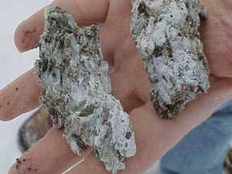
Vermiculite PiCtures
Notes:
Top Left Photo: http://www.epa.gov/asbestos/images/vermiculite5.jpg
Bottom Left Photo: http://www.atsdr.cdc.gov/asbestos/images/asbestos/types_of_exposure/vermiculite_ore.jpg
Right: http://www.home-air-purifier-expert.com/images/vermiculite-2forms.jpg

Slide 15
Perlite
Formed from a volcanic rock heated to 1400-1600°F
Inorganic
Contains up to 200 ppm of Fluoride
High water-holding capacity
Excellent aeration and drainage
pH between 6.0 and 8.0
No buffering capacity
Light weight
Notes:
It then pops like popcorn into this lightweight, rounded substance.

Slide 16
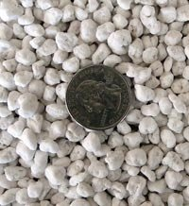
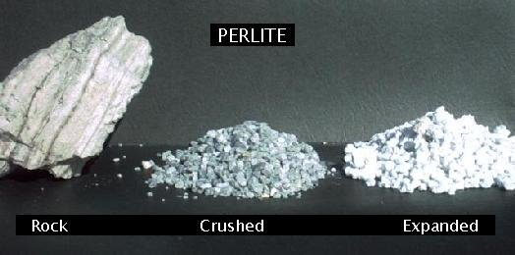
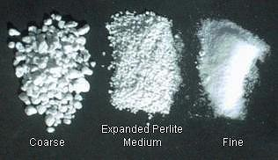
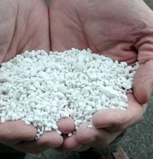
Perlite pictures
Notes:
Top Left Photo: http://www.perlite.net/perlite.jpg
Bottom Left: http://www.idahominerals.com/siteGFX/images/perlite_inhand.jpg
Top Right: http://www.oakhillgardens.com/images/products/x-coarse-perlite-new-1-1-11.jpg
Bottom Right: http://www.perlite.net/perlite2.jpg

Slide 17
Calcined Clay
Processed and baked at high temperatures.
Inorganic
No nutrient value but capable of absorbing nutrients
Moderate water-holding capacity
  Highly porous
Excellent aeration and drainage
pH between 5.0 and 6.0
Resistant to breaking down
Heavy weight

Slide 18
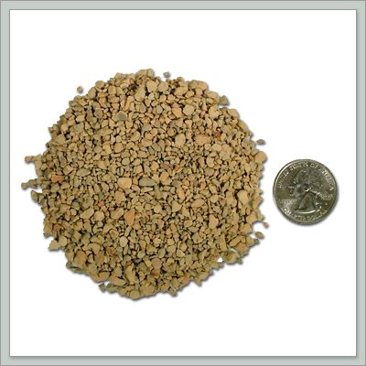
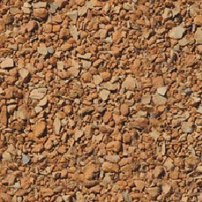
Calcined Clay Pics
Notes:
Leftmost Photo: http://media.diamondpro.com/img/products/calcined-clay-top-dressing-detail.jpg
Rightmost Photo: http://faculty.yc.edu/ycfaculty/ags250/week04/horticulture_substrates/calcined_clay_framed.jpg

Slide 19
Composted Bark
Composting helps destroy injurious/inhibiting compounds; increases cation exchange; and reduces/eliminates insects, diseases, organisms, nematodes, and weed seeds
High in organic matter
High in carbon (C:N ratio of 300:1)
Moderate water and nutrient retention
Variable weight
Less expensive than sphagnum/peat moss
Notes:
Benefits of a high C:N Ratio-typically above 30:1 and often 35:1
Slower Decomposition and Longer-Lasting Organic Matter. This means they can provide a sustained source of OM and improving soil structure over time.
Reduced Risk of Nitrogen Leaching. Because N is tied up in microbial biomass when carbon is abundant, it is less likely to be released too quickly and leach out of the soil. This helps maintain nitrogen availability for plants over an extended period, especially in soils with high organic carbon content.
Support for Fungal Communities. High C:N ratios tend to favor fungi over bacteria in the soil. Fungi are important for breaking down complex, recalcitrant organic compounds (like lignin) and for building stable soil aggregates, which improve water retention and root penetration.
Enhanced Soil structure and stability. Slower decomposition contributes to the formation of humus and other stable organic compounds. This improves soil aggregation, aeration, and water-holding capacity, which are essential for healthy root systems and reduced erosion.
Long-Term Fertility Building. Nitrogen is gradually released back into the soil as the carbon breaks down over time.

Slide 20
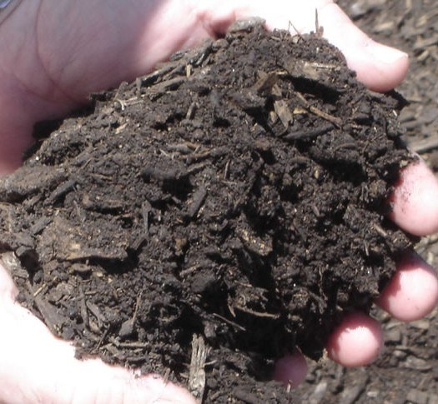
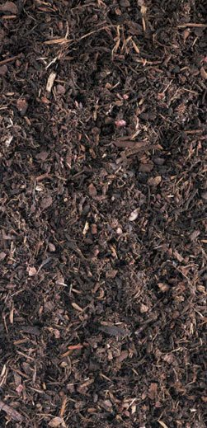
Composted Bark Pics
Notes:
Left Photo: http://www.ahs-ltd.co.uk/images/uploads/products/fine_compost_bark.jpg
Right Photo: http://billwandsnider.files.wordpress.com/2011/04/mulch-compost.jpg

Slide 21
Coir
Middle layer (middle part) of the coconut husk
High in organic matter with slow decomposition
Moderate in carbon (C:N ratio of 80:1)
High water holding capacity – up to 8x its weight in water
Low nutrient holding capacity
  May contain high levels of potassium and other soluble salts
pH between 5.0 and 6.5
Light weight

Slide 22
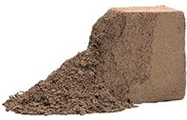
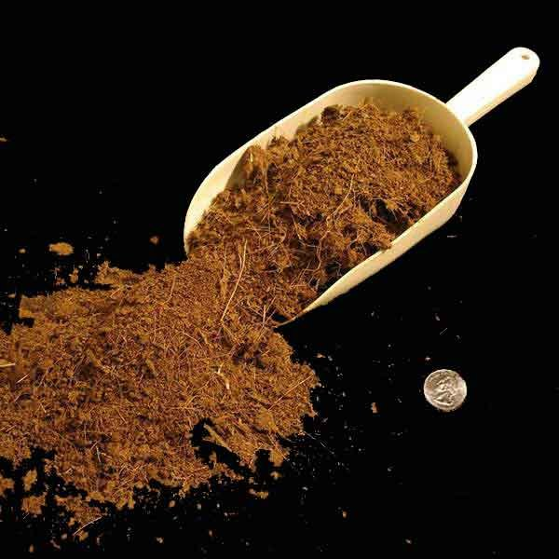
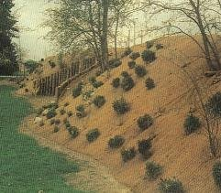
Coir Pics
Notes:
Top Left Photo: http://vgrove.com/images/products/bricks-bales.gif
Bottom Left Photo: http://www.erosionpollution.com/image-files/coirmatseededsmall.jpg
Right Photo: http://myorchidcare.com/potting-media/img/Coir-600.jpg

Slide 23
Rockwool
Created from melted volcanic rock spun like cotton candy. Rock melts at around 2900°F
Inorganic and non-biodegradable
Pore space over 90%
Moderate water-holding capacity
No nutrient-holding capacity
pH between 7.0 and 8.5

Slide 24
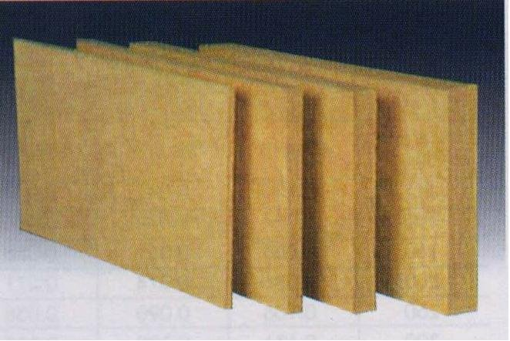
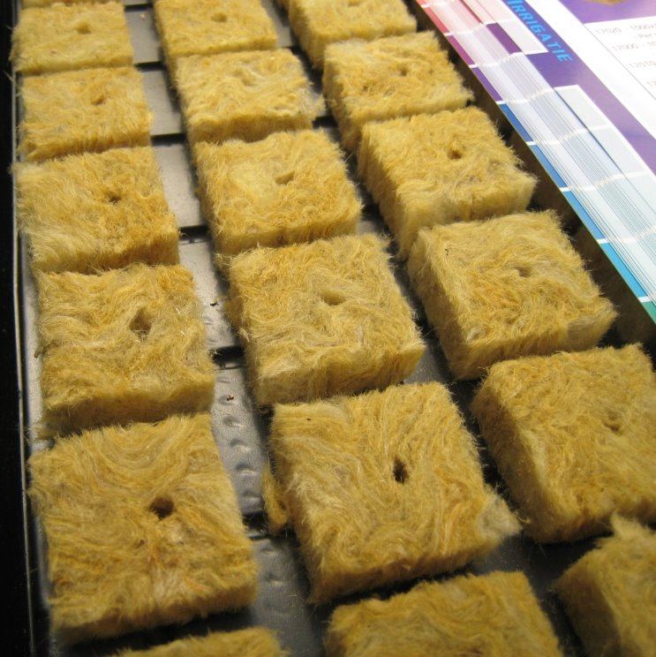
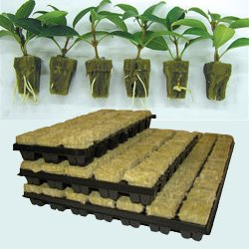
Rockwool Pictures
Notes:
Left Photo: http://upload.wikimedia.org/wikipedia/commons/c/c3/Rockwool_cubes-inlay_PNr%C2%B00091.jpg
Top Right Photo: http://image.made-in-china.com/2f0j00kvMaLpPETthG/Rockwool-Board.jpg
Bottom Right Photo: http://cadconstruction.weebly.com/uploads/3/1/0/7/3107288/5581140.jpg

Slide 25
Activity Part 1
Sensory Exploration
Write down at least three observations about each soilless media type.
What surprised you about each one?
Answer the reflection questions at the bottom of the page.

Slide 26
Activity Part 2
Make a soil recipe!
Using your assigned plant, consider what your plant needs to thrive.
With this information in our worksheet and from the internet, make a recipe for your assigned plant.
Use the cups to make a recipe.

Slide 27
Things to Ponder
Weight-are you going to need some weight to the pot? Where is the pot going to be stored? Greenhouse? Outside?
What pH is the plant looking to thrive in?
Does the plant like well-drained? Good aeration?
Are there certain nutrients it is looking for?

Slide 28
Wrap UP
What is soilless media?
Which component that we explored today was most interesting to you?
What was the biggest takeaway from today’s activity/lesson?

Slide 29
Grant Acknowledgements
This material is based upon work supported by the National Science Foundation under Grant No. 2202151. Any opinions, findings, and conclusions or recommendations expressed in this material are those of the author(s) and do not necessarily reflect the views of the National Science Foundation.

