Slide 1

Field Microscopes

Slide 2
Objective
Explore some different components of plants at the cellular level.
Define different parts of cell structure and learn value they provide to the plant

Slide 3
Why do we care about this?
Careers
  Crop Scout
  Genetics
  Landscaping
  Conservationists

Slide 4
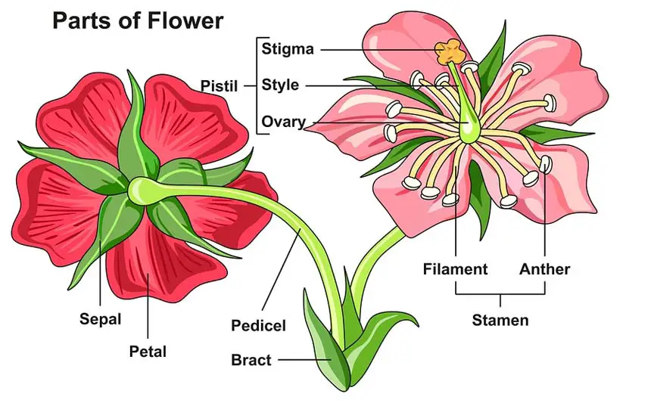
Parts of a Flower
Notes:
Image Source: Shuttershock

Slide 5
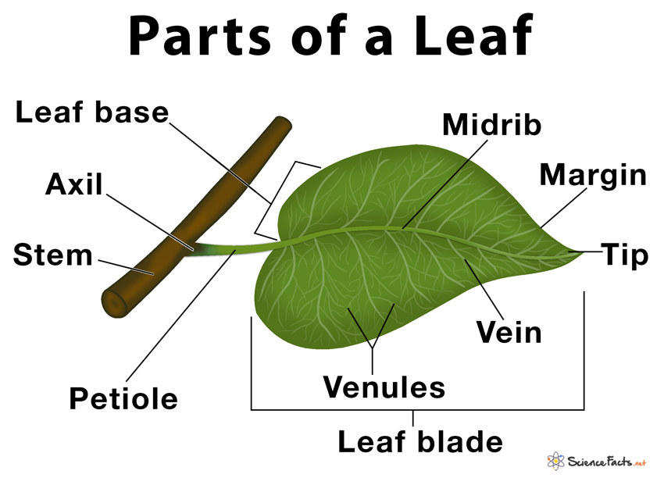
Parts of a Leaf
Notes:
Image Source: sciencefacts.net

Slide 6
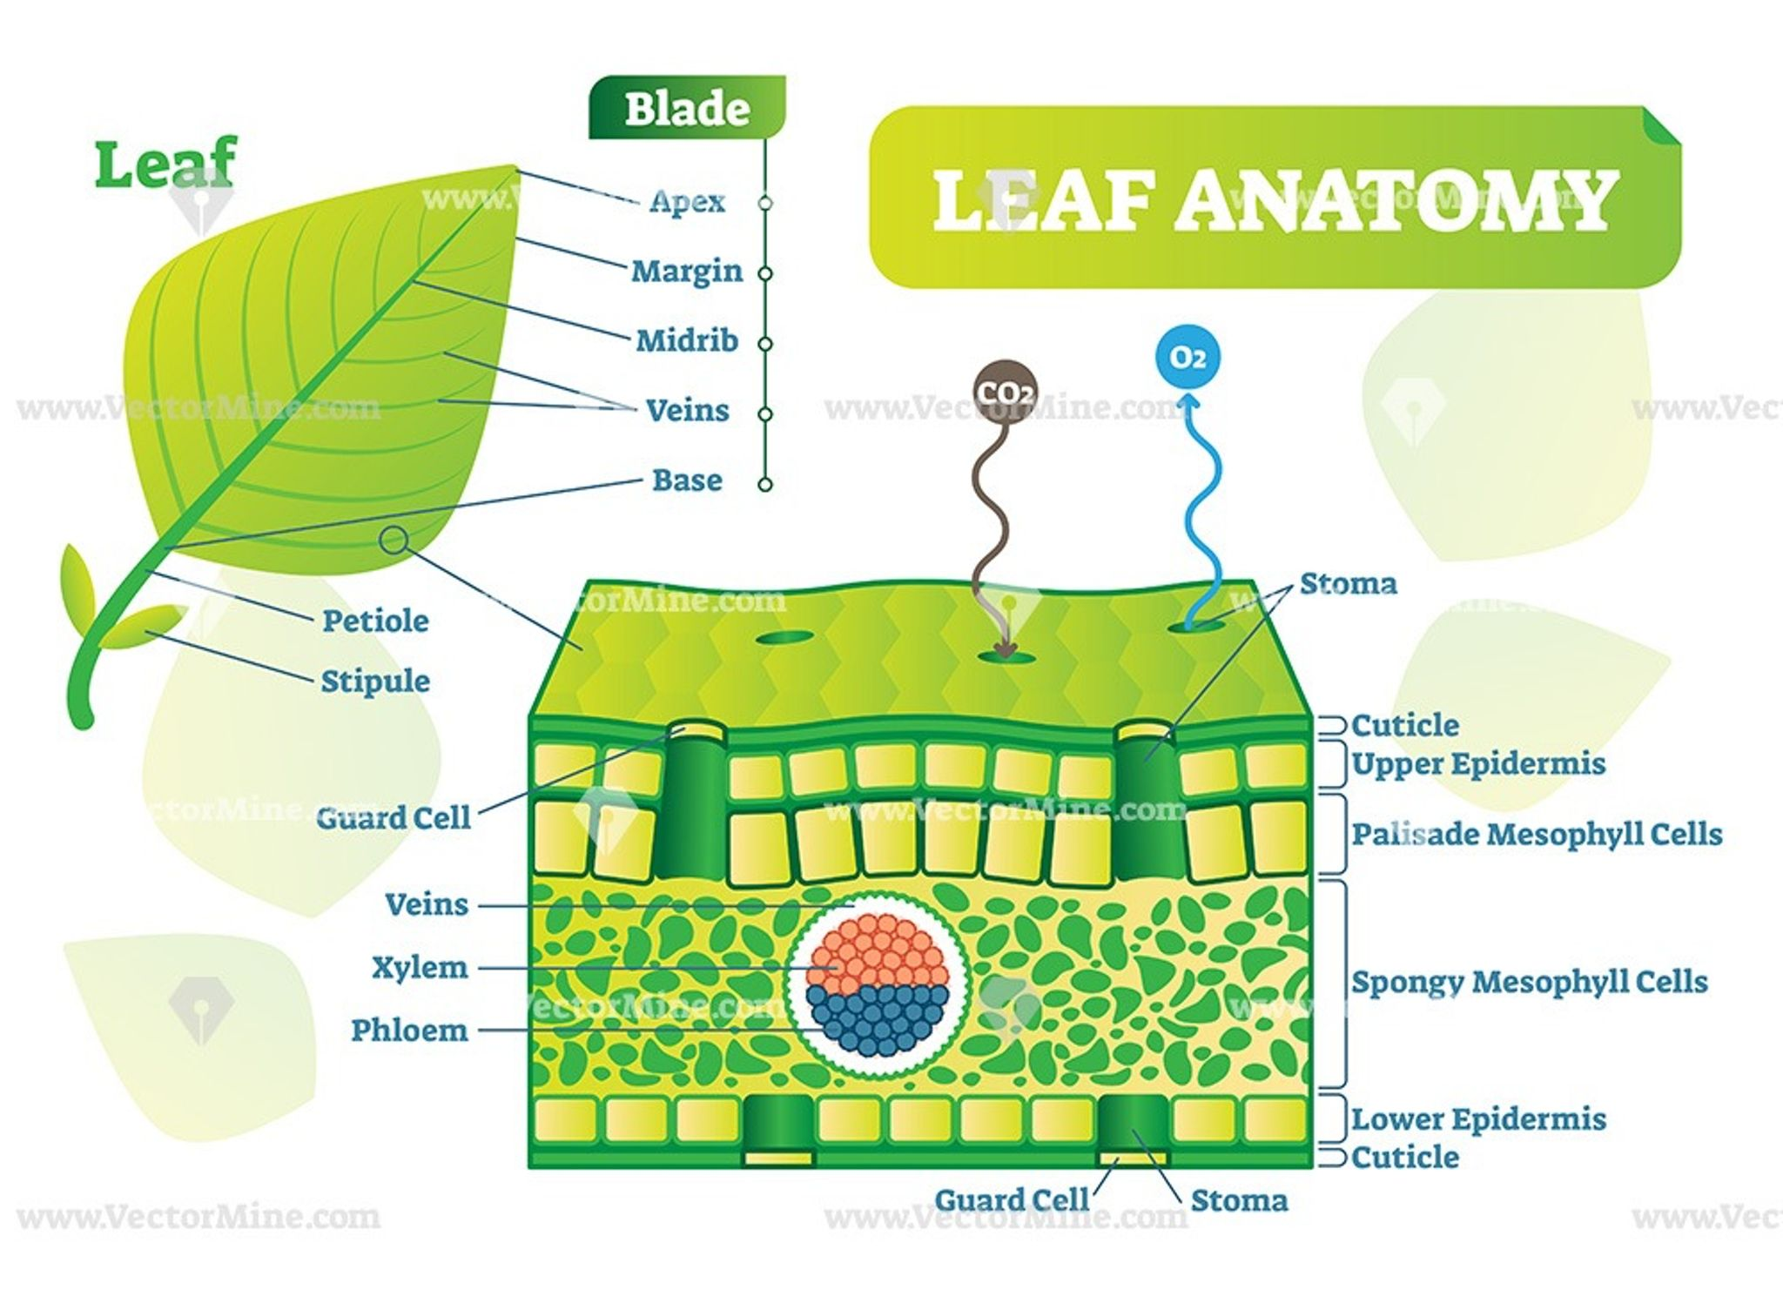
Leaf Anatomy
Notes:
Image Source: VectorMine.com

Slide 7
What do we look for?
Physical Damage
  Spots, lesions, bugs, insects, tears
Plant Science
  When we start diving into the cells, what can we see?

Slide 8
Vascular Tissue
The plant’s transportation
  Xylem=moves water from roots to shoots
  Phloem=moves food and nutrients from roots to shoots

Slide 9
Things we’ll explore
Pith = spongy tissue in plant stems
Epidermis = outermost layer of cells covering the leaves, stems, roots, and flowers
Cambium = sits between xylem and phloem. In charge of secondary growth, to increase thickness of stems and roots
Cortex = helps with storage, transport, and structural support. Found underneath the epidermis
Stomates (Stomata) = pore in the epidermis that allows gas to move between the plant and the environment around it

Slide 10
More Things to Explore
Leaf Hairs
Petal Tissue
Leaf Veins
Reproductive Organs

Slide 11
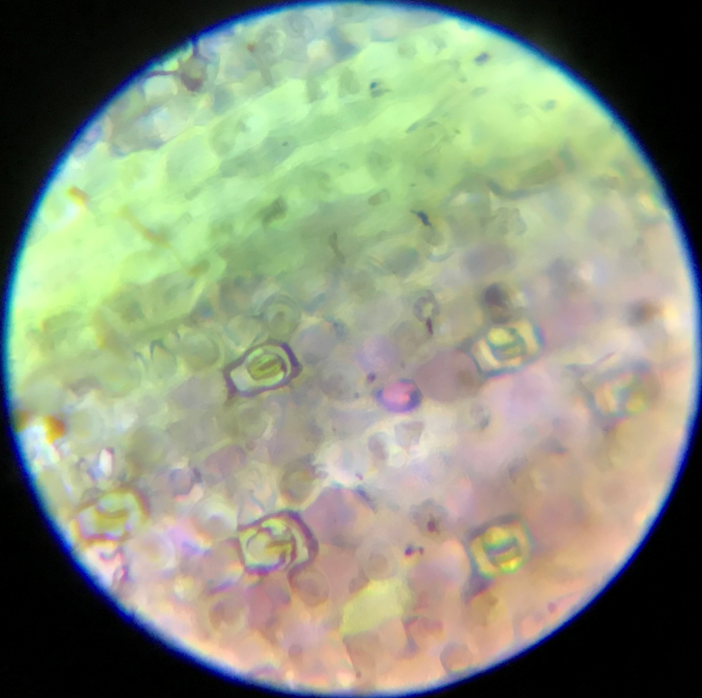
Stomates
The purple, almost bolded areas of this leaf.
Notes:
Leaf from Erin. Stomatas are normally on the back side. They open and close so air can move through them (like a window)
The next few slides are simply some examples that I have seen to help guide students with what they may be looking for.

Slide 12
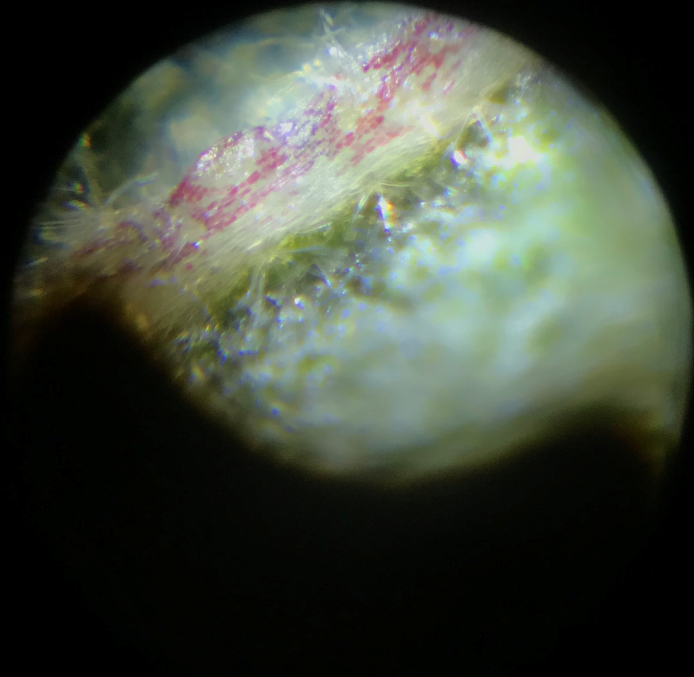
Leaf Hairs
Notes:
Hairs on mid-rib of leaf

Slide 13
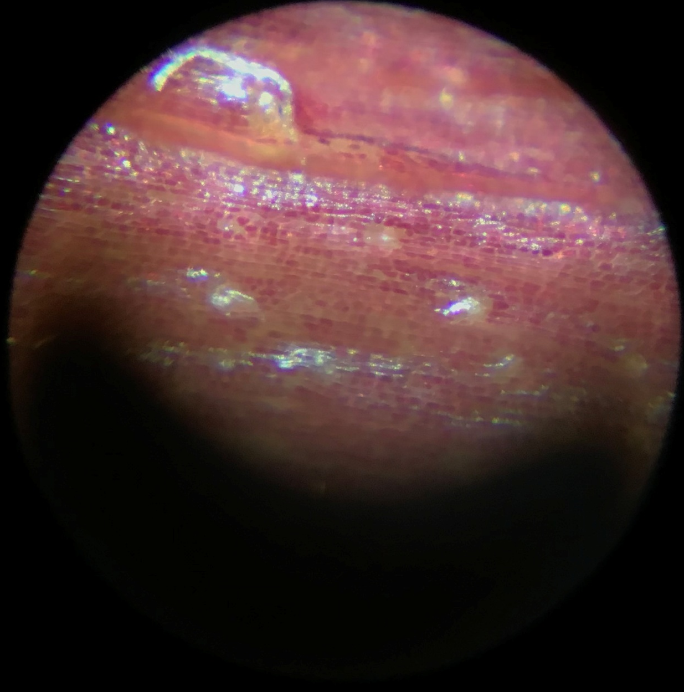
Petiole Cells
Notes:
The petiole. The lighter, whiter spots, could be like oil glands, or just the light shining through.

Slide 14
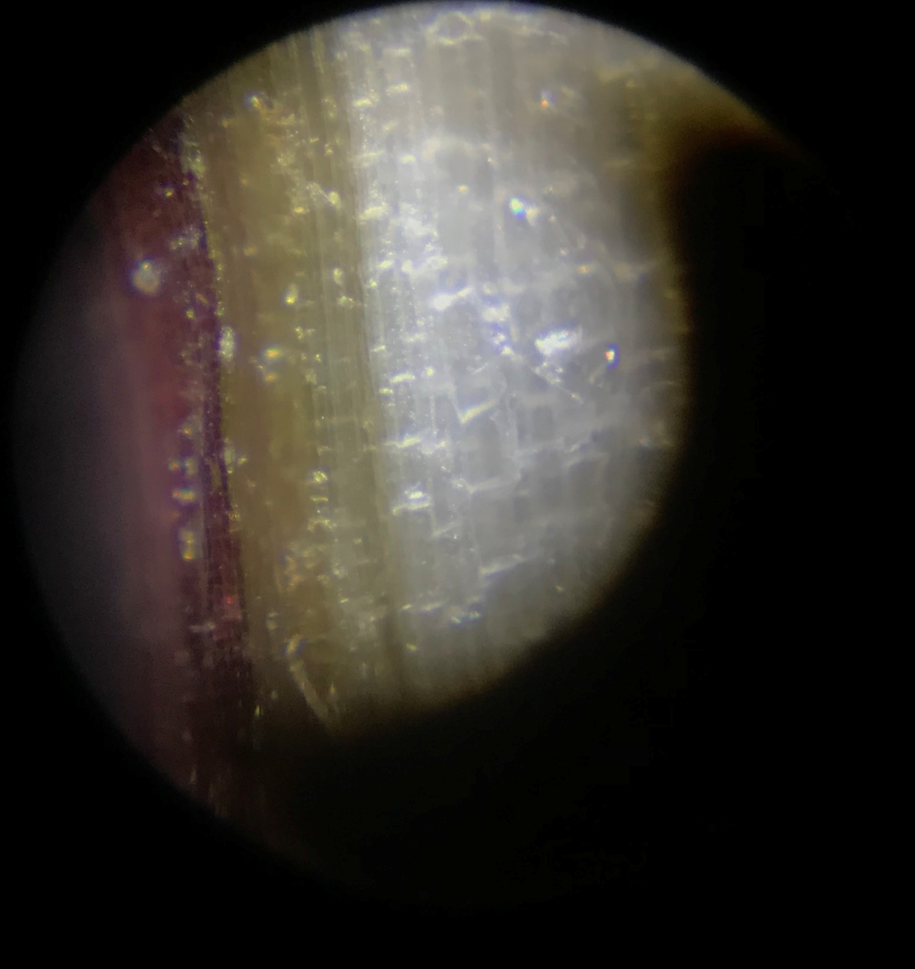
Cell Layers
Notes:
Outer layer, epidermis, purple on left. Cambium layer, green in the middle. Vascular tissue, white on right.

Slide 15
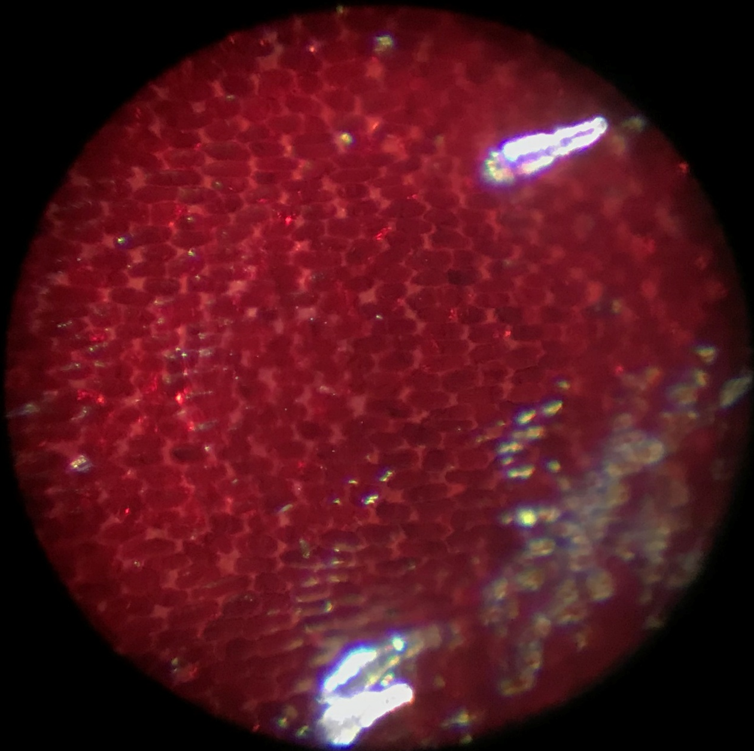
Hibiscus Petal Tissue
Notes:
Hibiscus petal tissue

Slide 16
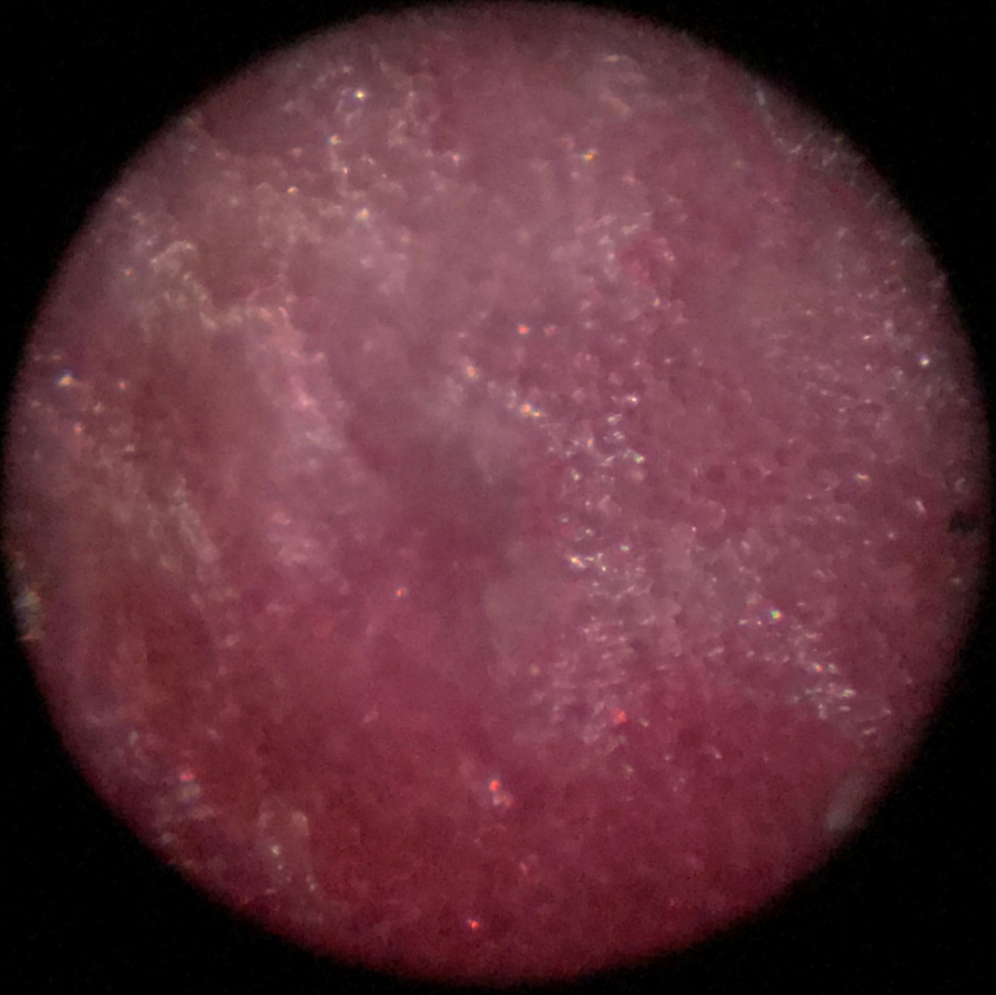
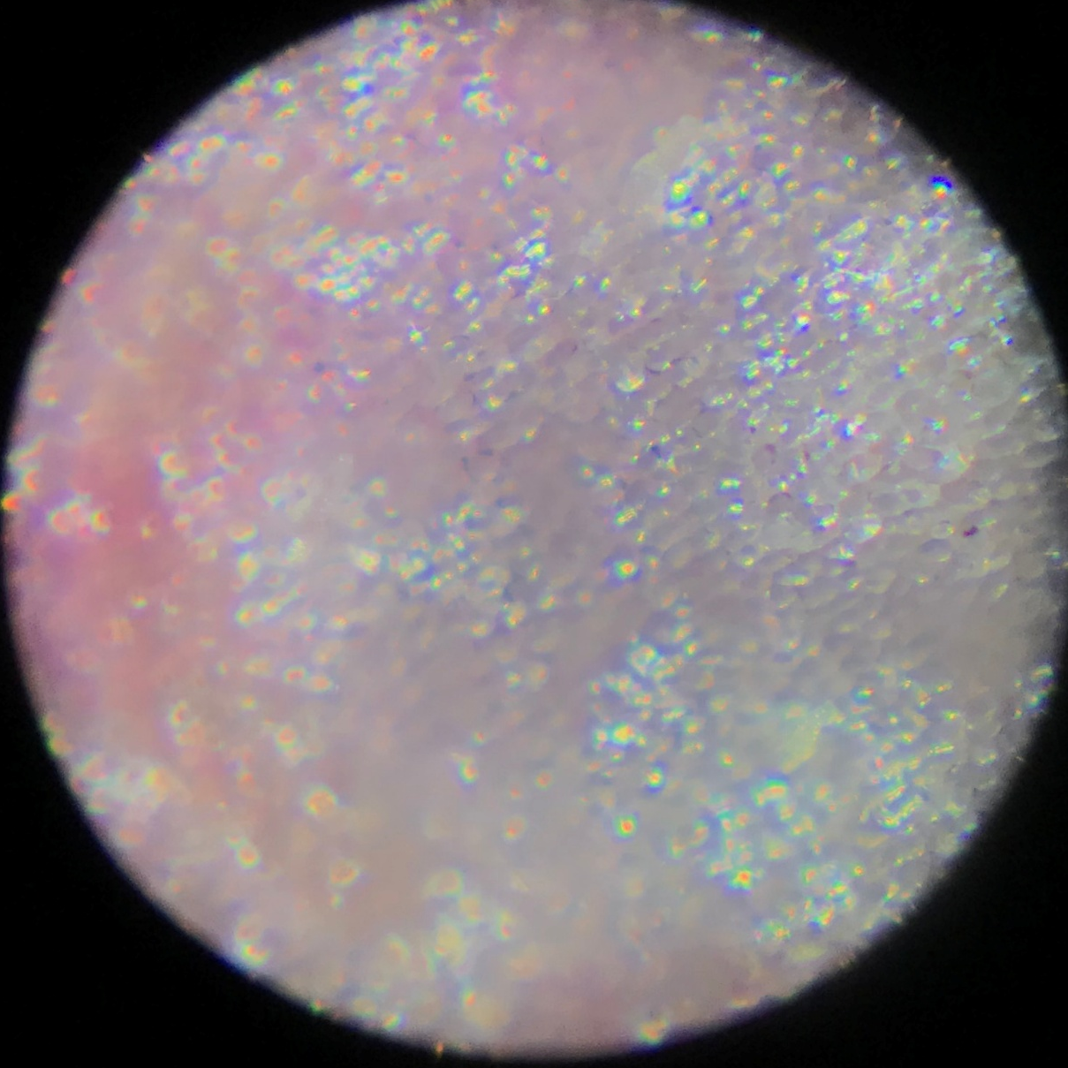
More Hibiscus Petal Tissue
Notes:
Hibiscus petal tissue, the lighter colors of those petals.

Slide 17
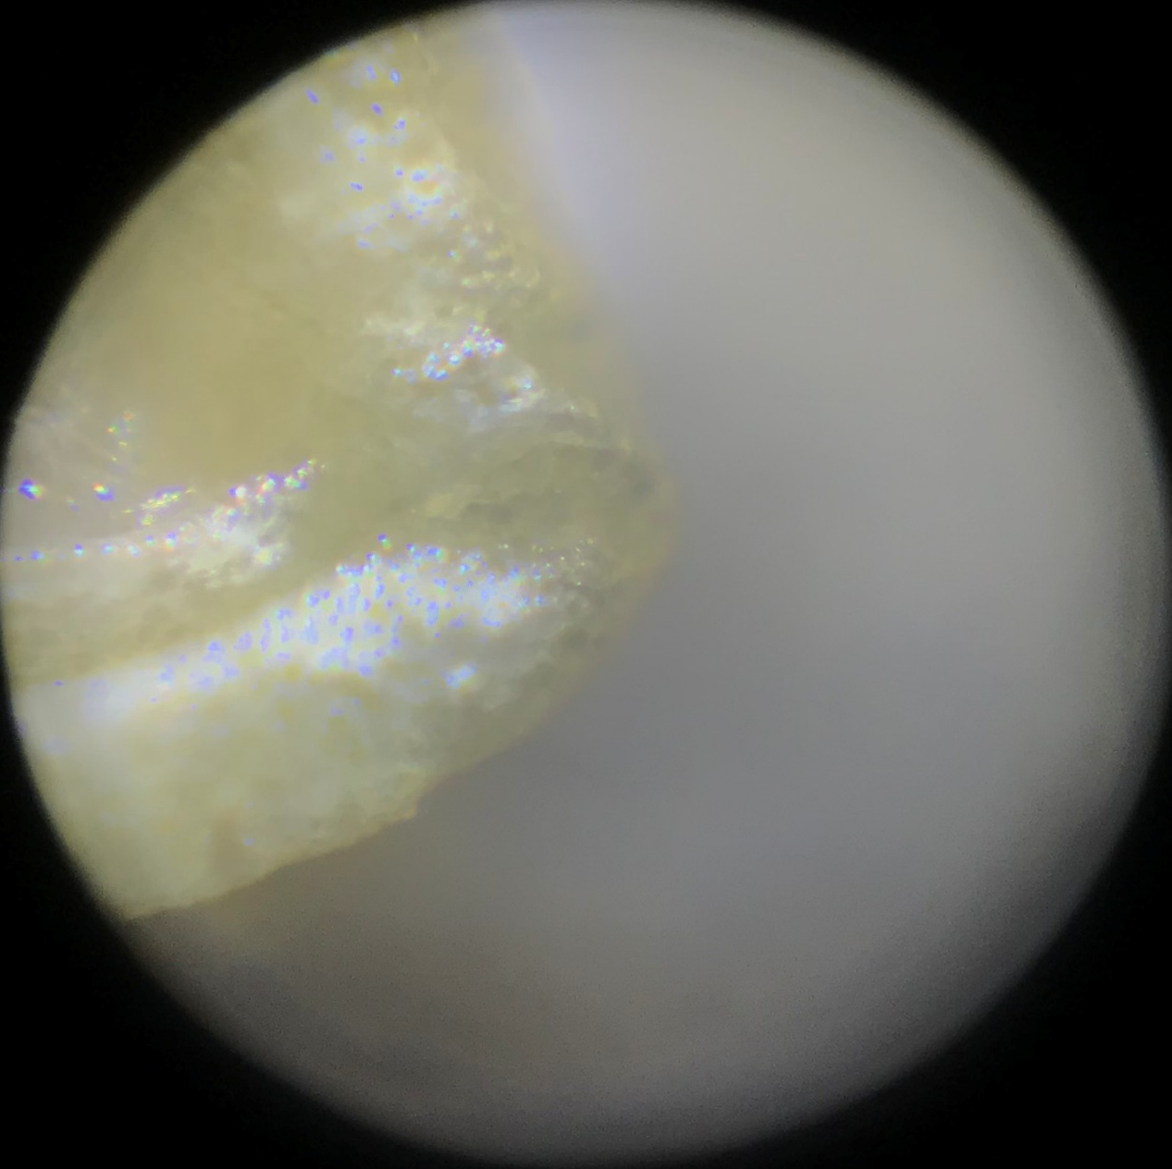
Stamen
Notes:
Stamen on one of the flowers

Slide 18
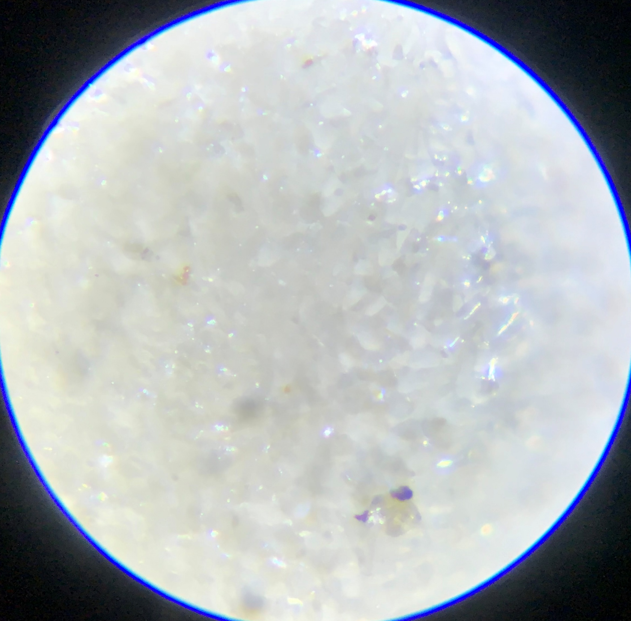
Stigma on Flower
Notes:
Stigma on the flower

Slide 19
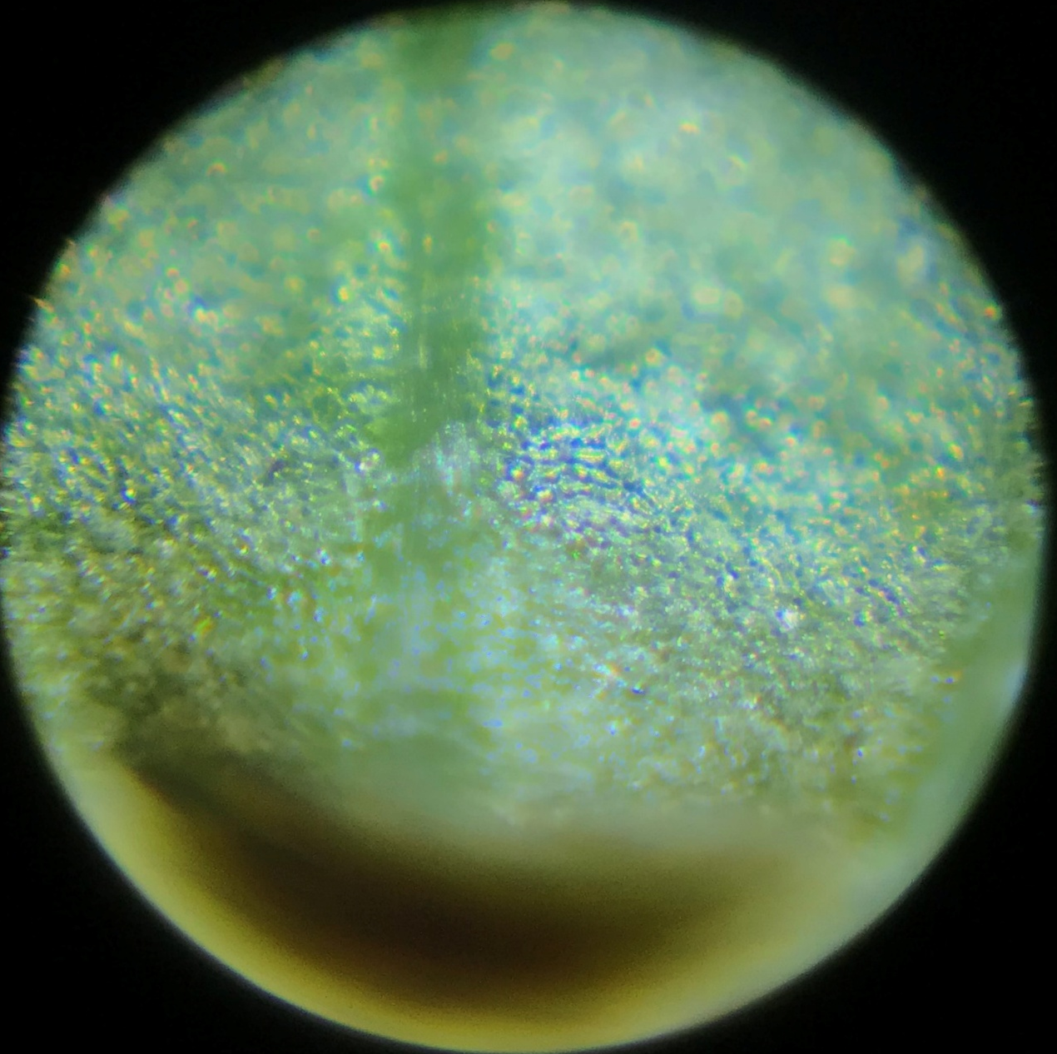
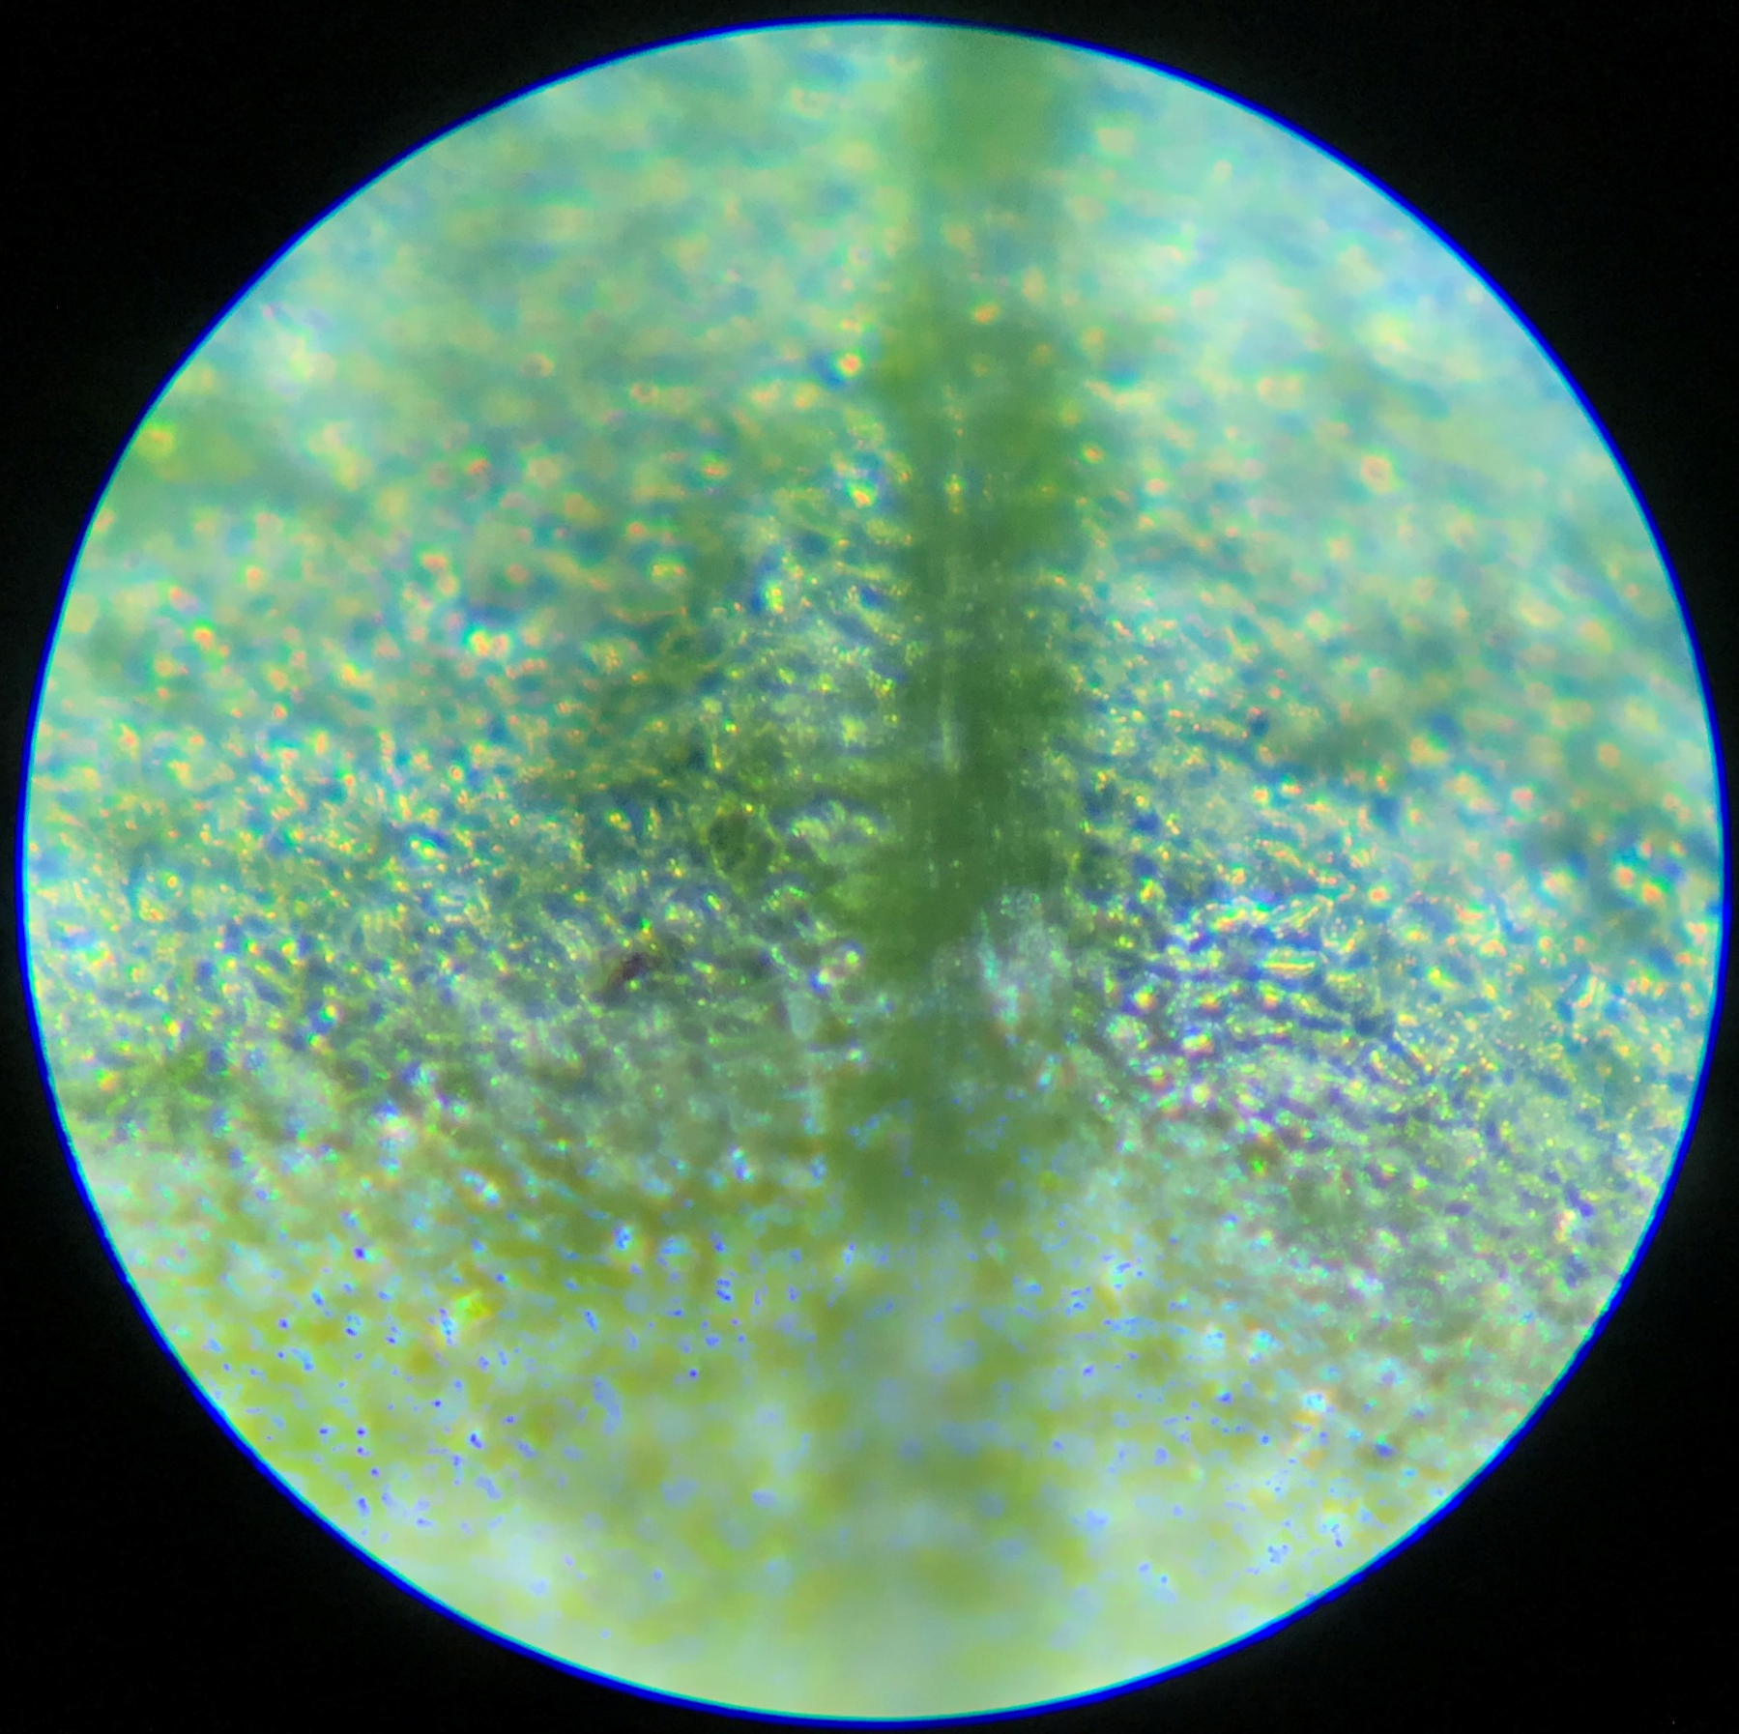
Leaf Vein
Notes:
Leaves with a visible vein

Slide 20
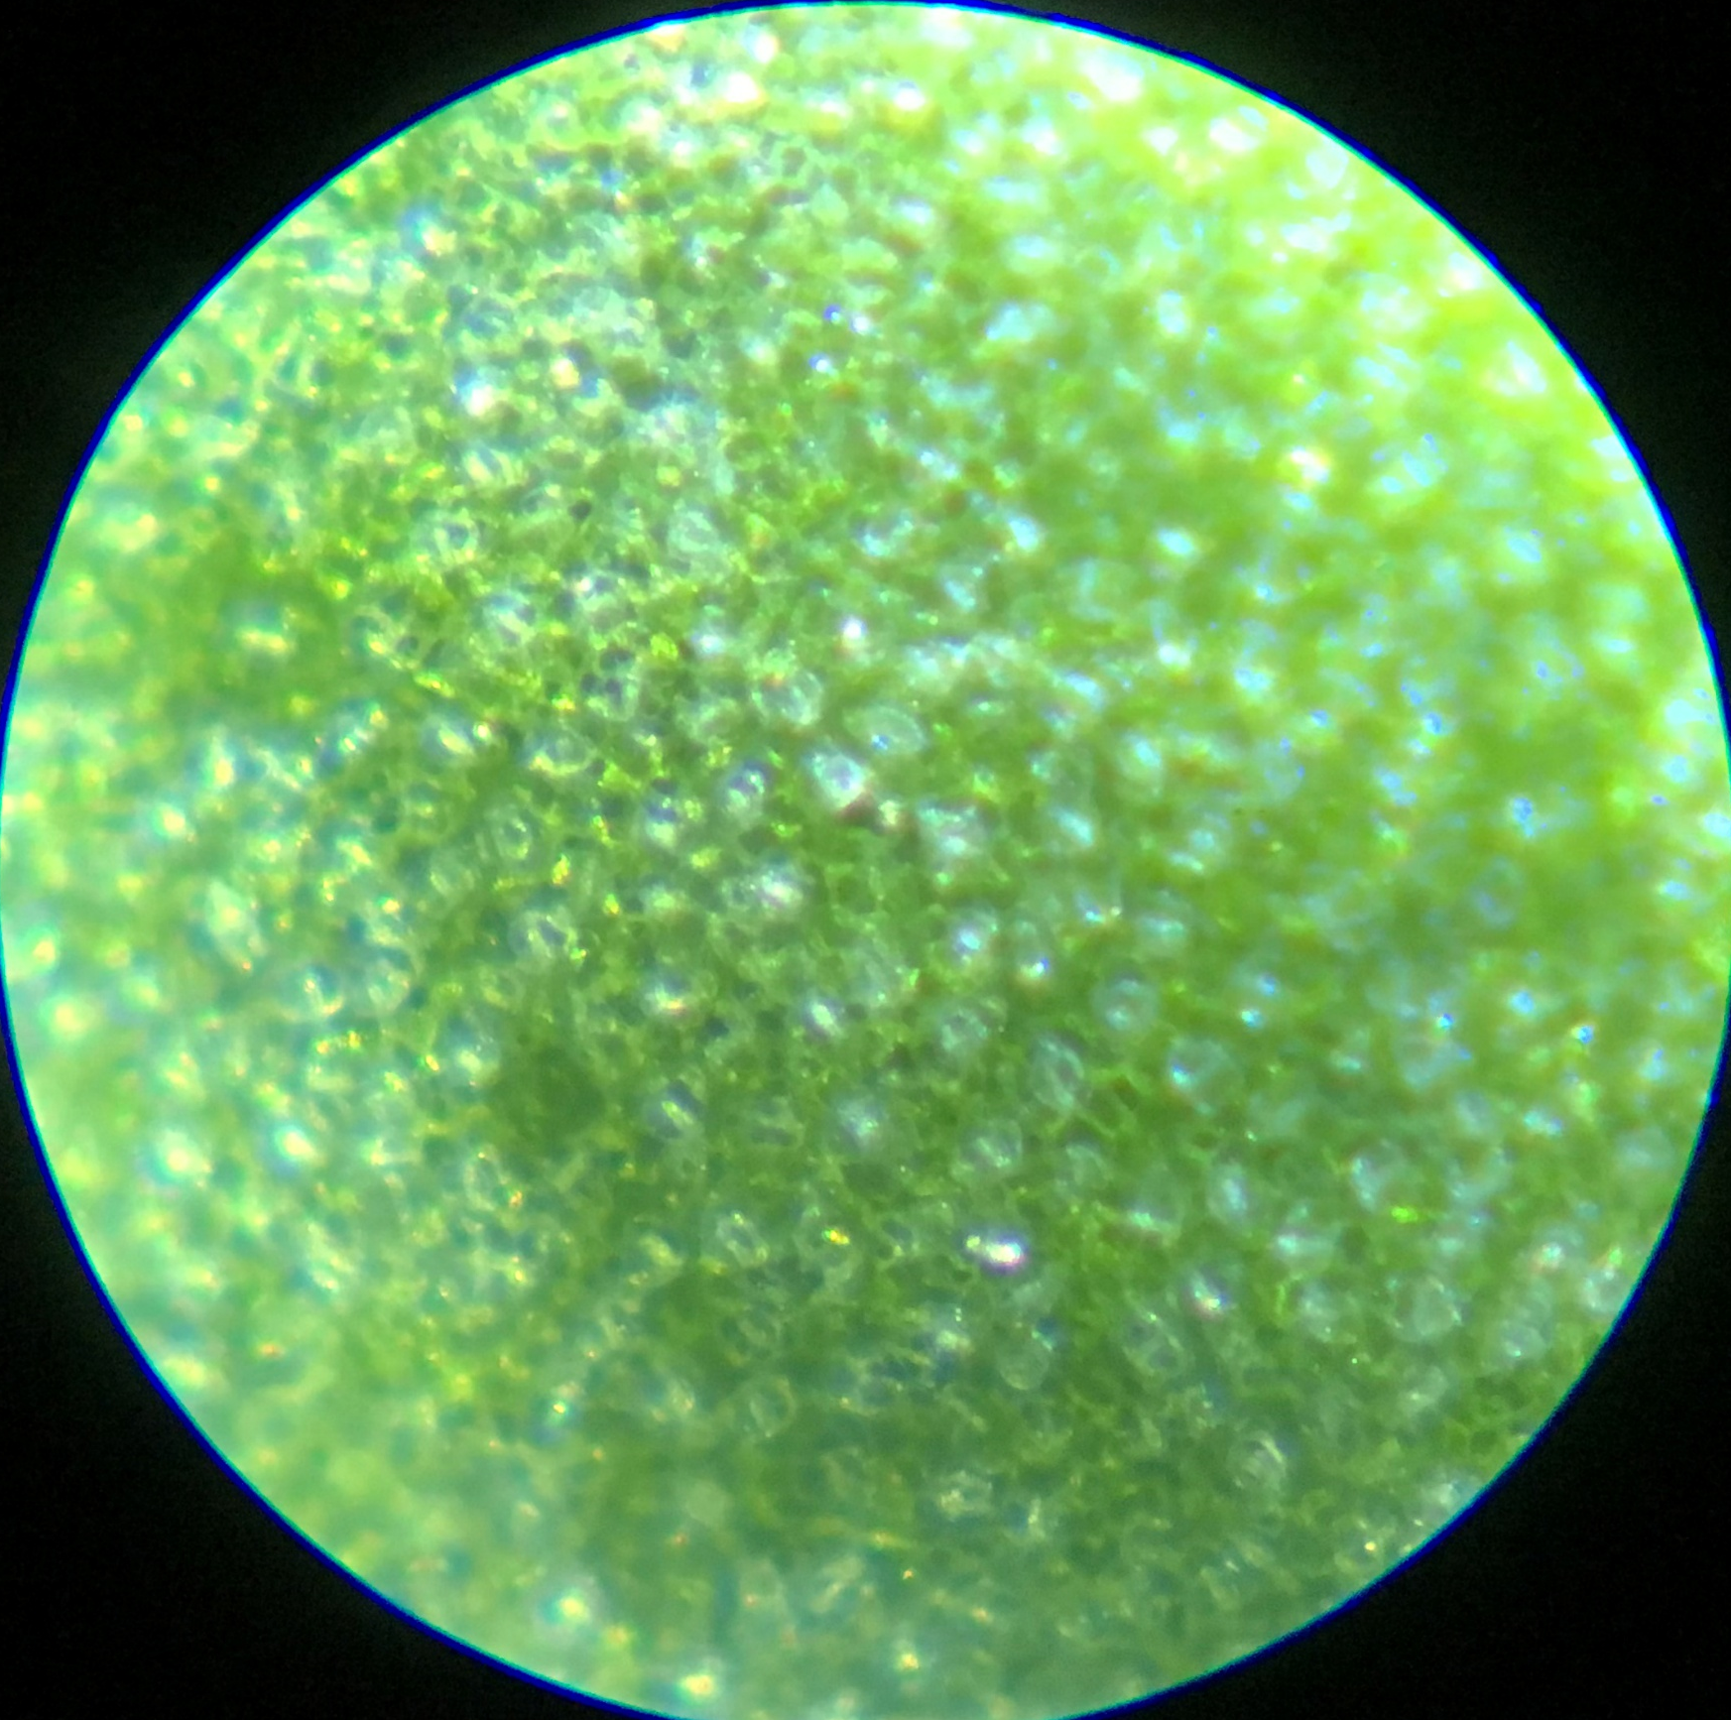
Leaf Blade
Notes:
Part of the leaf face

Slide 21
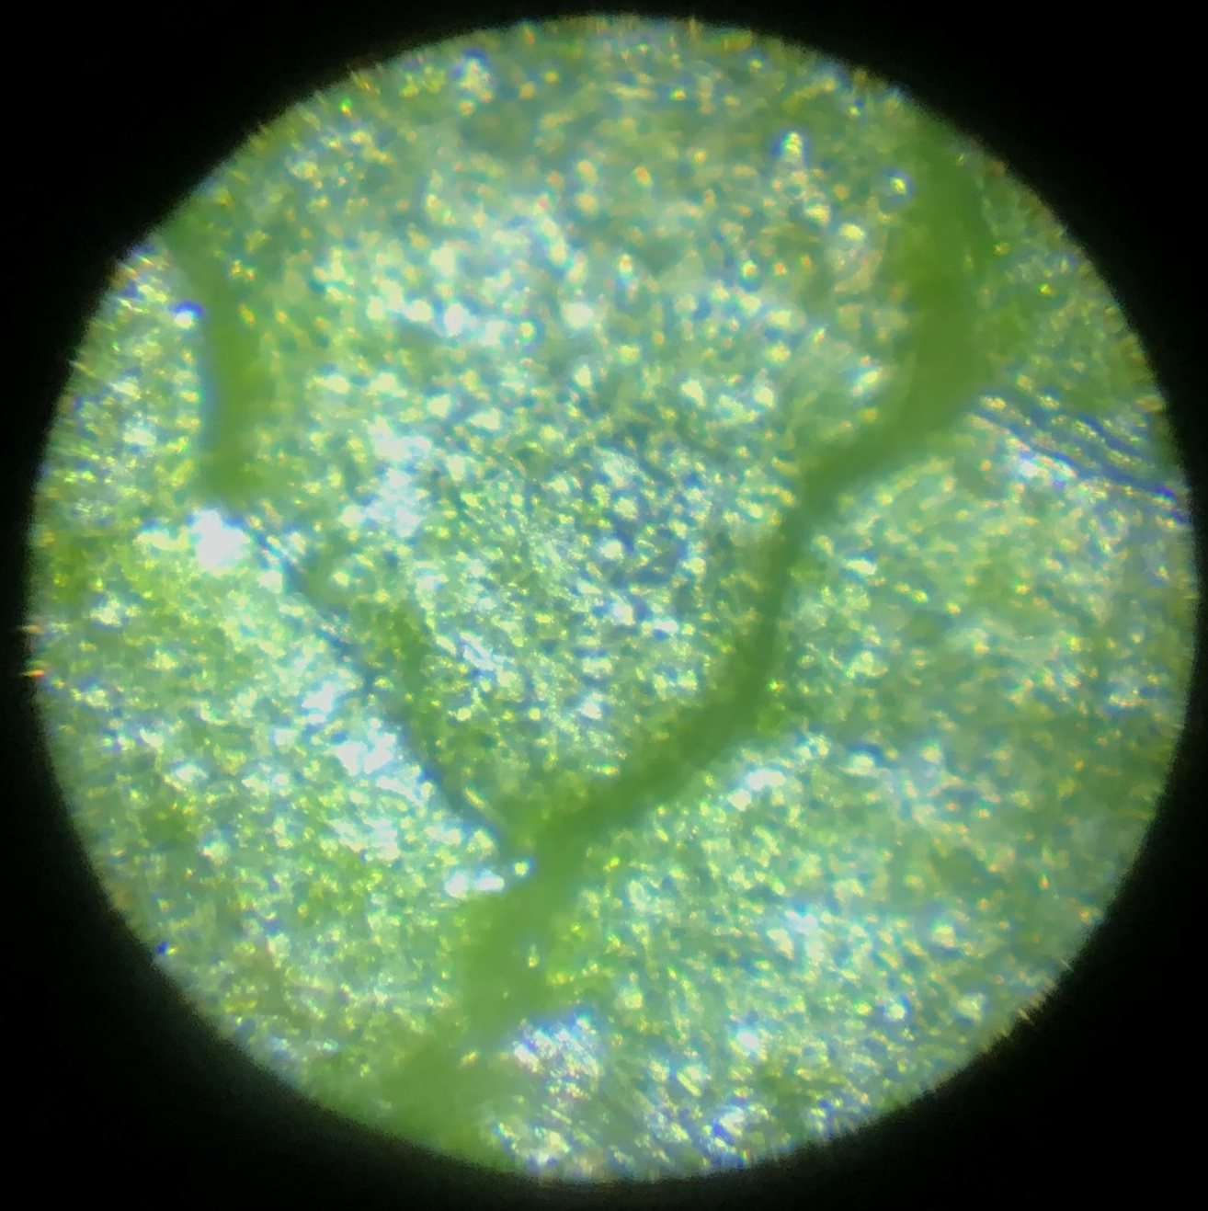
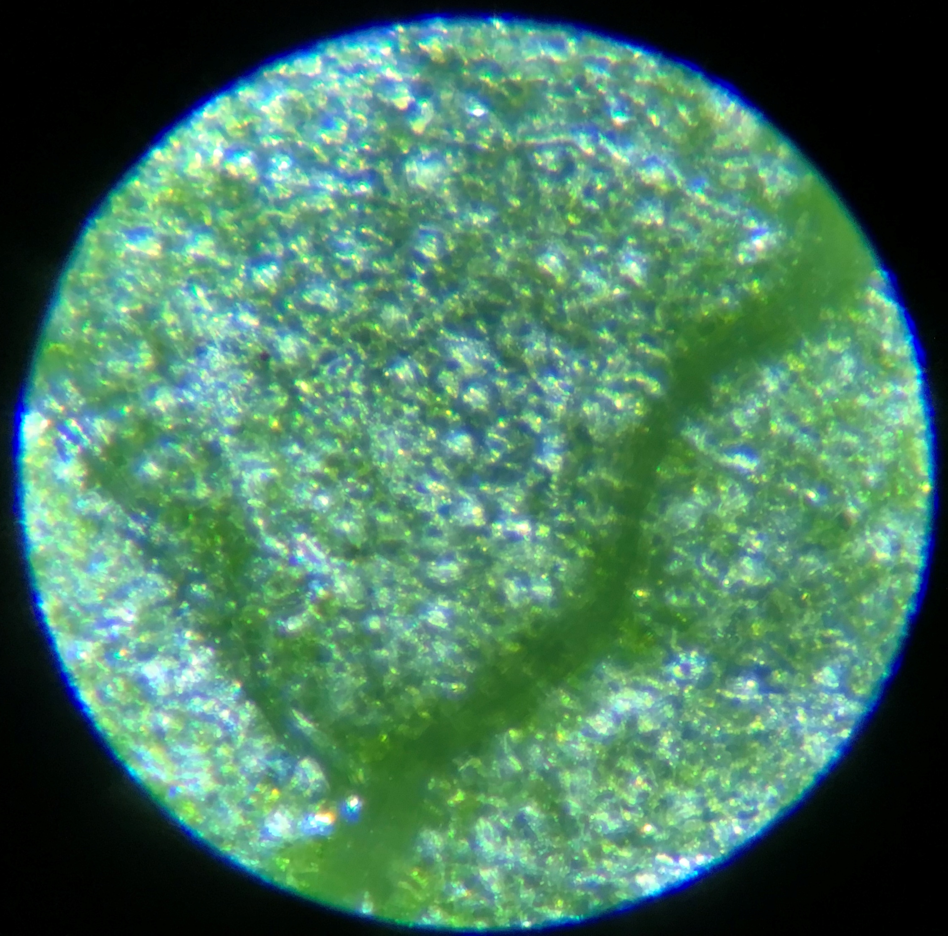
More Leaf Veins
Notes:
Vein with vascular tissue in the river portion (the dark side) if you look really close

Slide 22
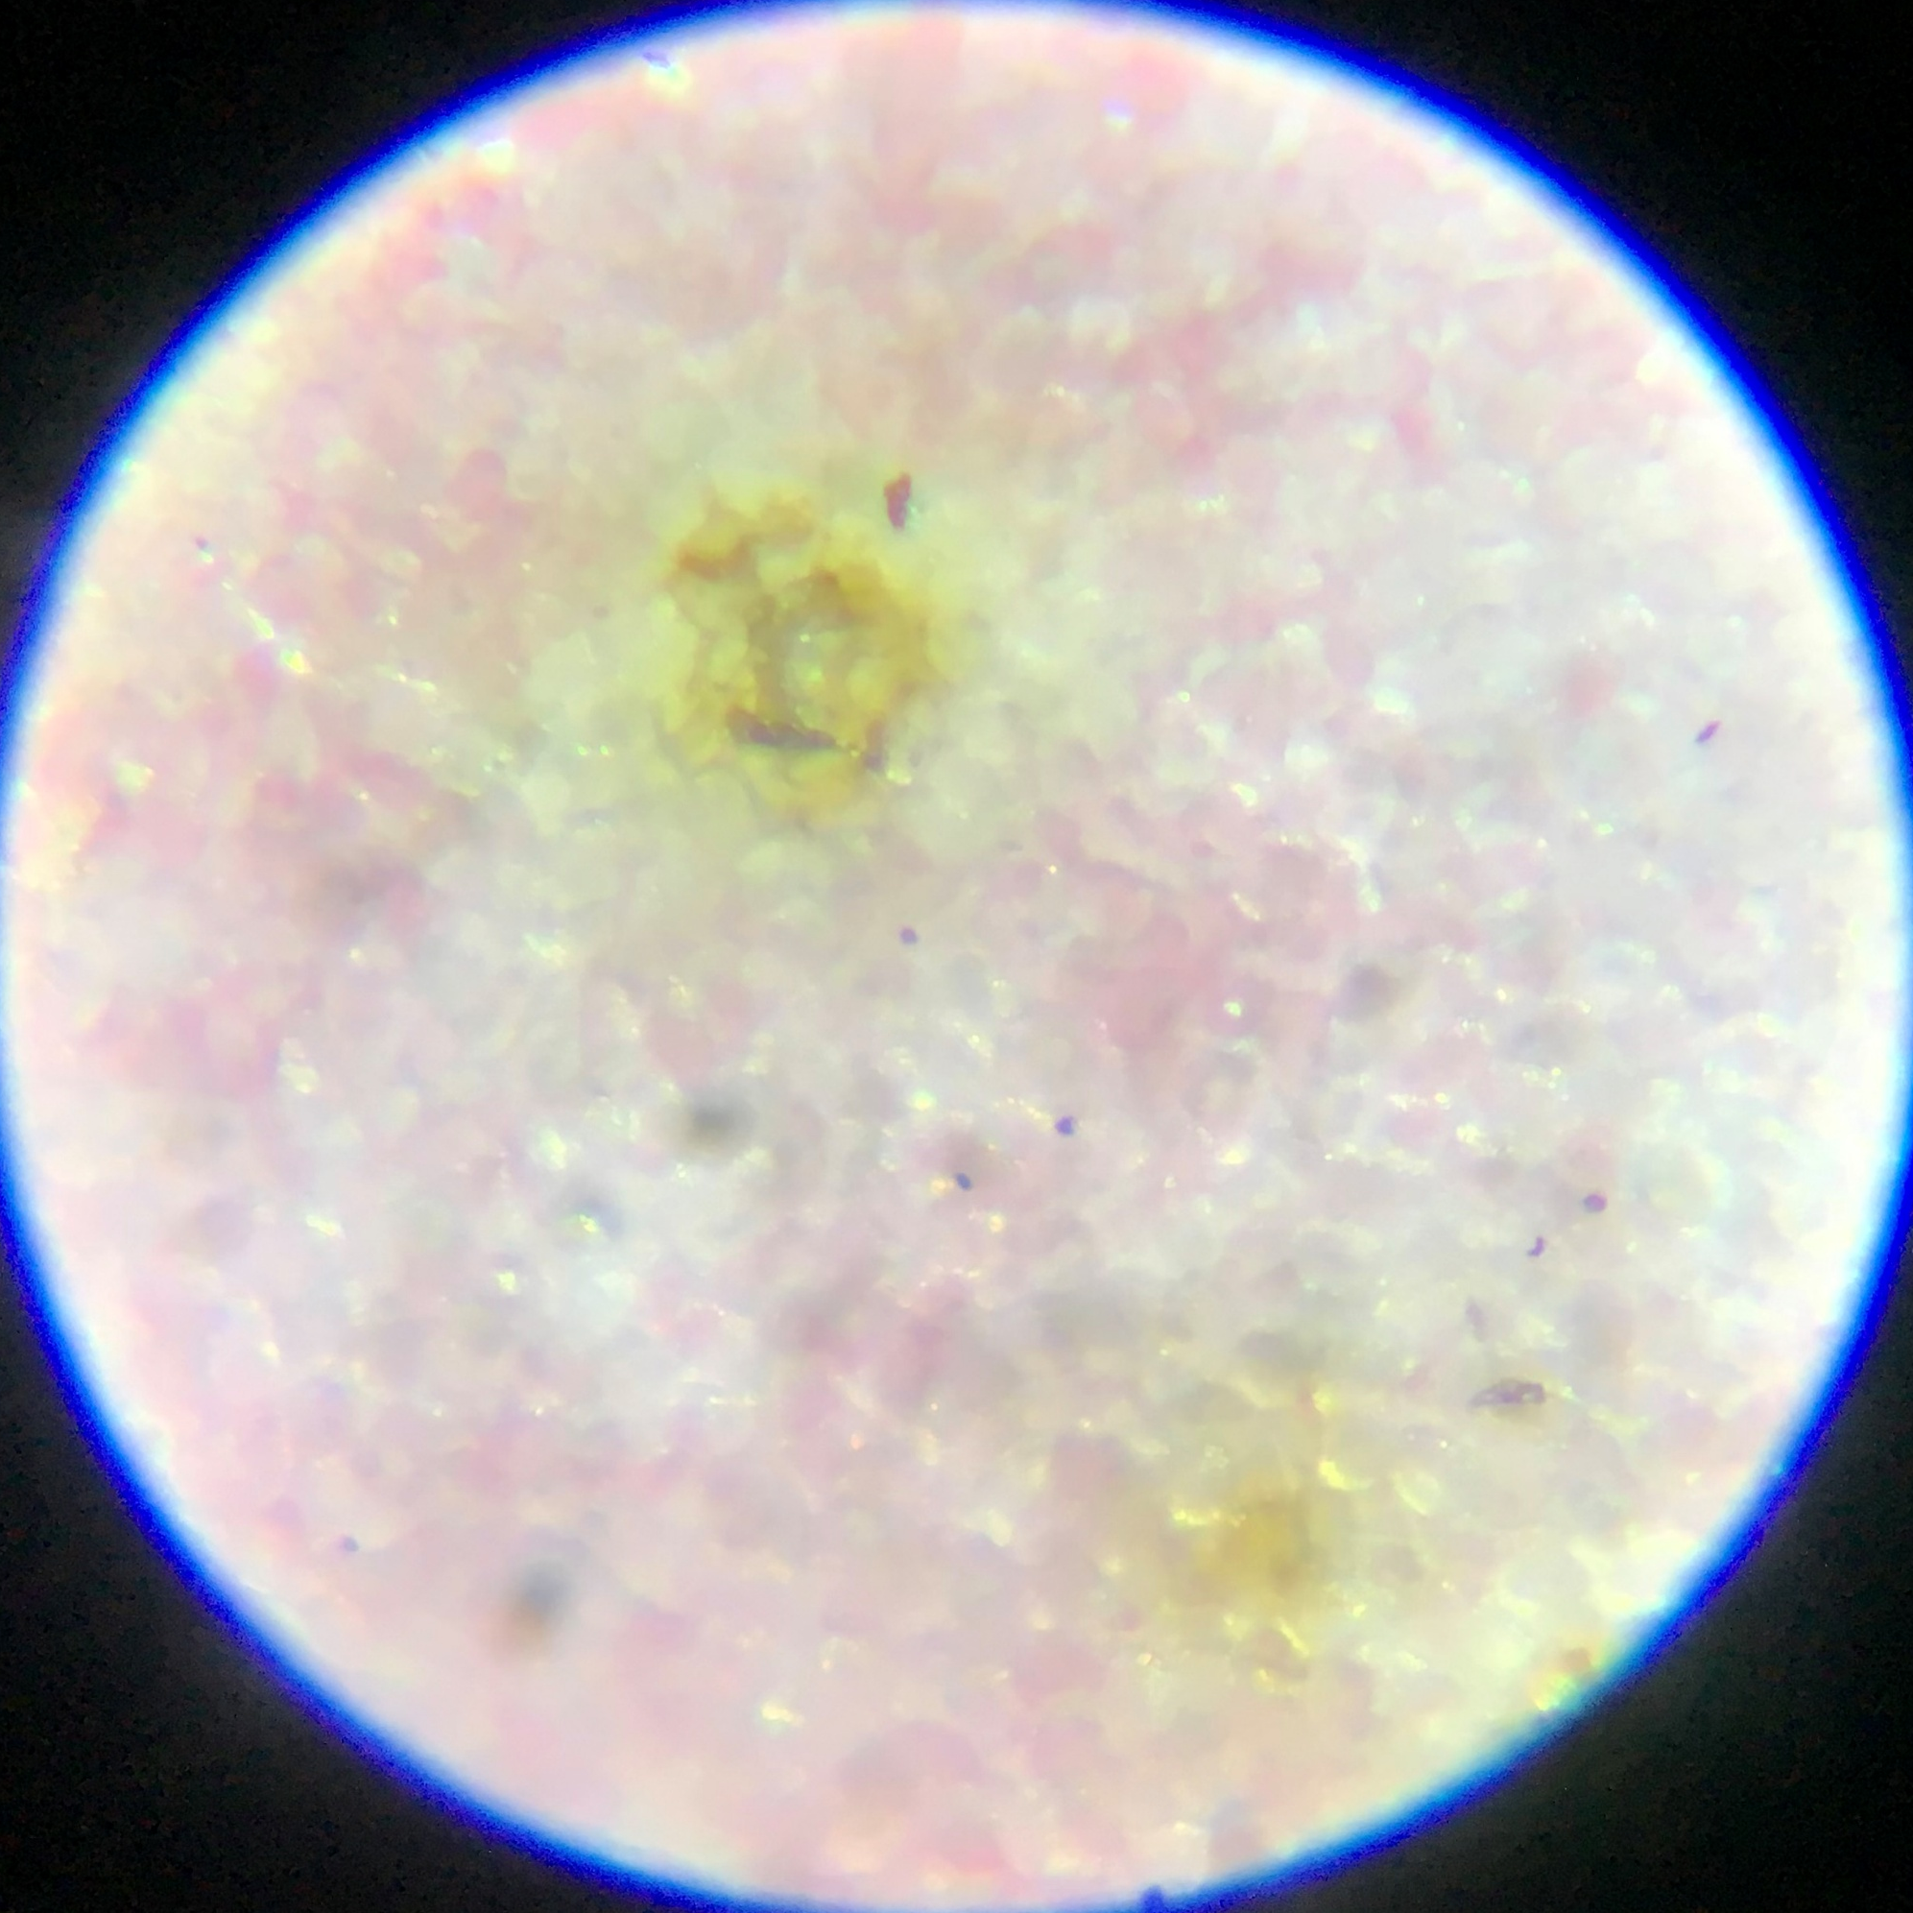
Flower Tissue with Damaged Spot
Notes:
Flower tissue with damaged spots on the flower tissue

Slide 23
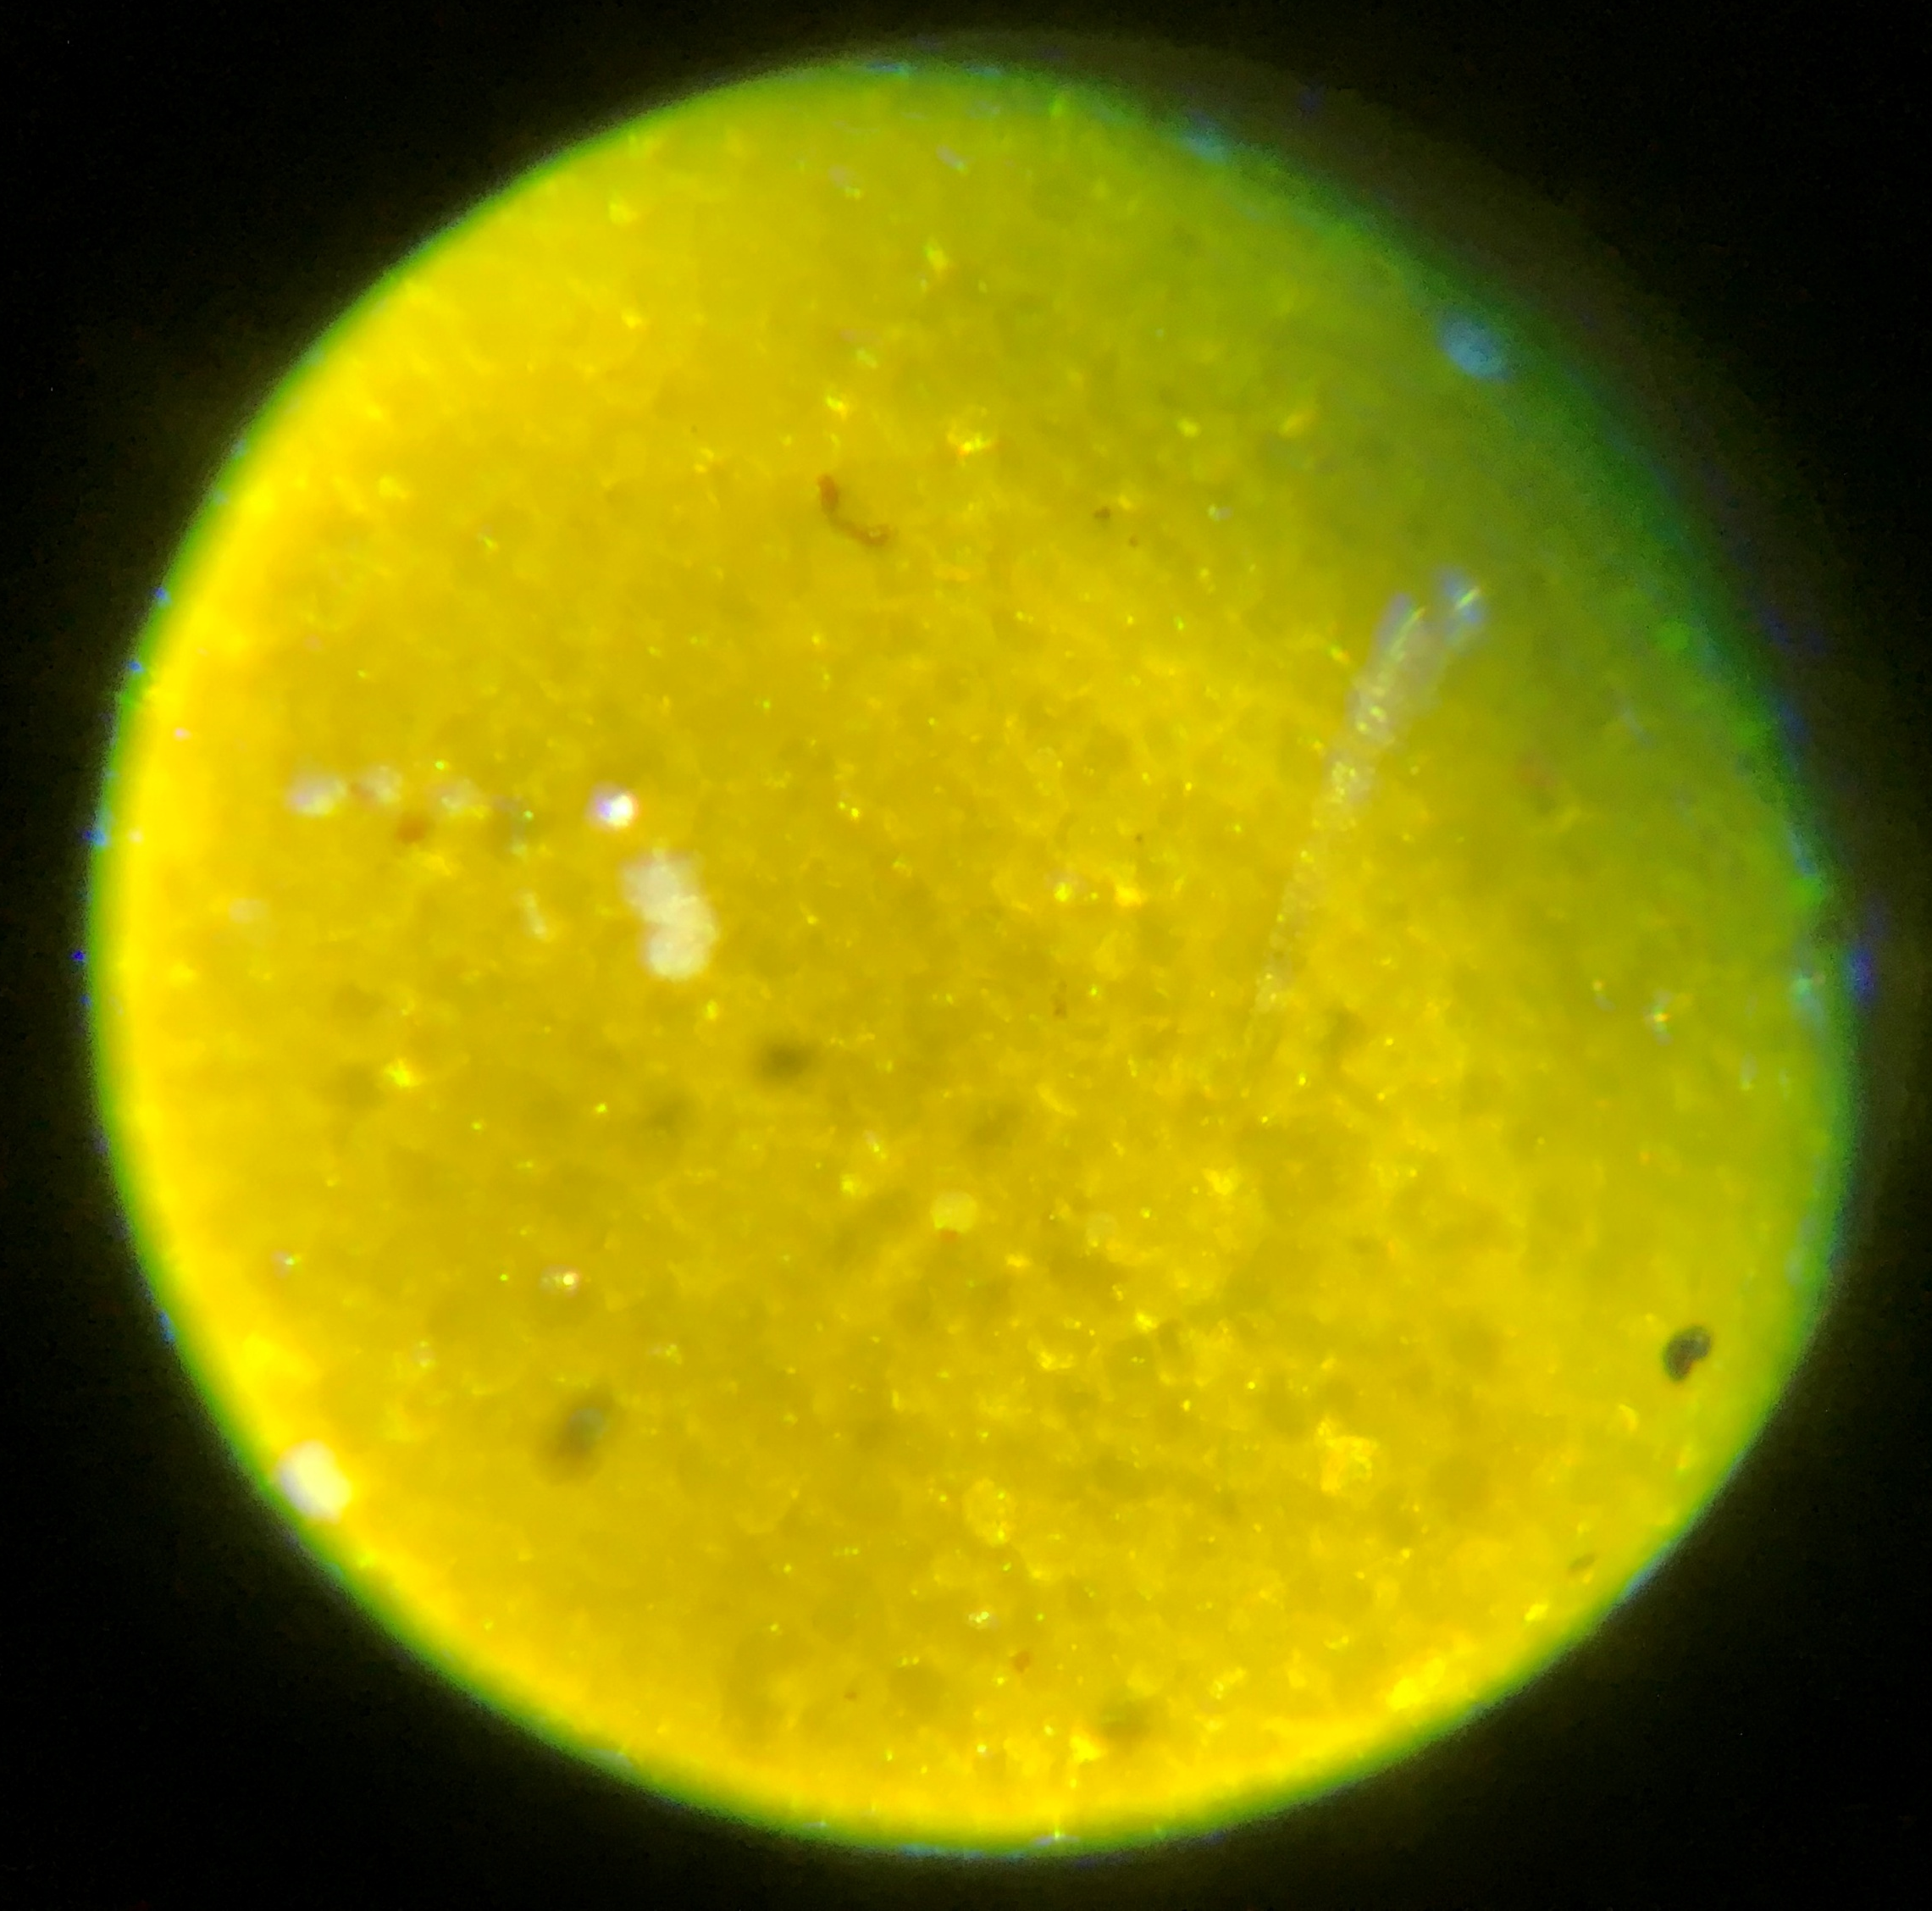
Sunflower Tissue
Notes:
Sunflower tissue

Slide 24
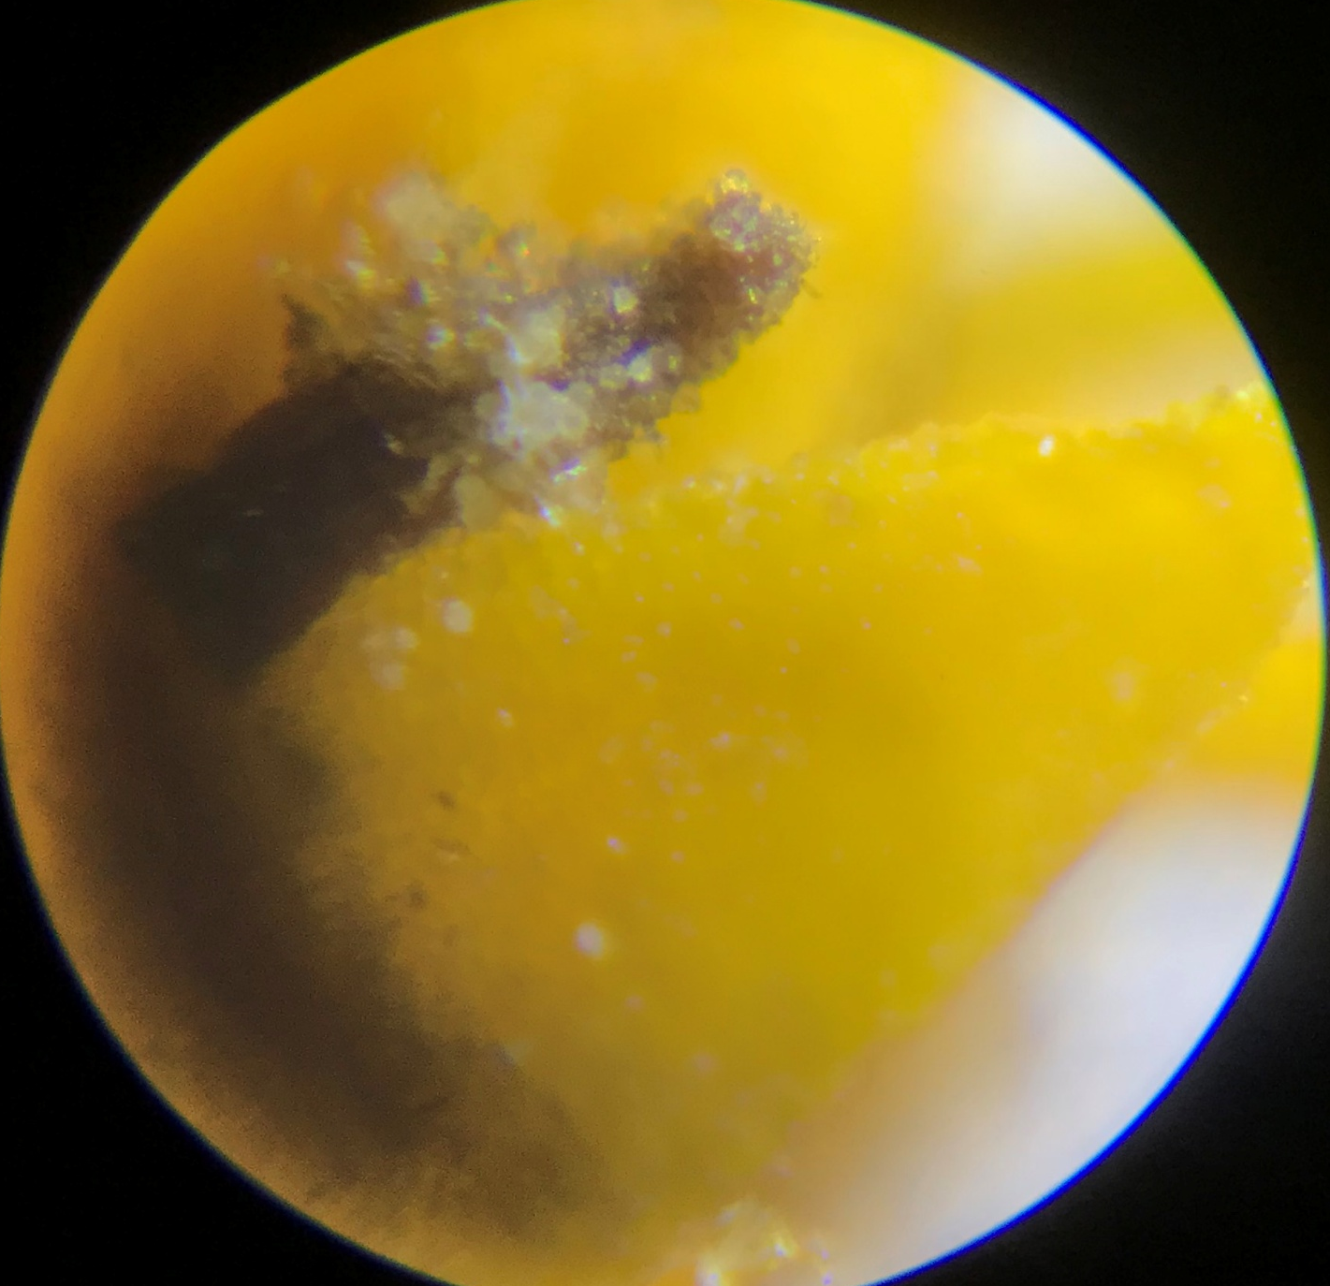
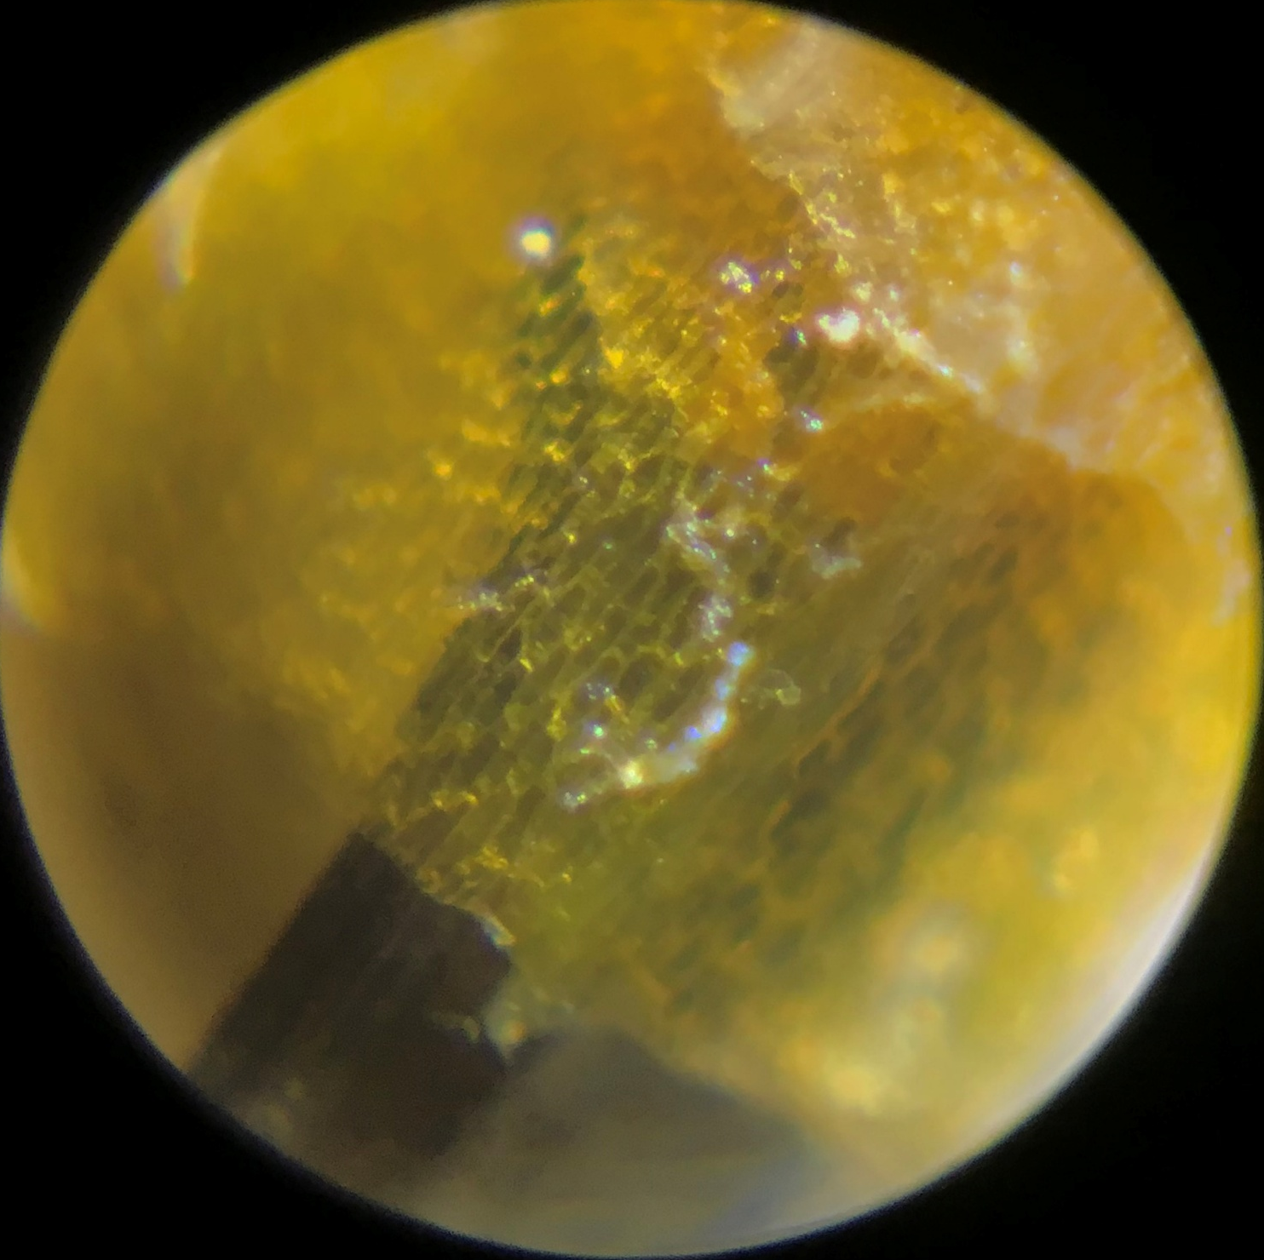
Ray Flowers
Notes:
Ray flowers (the inside cone structure of the sunflower). So they are the fertile flowers. The showy ones on the outside are not on fertile.

Slide 25
Grant Acknowledgements
This material is based upon work supported by the National Science Foundation under Grant No. 2202151. Any opinions, findings, and conclusions or recommendations expressed in this material are those of the author(s) and do not necessarily reflect the views of the National Science Foundation.

