Slide 1

Drones

Slide 2
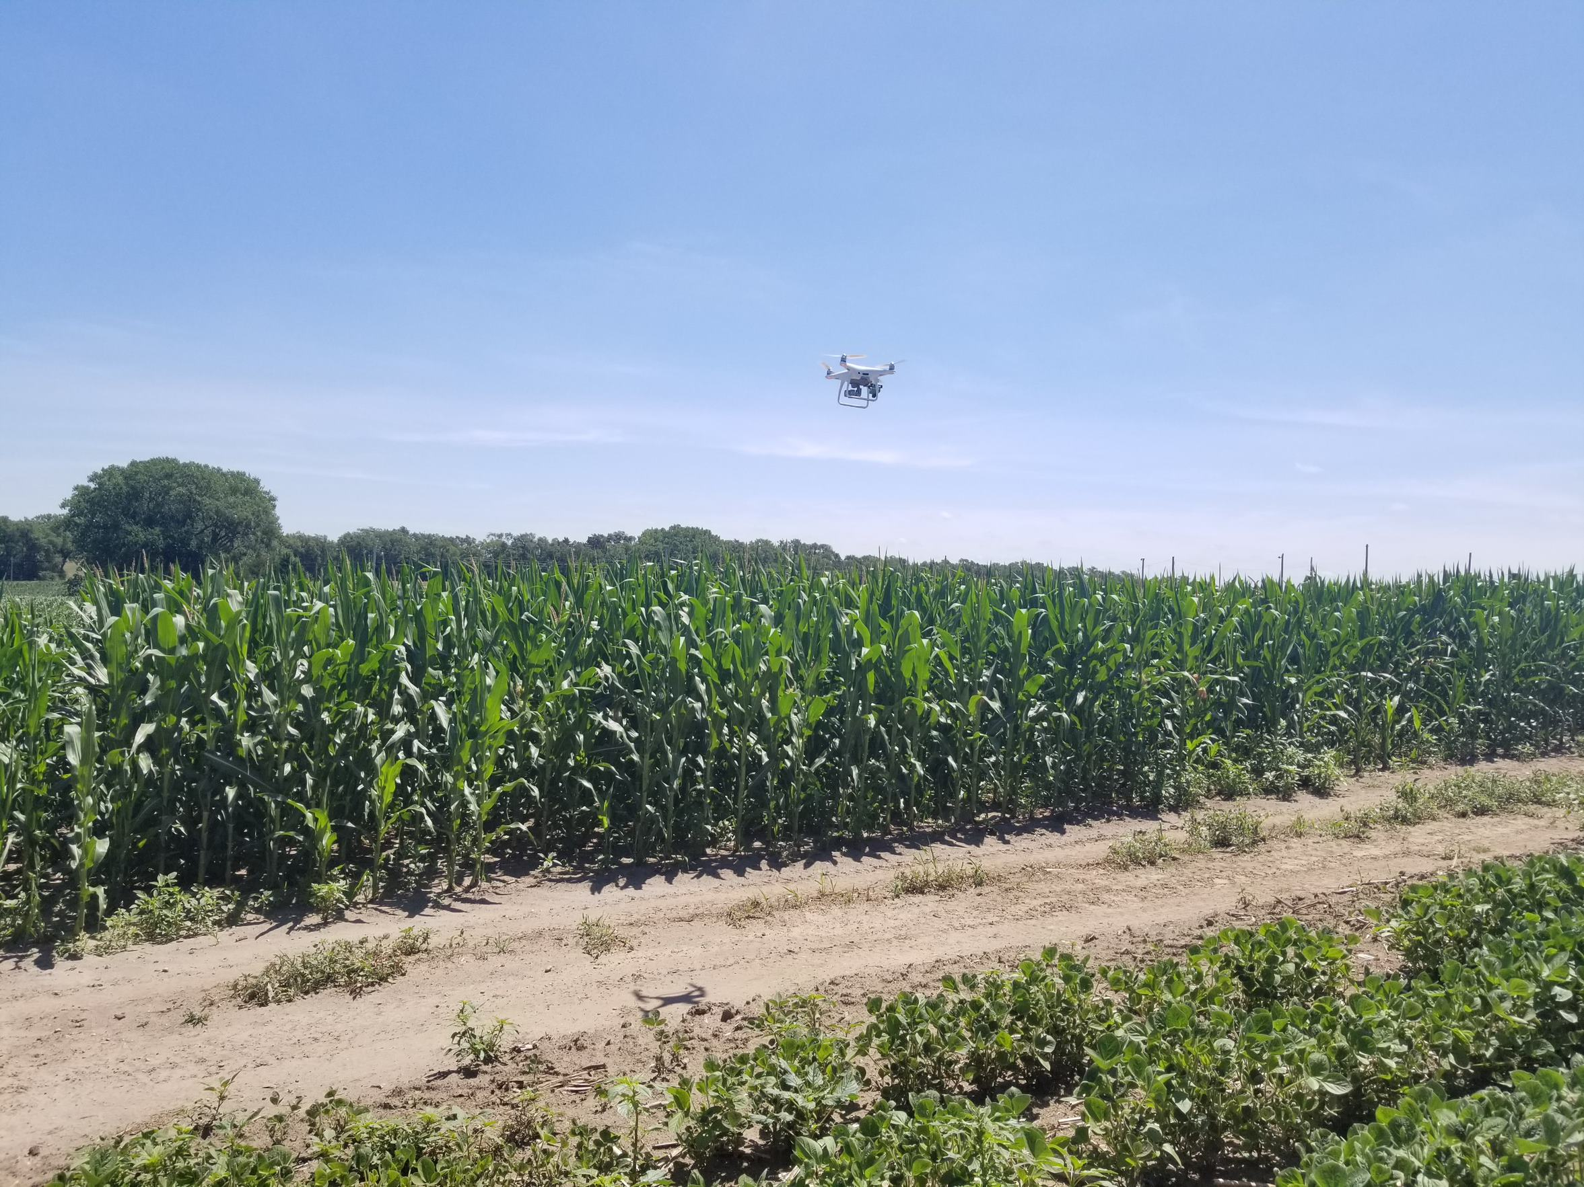
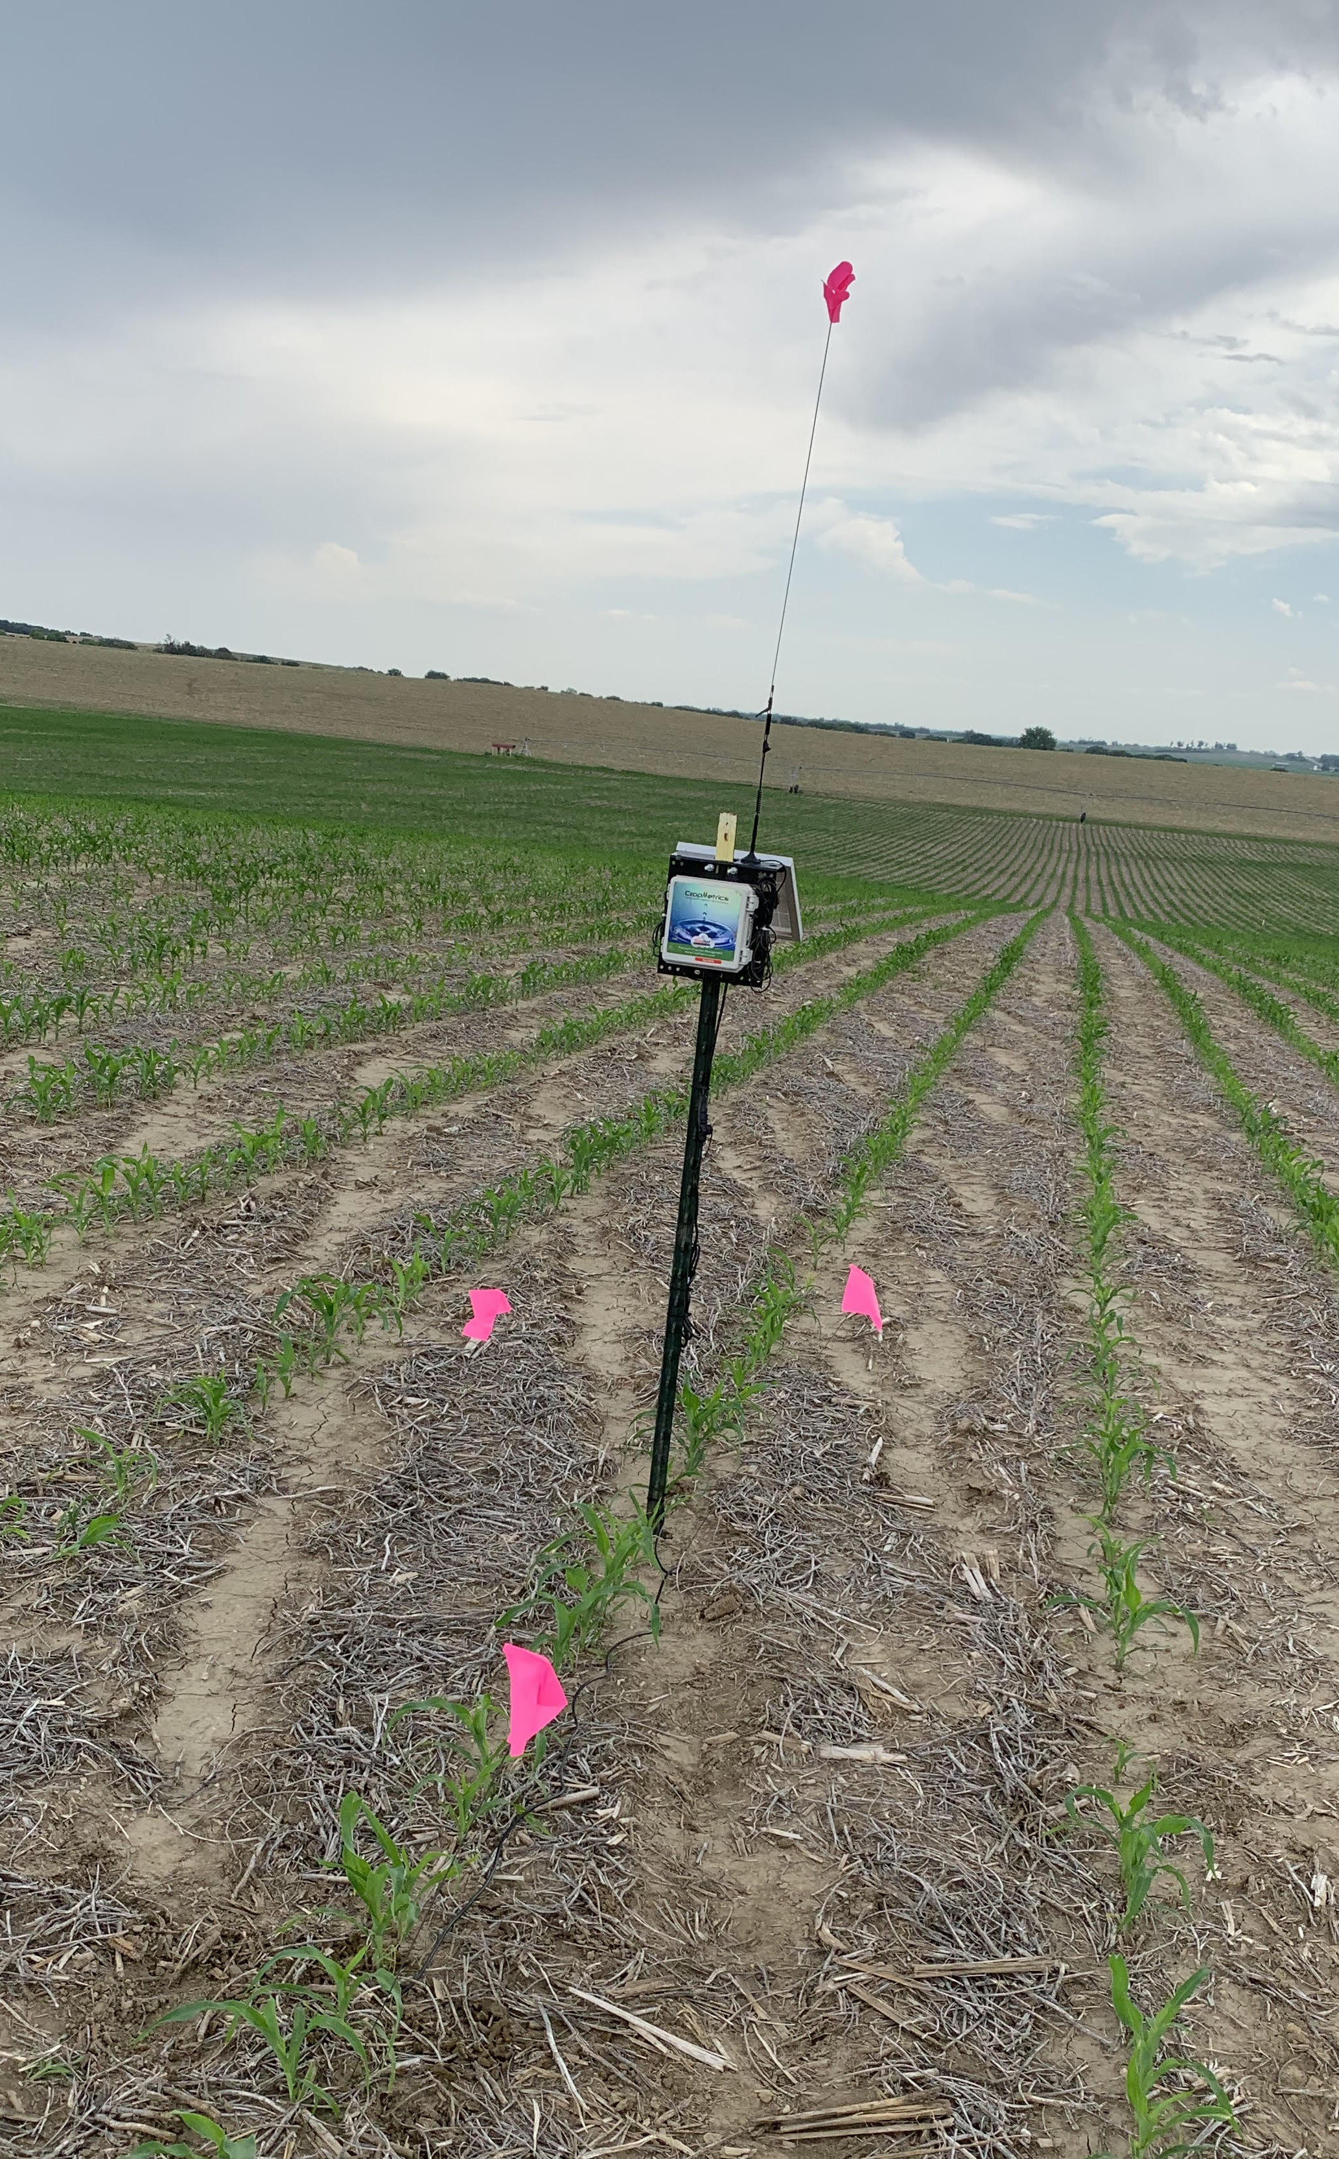
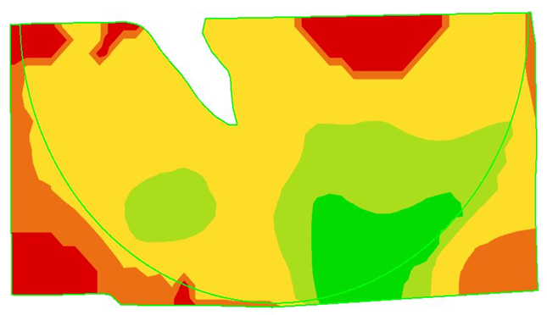
When you hear the words, “precision agriculture”, what do you think of?
Photos courtesy of Courtney Nelson and Rob Thomas
Notes:
Pose this question to your students and see what sort of responses you get. You can use this question for their journal question/question of the day/etc. I have these pictures all staggered on transitions, so the drone photo comes first, then the soil moisture probe, then the “pretty map”. Those are some of the first things that my mind wanders to. You can share your own thoughts with the class. This rolls into the next slide sharing what precision ag really is.

Slide 3
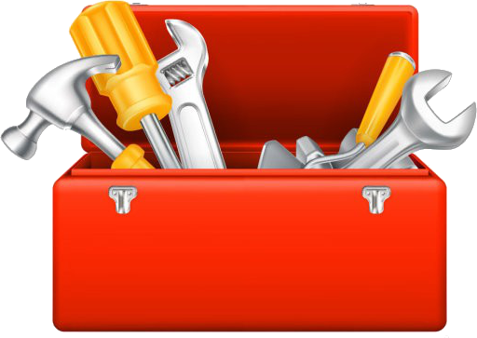
What is Precision Ag?
Is a method of farm management
Being intentional with our decision-making
Technology is a tool in our toolbox to enhance our decision making
Optimizing results with less inputs
Stock photos, royalty-free images, graphics, vectors & videos | Adobe Stock
Notes:
While all the things on the last slide are precision ag tools, I want to encourage you to think of precision ag as not just the technology. I challenge you to think about it as a method of farm management. We will dive deeper in further units about the differences in traditional and precision ag practices, but you can explain now that this is us being intentional with our decisions. Saying that we are going to make a specific recipe of a feed ration rather than just throwing in a touch a silage, some hay, maybe some soybean meal today because I’m feeling adventurous. This is also not us going to one area of the field to sample then doing things for the field based on that one spot. This is us working to collect data and going one step further to make sense of the data. Technology is that tool to help us enhance our decision making. “optimizing results with less inputs”. Break down words as needed. I connect optimization to something that they have done or will soon do in math for example. I will have an example where I say, if you are making Chex Mix, you want to have the right mix. Don’t want it too heavy on the Chex, or the M&M’s. Want to find that sweet spot in the middle where you have the mix of sweet and salty. That’s a fun example, and I’d encourage you to share another one if you have one.

Slide 4
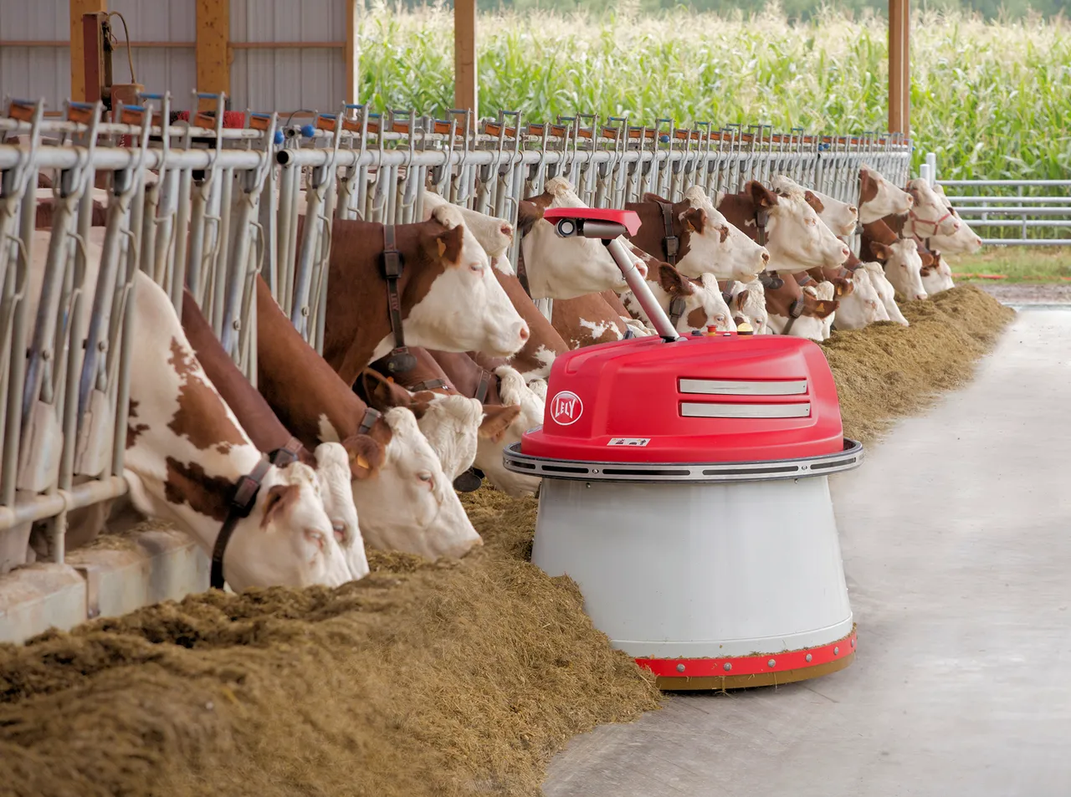
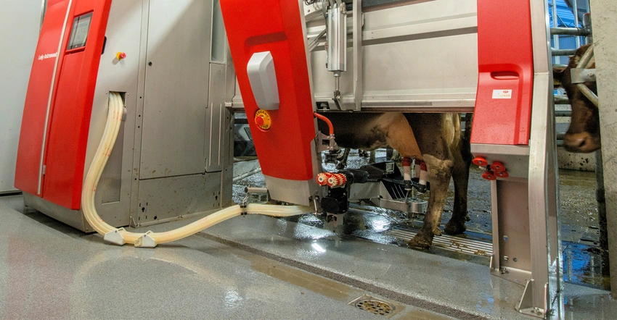
Some Examples
Robotic Dairies
Collars and Robot Sweeper
Photo courtesy of Farm Progress
Notes:
Management of Fertilizer, Water, Seed/population, and Feed mix/rations. More on this to come. This is to showcase to examples of precision ag to give them a better idea of what this entails. If you have any other examples, please share.
Lely's updated dairy robots work faster, smarter

Slide 5
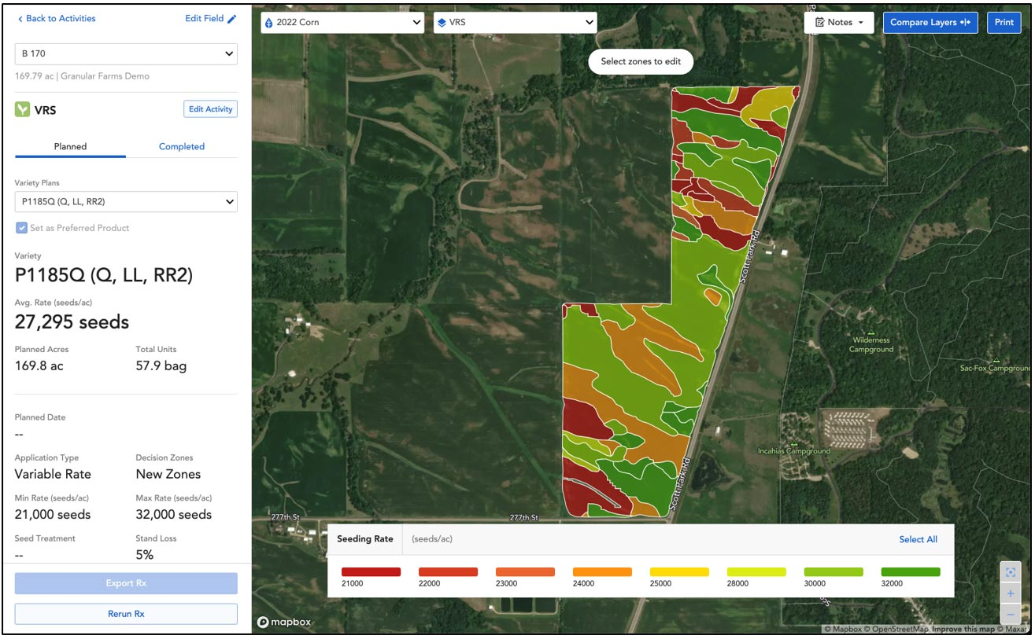
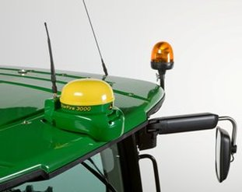
Examples
Global Positioning Systems
Variable Rate Technology
Notes:
Variable Rate Seeding Photo: Putting Variable-Rate Seeding to Work on Your Farm | Pioneer® Seeds

Slide 6

Why does it all matter?
Globally
  Feeding 9.7 billion by 2050
  Produce more with less
    We’re not gaining more farm ground
Photo courtesy of Microsoft Stock Images
Notes:
It is helpful, as you consider careers, to ponder what problems you enjoy solving. Even when you go to sport events or scroll Tik Tok, you are solving a boredom problem that you are working to fix. You want entertainment, so those are examples of solutions. Let’s jump into the “why” of precision ag before we go too much further. On a global scale, we have to feed 9 billion people by 2050. This will continue to be talked about until 2050, so you will hear about this in college, especially if you go into an agriculture degree. How can we work to accomplish this with urban sprawl? Precision ag may be an option to help us be intentional with the land that we have.
A fun suggestion for you: do the Earth as an Apple demonstration! A link explaining the activity can be found here: Earth as an Apple – Earth Day Activity – Eat Well (canolaeatwell.com)

Slide 7
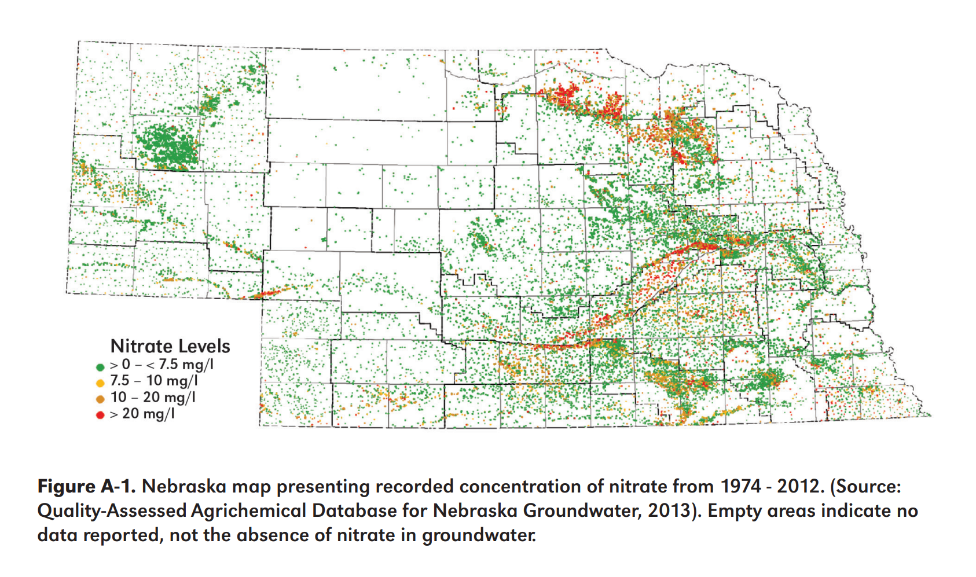
L
O
C a l
Sustainability, Economic, Human Health
https://extensionpublications.unl.edu/assets/pdf/ec2008.pdf
Notes:
On a local level, nitrate problems. Discuss what is going on in this graph. Orange and red dots are problems, as the safe level for nitrate concentration in our water is less than 10 ppm or mg/L. Have them find where your school is on the map. Also see if they notice the trend that high nitrates follow the rivers in the state and land in areas near our riverbeds. This can trickle into conversations about items such as: load control, drought, Republican River debacle, conservation. These nitrate issues can ultimately cause health issues.
One example of a health issue is blue baby syndrome. This predominantly affects infants and elderly folks, but high nitrate concentrations can attack the oxygen in your blood. By blocking that oxygen, it makes it more difficult to breathe, and, in extreme cases, will cause their skin to physically turn blue since they can’t breathe properly. Health experts are also beginning to contribute nitrate levels to higher levels of cancer rates. In Platte County with families that live along the Loup River, they are beginning to see trends of colon cancer. They are starting to attribute this to the water quality in their region. Take-home message: water testing at home and being intentional with lawn and field fertilizer application is important.
Another “why” for farmers when if comes to wanting to adopt precision ag is profitability: help farmers bring more children back into the operation, or get them back to the operation sooner. Even allow the farmer in general to make a living.

Slide 8
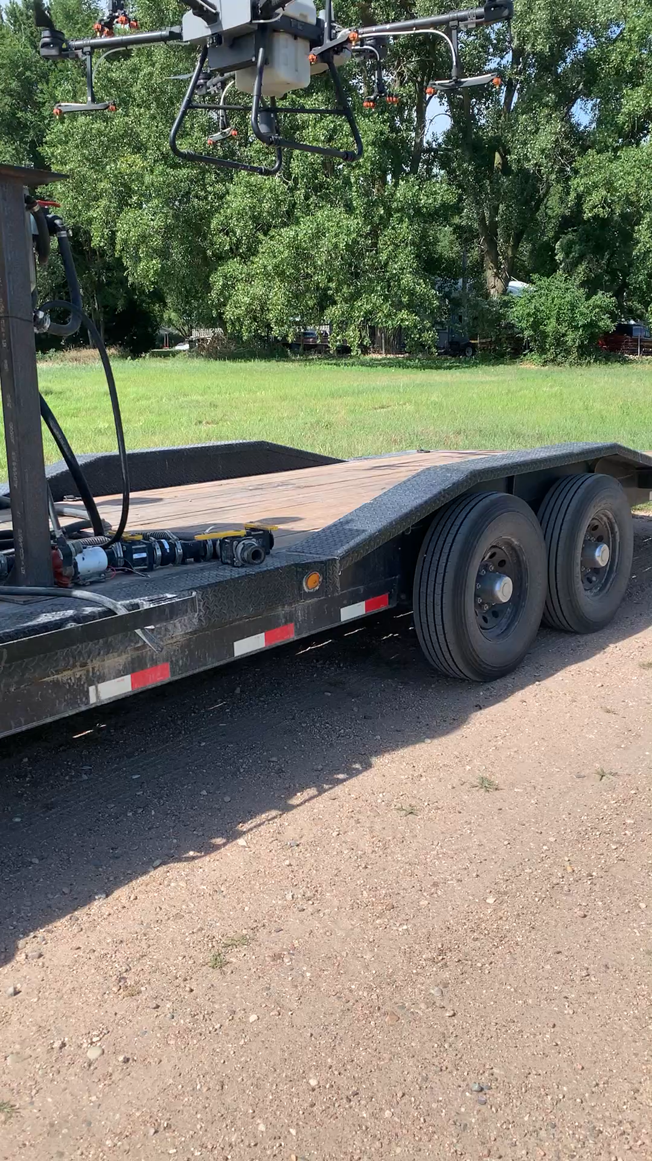
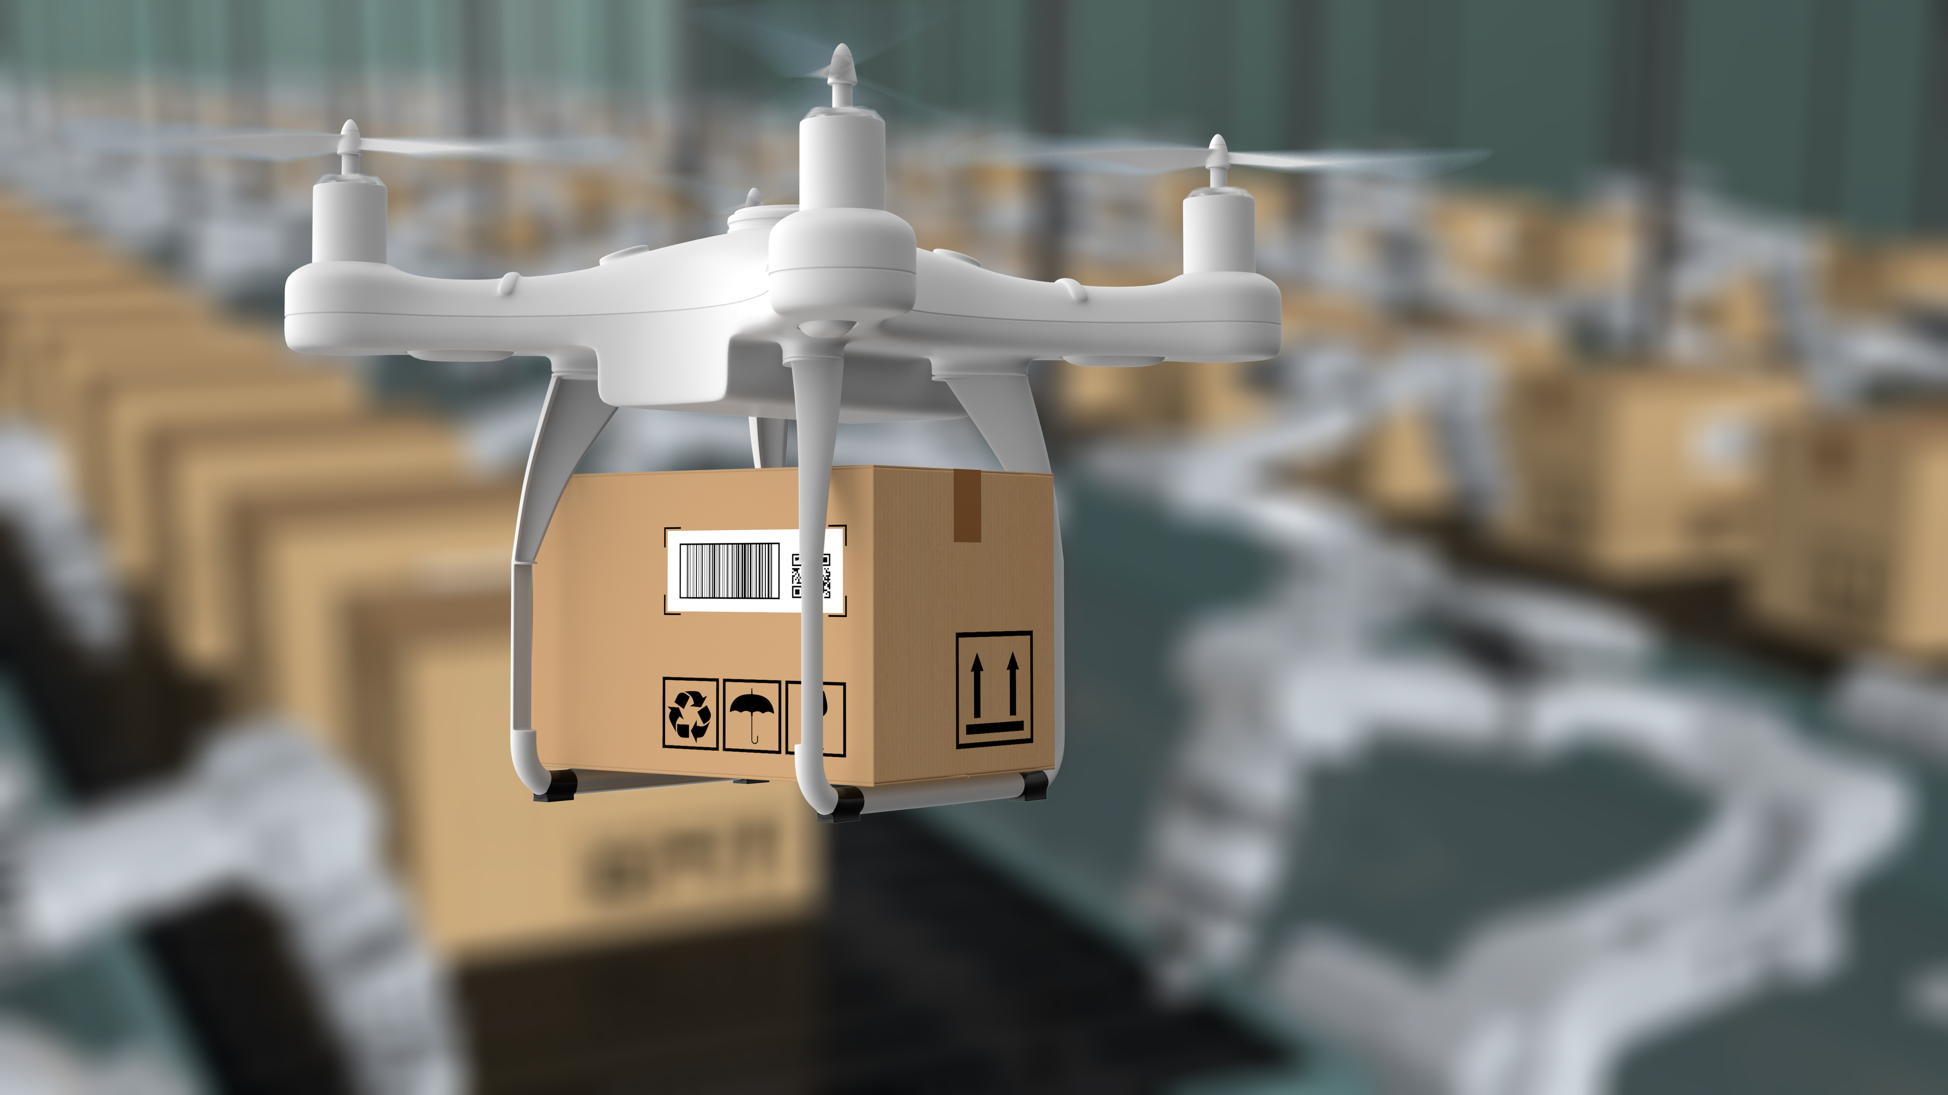
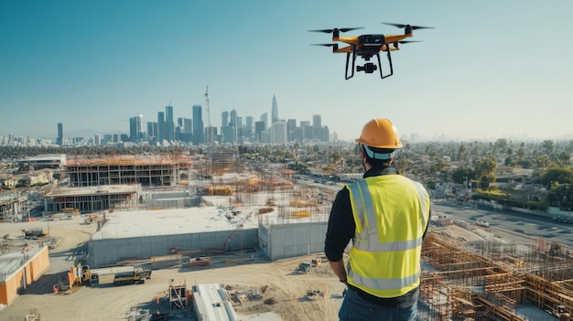
What are drones used for?
Notes:
Drones are used for many things: search and rescue, supposedly delivery, construction, real estate, and agriculture. I have a video here that shows us a spray drone fleet switching out for one drone to go out to the field and the other to come in to be refilled.
Drone Delivery Picture from Stock Images, Construction Image from freepik.com, video from Courtney’s camera roll

Slide 9
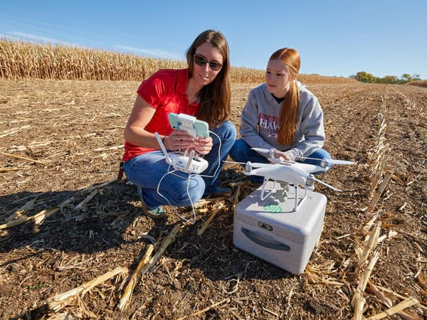
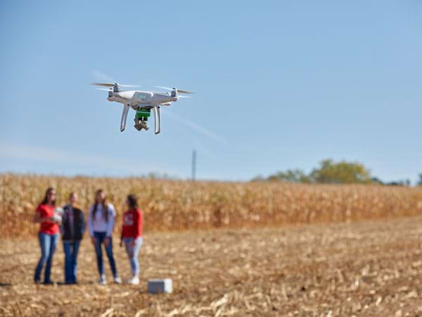
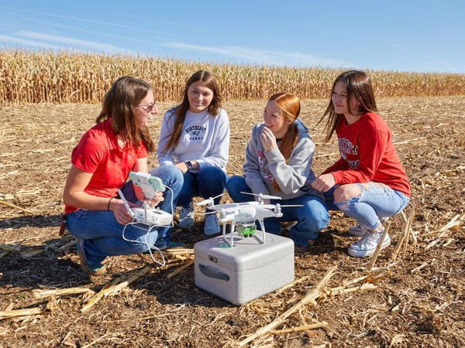
IN the Field
Notes:
Photos from Northeast Community College

Slide 10
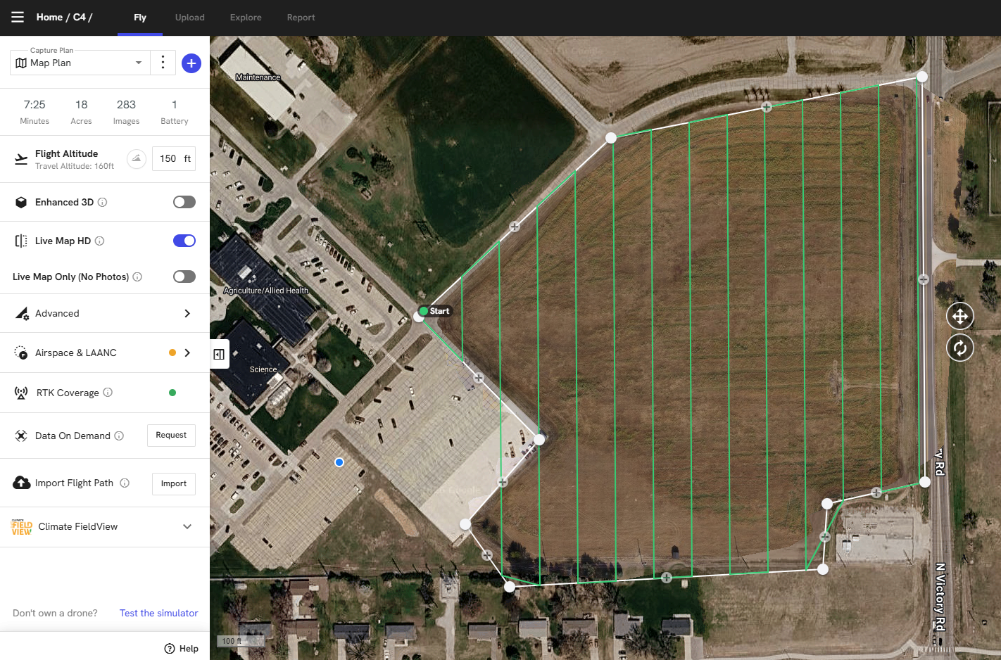
Drone Use in Agriculture
Mapping
  The set up
Notes:
Set up page for Drone Deploy. We have our boundary that we can set up initially, then it will remember this boundary each time we show up to fly. We can adjust our flight altitude, legally going up to 400 feet above ground level (AGL) without getting permission from the FAA. On our stats on the left, you can see that the current flight plan will take seven minutes and 25 seconds, it will cover 18 acres, and it will take 283 images during that time. A battery lasts about 25 minutes.

Slide 11
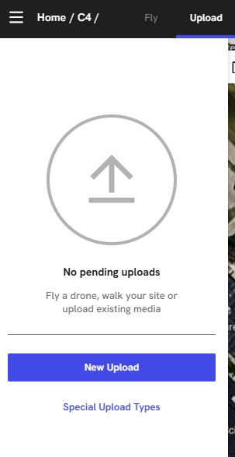
Upload Images

Slide 12
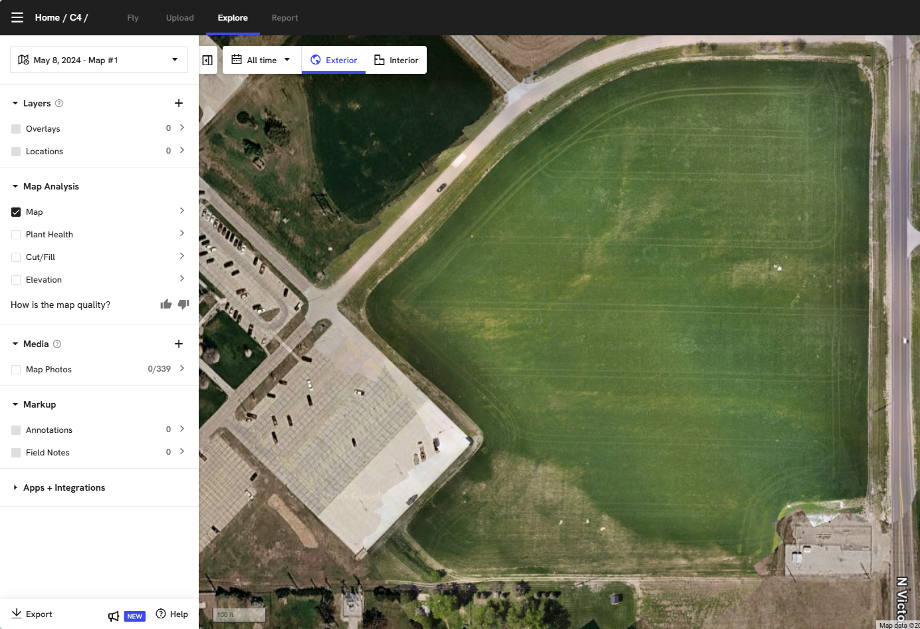
Explore Page
Basic RGB Imagery
Notes:
RGB-Red Green Blue. These are the bands of light in the Visible Light Spectrum, the bands of light we see with our human eyes.

Slide 13
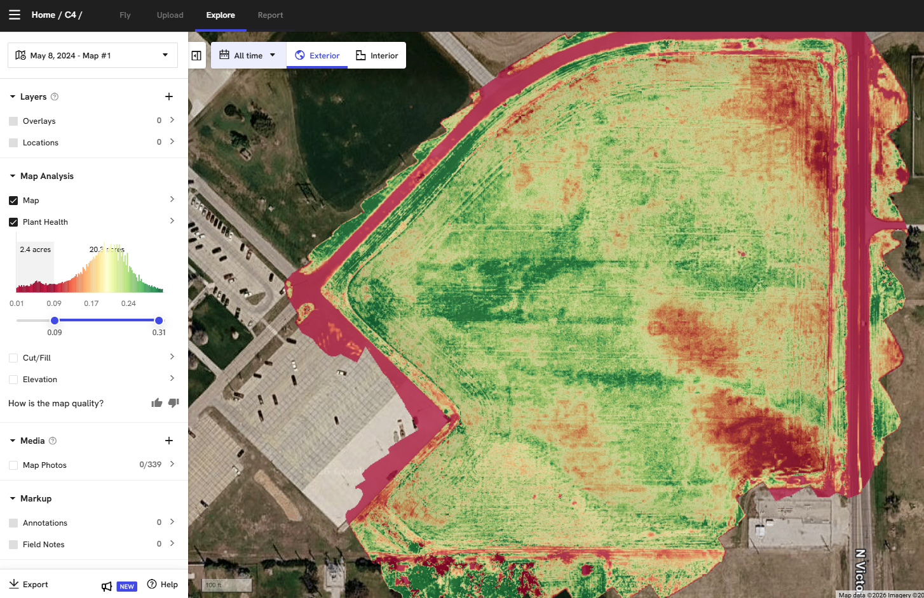
Explore Layers
NDVI Imagery
Notes:
We can look beyond the Visible Light Spectrum to see issues in the field sooner than we can notice them with our human eye. This is a map showing us our NDVI Imagery. The red is the worst performing part of that field and green is the best.

Slide 14
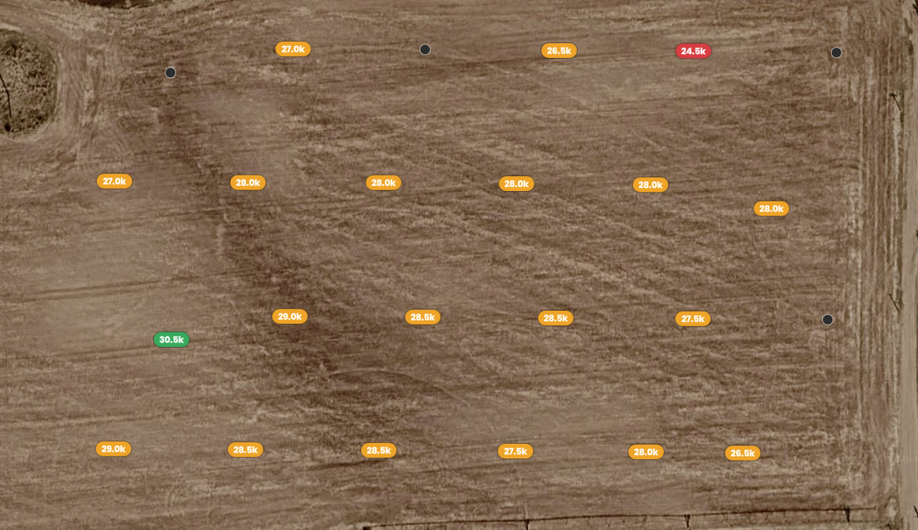
Stand Count
Notes:
Another use for mapping is to give us some stand count values. This is valuable because we can see stand counts across a larger stretch of a field than what we can just count by hand. Nice resource. And we can still do the hand method to calibrate this and help us gauge how accurate this is. Note: this has to be done by about V2 before all the leaves start to touch each other. Otherwise, the values get skewed.

Slide 15
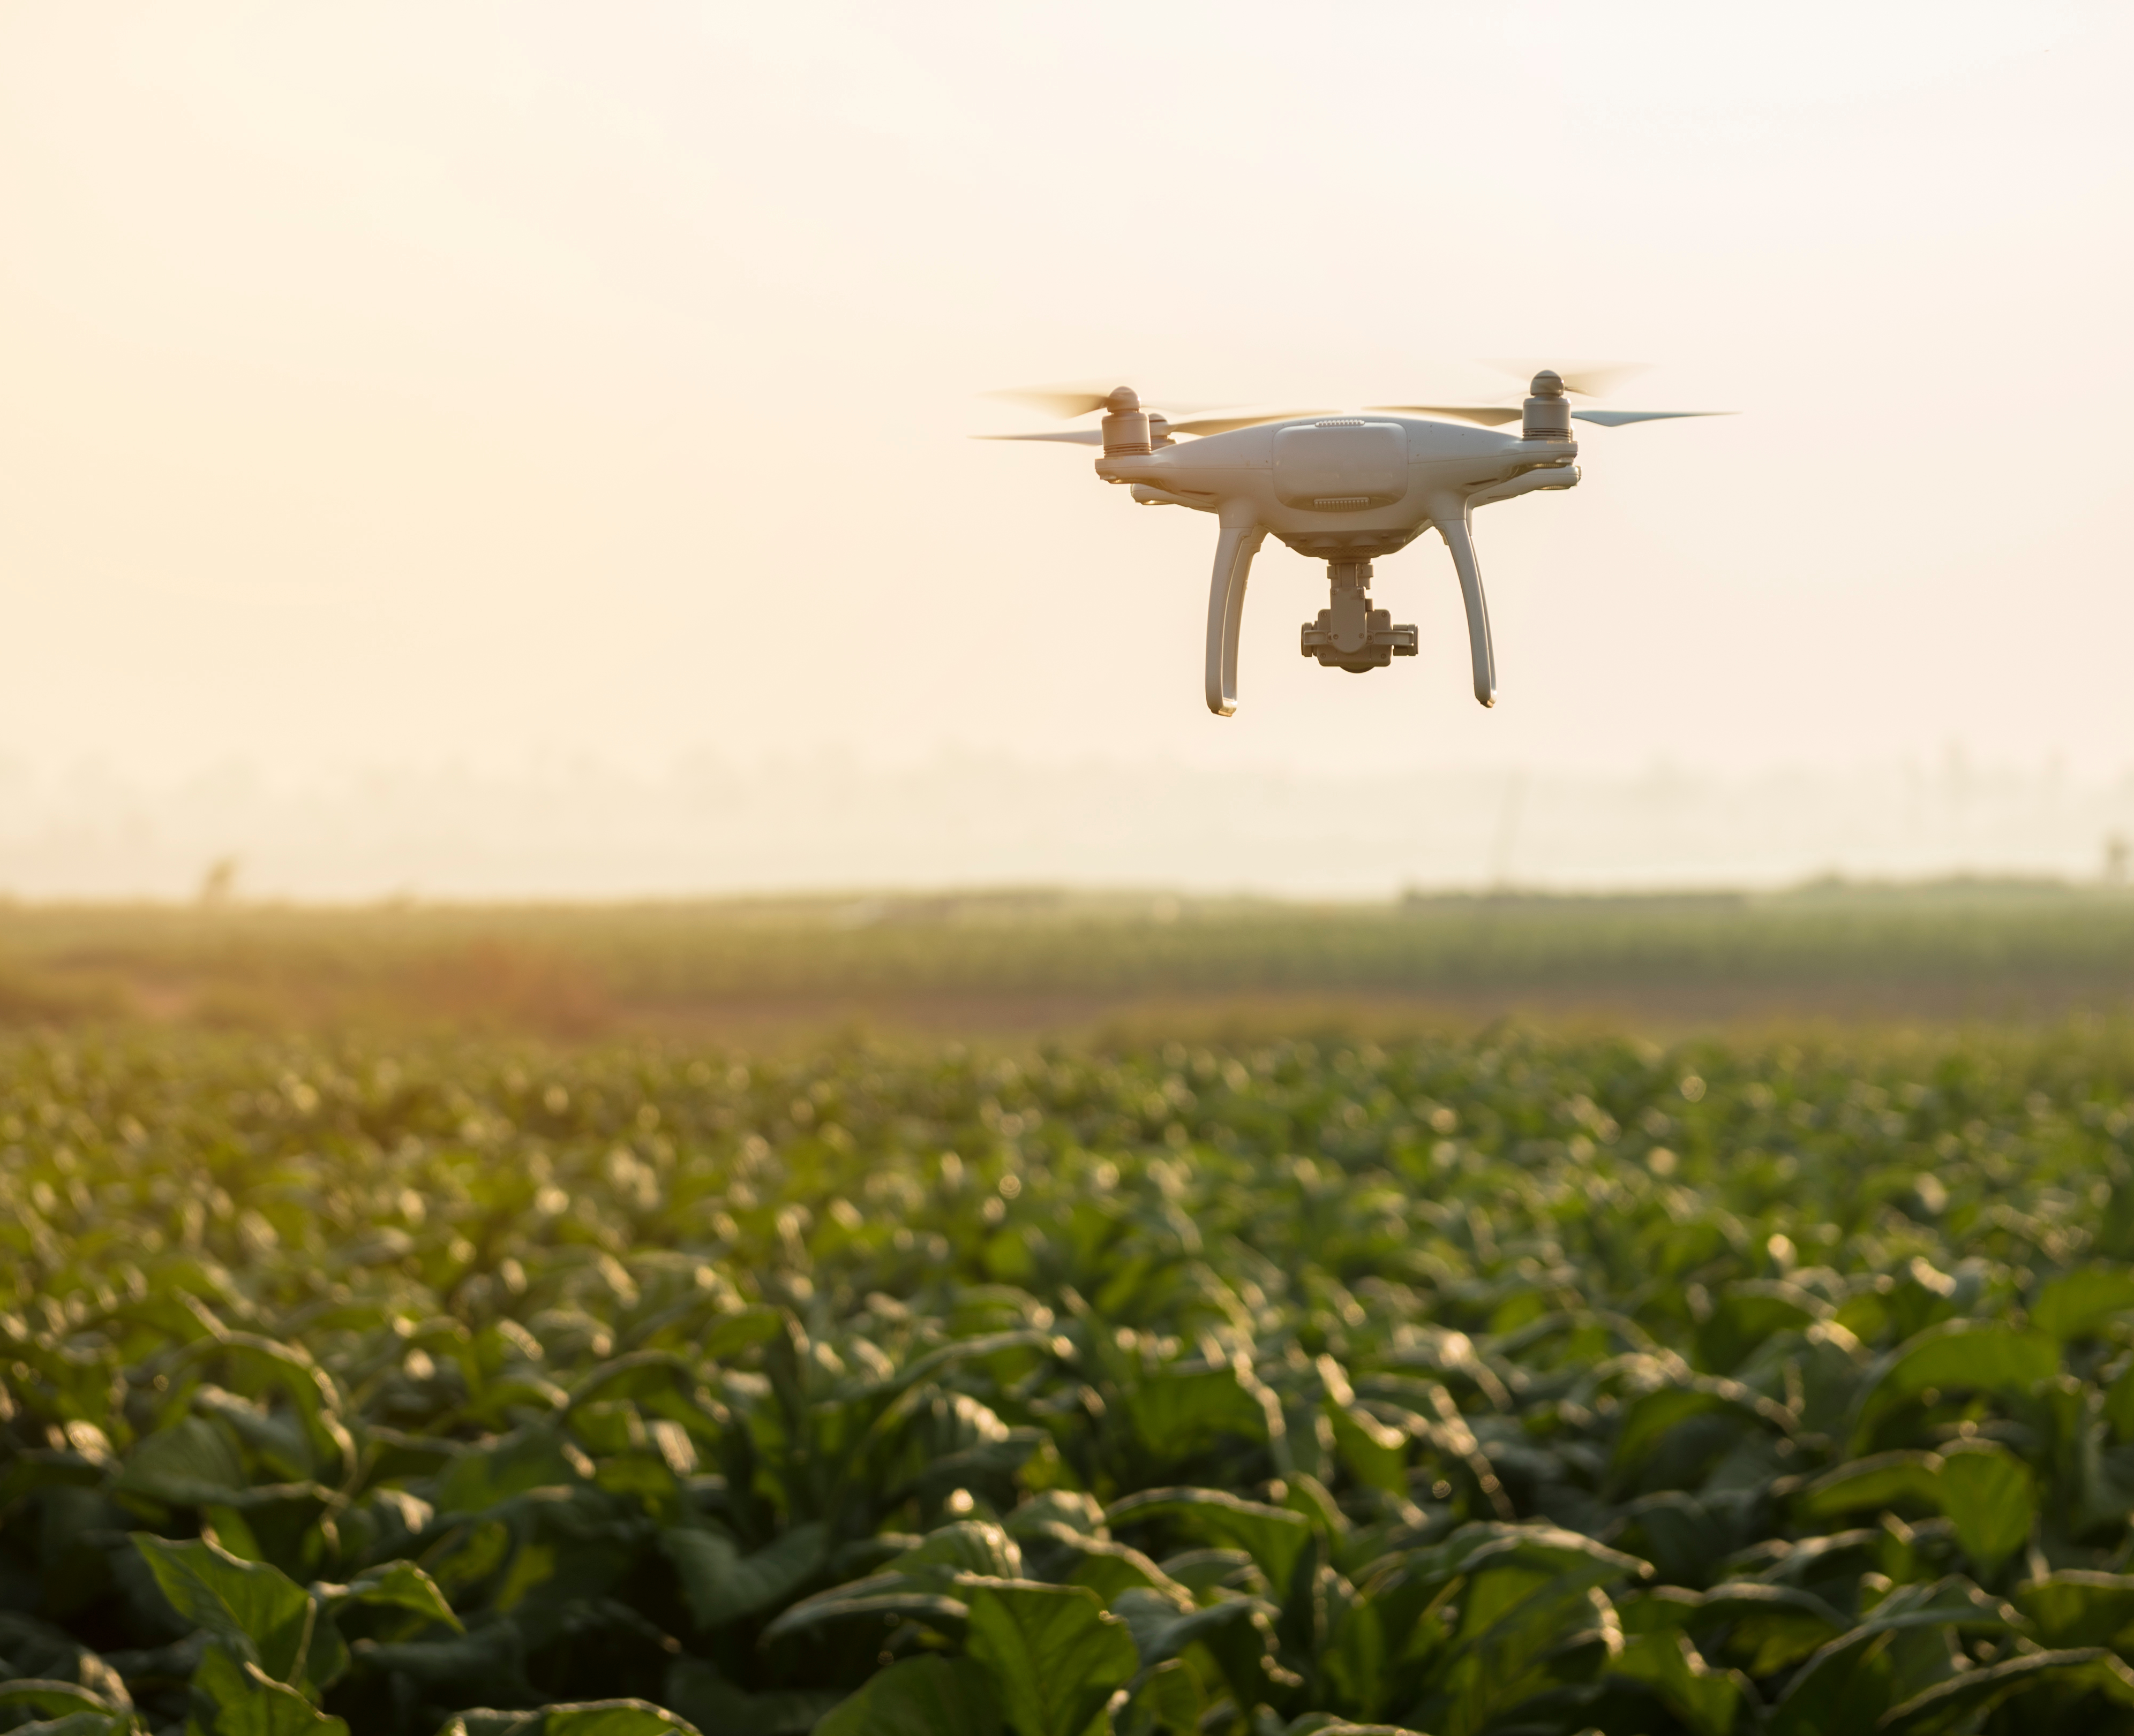
Things to Know about Drones
You do have to have a license
You can fly your drone up to 400 feet above the ground.
Keep your eye on the drone.
You cannot fly over people.
Notes:
Drone licensing will be explored more on the next slide.
You can legally fly your drone up to 400 feet above ground level (AGL) before you have to ask for permission from the Federal Aviation Administration, who controls the airspace over the United States.
You always have to keep your drone in what is known as “Visual Line of Sight” (VLOS)
You cannot fly your drone over people at public spaces. Safety hazard, if the drone were to fall out of the sky and hit them on the head.

Slide 16
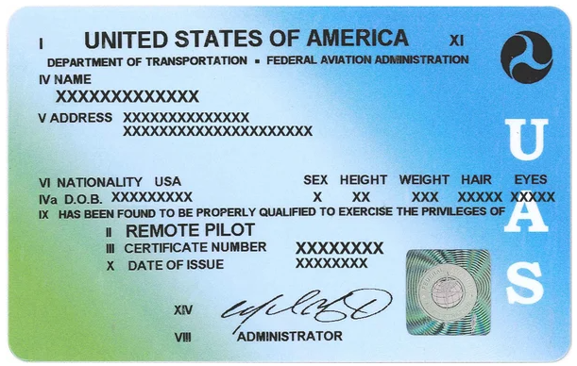
Drone Licensing
Granted by Federal Aviation Administration
Take exam and pass with a 70% or higher
Cost: $185 for exam
License is good for 24 months, then online retraining
Notes:
In Nebraska, there are testing centers in several locations. As of current, you do have to go in person to take the exam.

Slide 17
Pre-Flight Inspection
Physical Condition of the Drone
Obstacles
Clear Space for Takeoff
Make sure those around you know you are about to take off
  Communicate!
Notes:
Before you take off, you want to ensure that it is safe to do so. These things even apply to taking off indoor drones in the school building or at home. You want to ensure that the drone is in good physical condition to take off. If you are outside, you also want to check the weather. In Nebraska, wind is the biggest factor to pay attention to for a good flight day.
When you identify the location you want to fly, ensure that you have good space to take off. Be aware of what direction your drone is facing, what direction “forward” is if you need to use the manual controls.
Communicate with those around you that you are going to take off so there are no surprises!

Slide 18
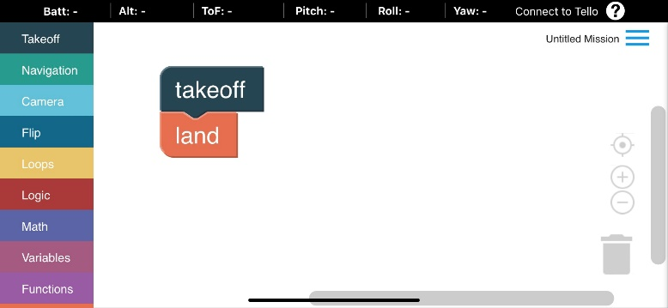
Activity
Block coding
  Coding is giving a computer instructions in a way that it can understand
  Block Coding is a very simple version and a great starting point for introduction to coding

Slide 19
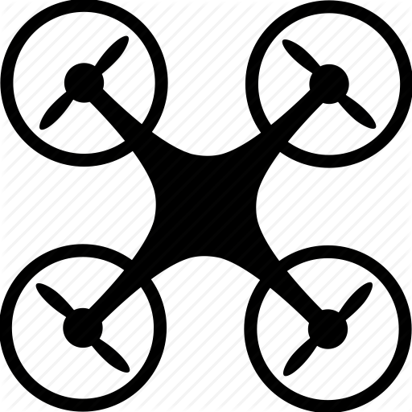
Pathway for Drone Activity
60”
N
60”

Slide 20
Wrap up
What are some ways we use drones in agriculture?
Would you buy a drone if you were a farmer? Why or why not?
Would you buy a drone if you were an agronomist? Why or why not?
What other jobs would benefit from having a drone? Why
What questions are you still pondering about drones?

Slide 21
Conclusion
Drones are an up-and-coming technology really expanding what we can do in agriculture and in other industries.
The world of drones will continue to evolve as you complete your schooling.
There are lots of ways to get involved with technology in agriculture. Drones being simple one of many!

Slide 22
Grant Acknowledgements
This material is based upon work supported by the National Science Foundation under Grant No. 2202151. Any opinions, findings, and conclusions or recommendations expressed in this material are those of the author(s) and do not necessarily reflect the views of the National Science Foundation.

